Slide 1
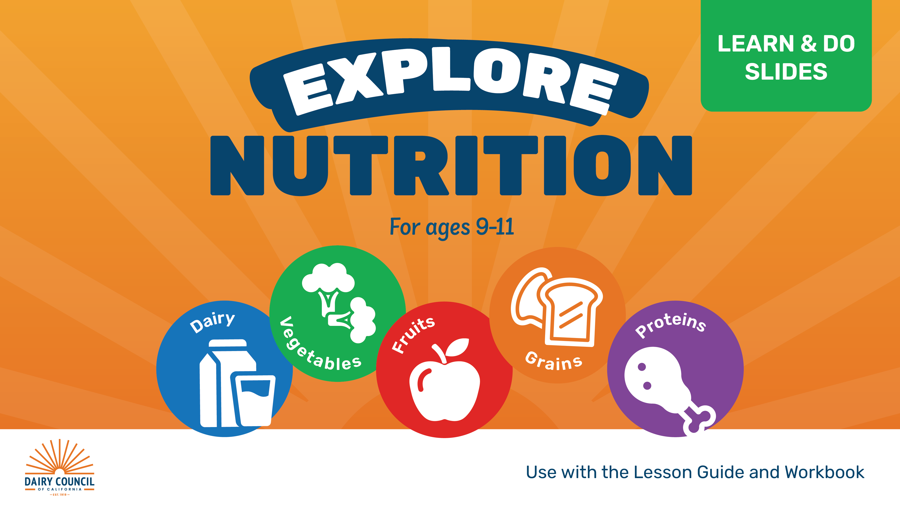

Slide 2
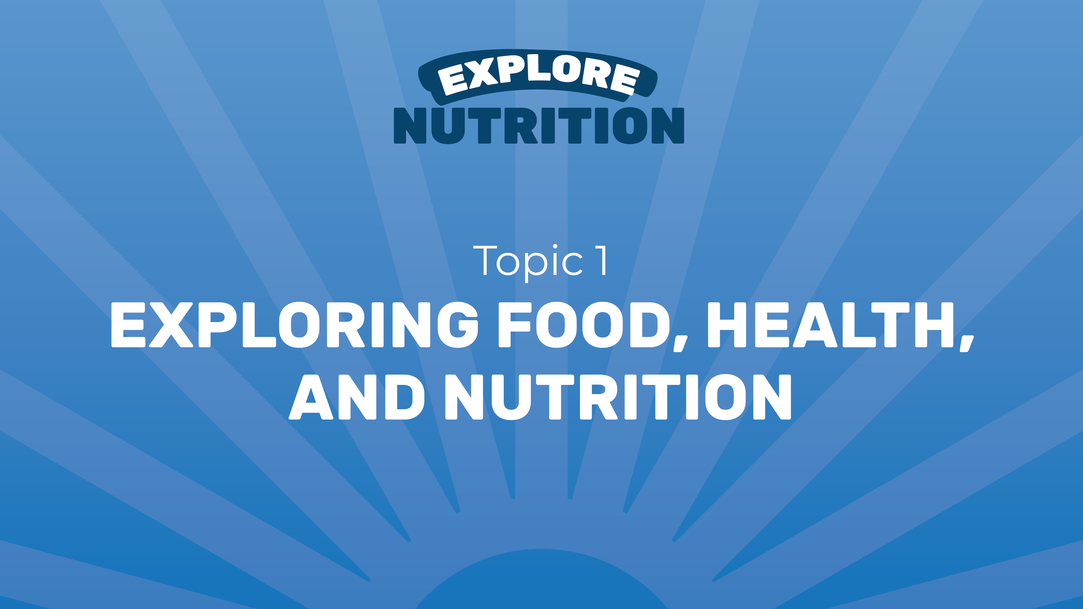

Slide 3
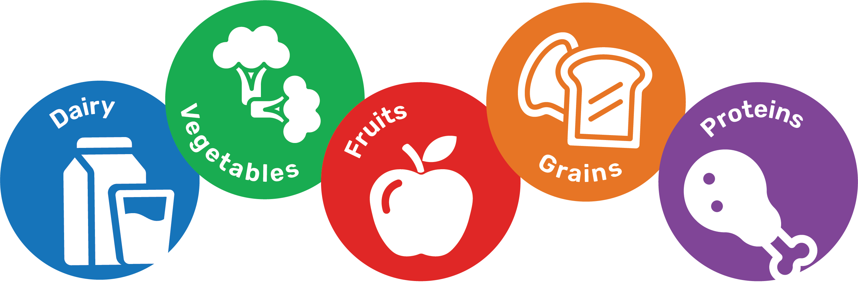
LESSON 1
FOOD GROUP POWER
TOPIC 1

Slide 4

TOPIC 1
LESSON 1
What can food groups teach you about healthy eating?

Slide 5

TOPIC 1
LESSON 1
Think of food groups like players on a team or instruments in a band. Each one has its own strengths and contributes something different. Food groups work the same way. Each group helps the brain and body in different ways.
One way to define healthy eating is by eating a mix of foods from different groups each day and week: dairy, vegetables, fruits, grains, and protein foods.
Nutrition is how the body uses food. Eating is a practice that cares for the body and supports many areas of health.
Eating different types of foods from all of the groups supports health, growth, energy, learning, and performance.

Slide 6
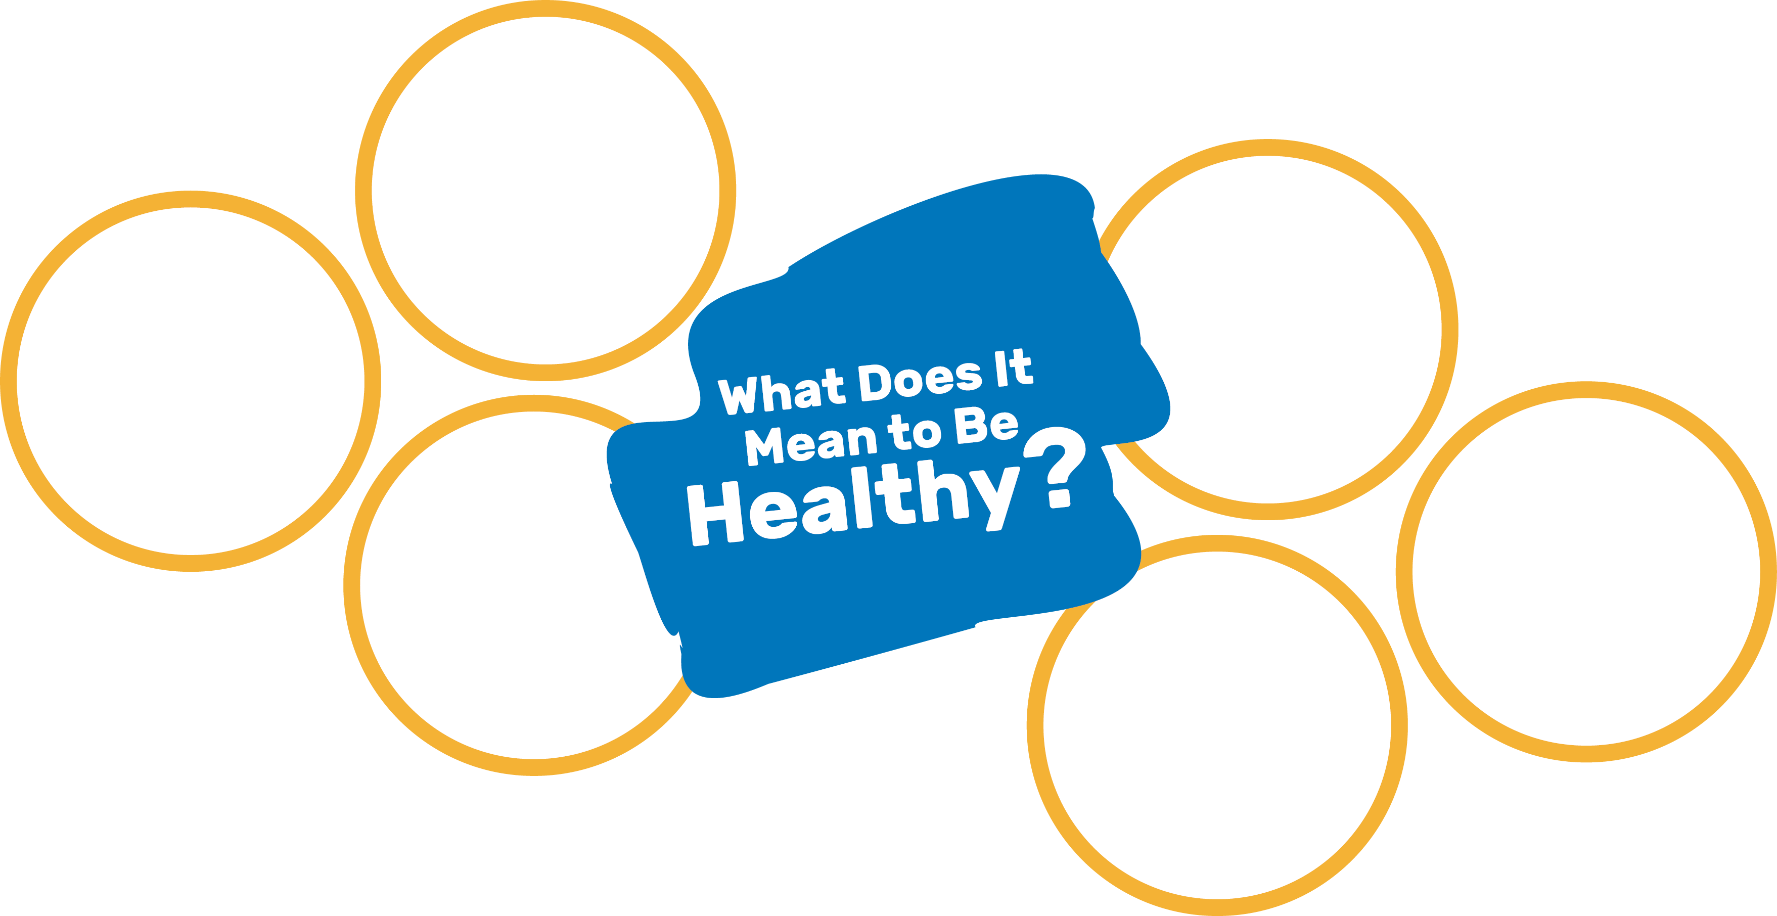
What Does It Mean to
Be Healthy?
TOPIC 1
LESSON 1
Definition of healthy:
beneficial to the body; being well
Directions: Write your ideas about what it means to be healthy or what healthy looks and feels like to you.

Slide 7
What Does It Mean to Be Healthy?
TOPIC 1
LESSON 1
Play outside
Get enough sleep
Spend time with friends or family
Take care of ourselves when we are sick
Move our bodies
EXAMPLES
Eat food to fuel our bodies

Slide 8
TOPIC 1
LESSON 1
Healthy
beneficial to the body; being well
Food
groups
one way to sort foods based on some of the nutrients they contain and how they help the body
Nutrition
how the body uses food for energy, health, and growth

Slide 9




What Do You Know About Food Groups?
TOPIC 1
LESSON 1
Directions: Fill in the Know and Wonder boxes. Then, at the end of the lesson fill in the Learn box.
What do you know about the food groups?
What do you wonder about the food groups?
What did you learn about the food groups?

Slide 10
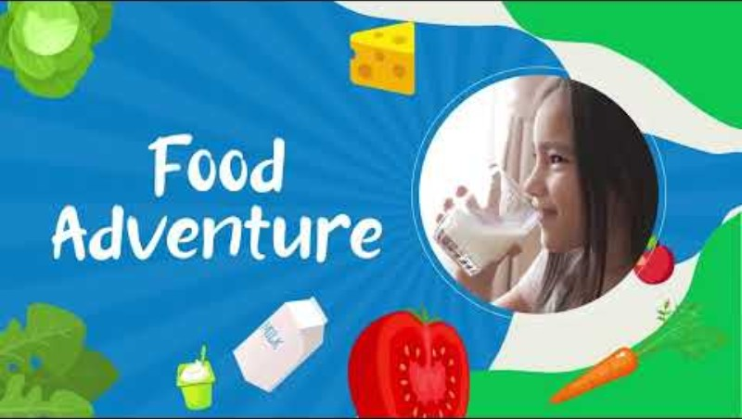

Slide 11
Food Groups
TOPIC 1
LESSON 1
Foods are sorted into groups because of the nutrition they have. Each group helps the brain and body in different ways. Eating a variety of foods from different groups helps support health, growth, energy, learning, and performance.

Slide 12
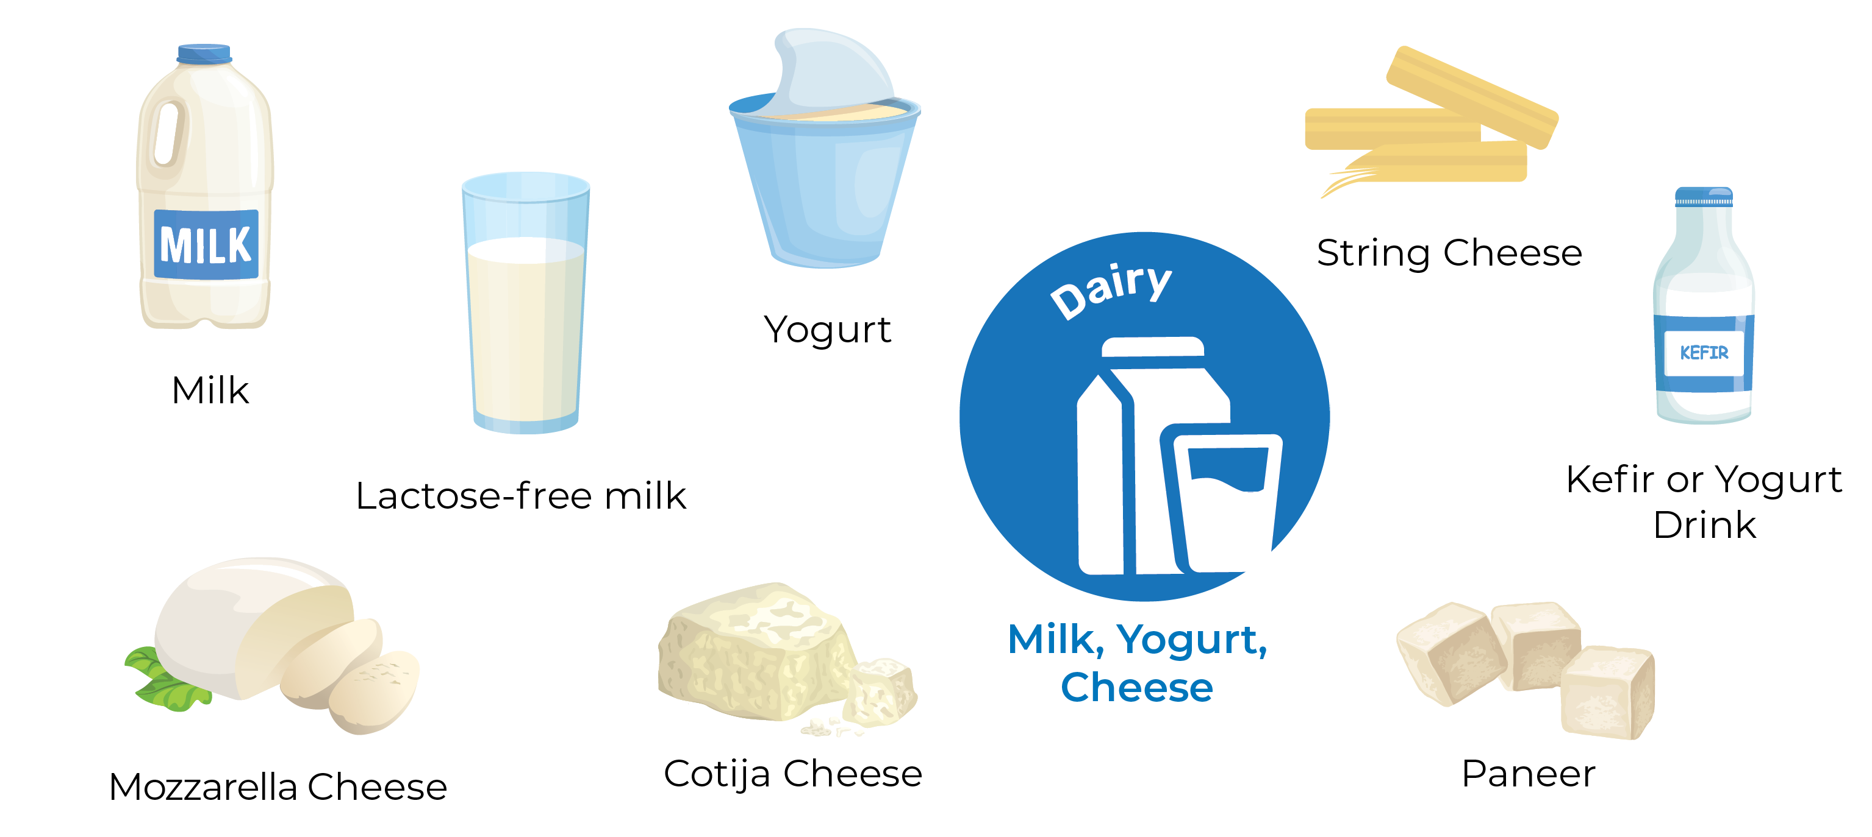
Food Groups: Dairy
TOPIC 1
LESSON 1
Add foods you enjoy eating to show the many foods, flavors, and cultures within the food groups.

Slide 13
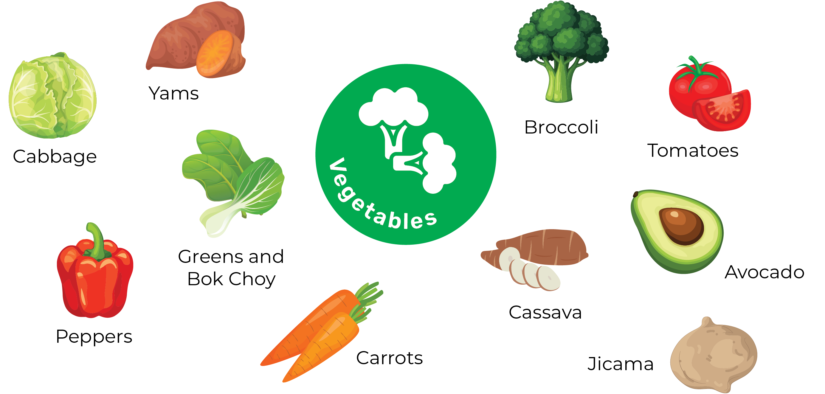
Food Groups: Vegetables
TOPIC 1
LESSON 1
Add foods you enjoy eating to show the many foods, flavors, and cultures within the food groups.

Slide 14
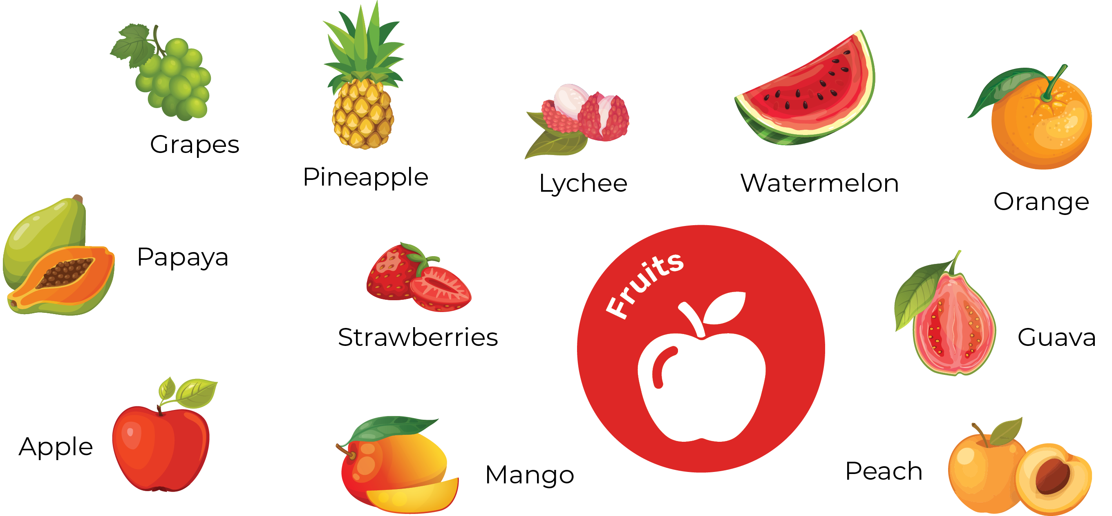
Food Groups: Fruit
TOPIC 1
LESSON 1
Add foods you enjoy eating to show the many foods, flavors, and cultures within the food groups.

Slide 15
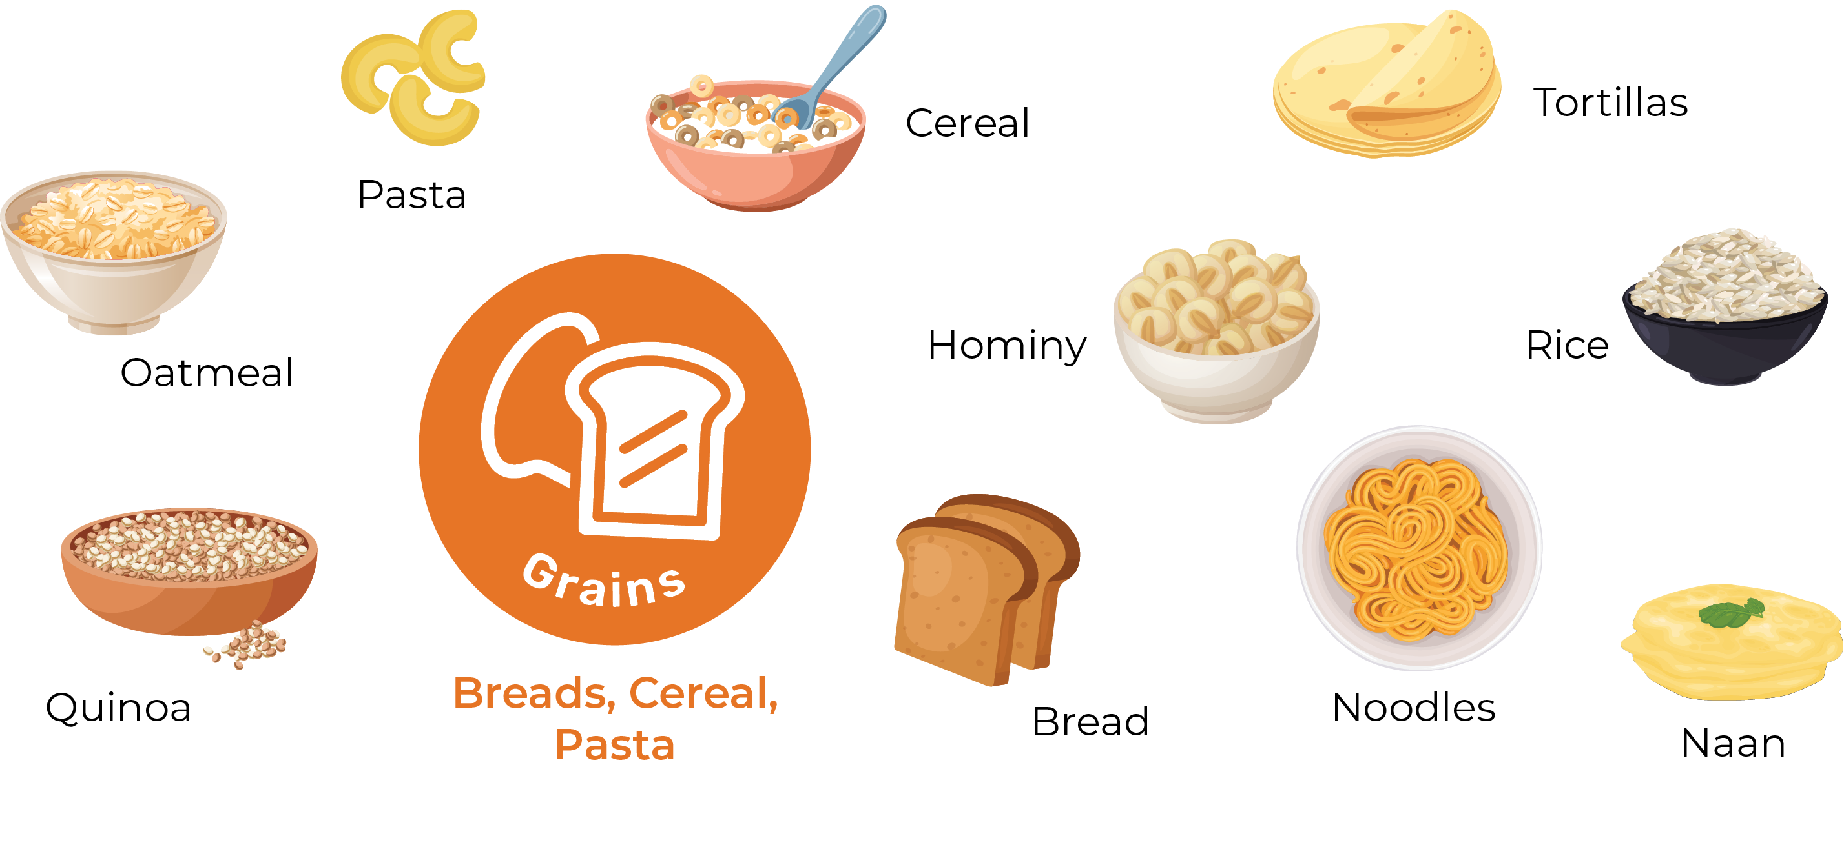
Food Groups: Grains
TOPIC 1
LESSON 1
Add foods you enjoy eating to show the many foods, flavors, and cultures within the food groups.

Slide 16
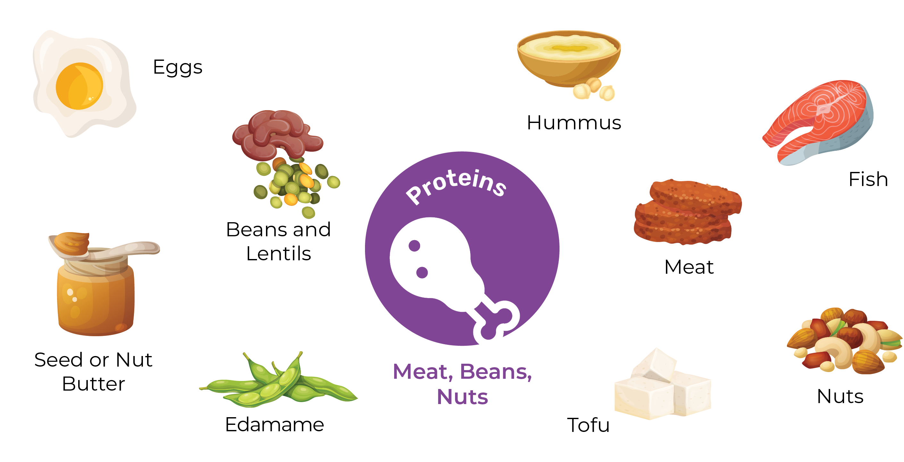
Food Groups: Proteins
TOPIC 1
LESSON 1
Add foods you enjoy eating to show the many foods, flavors, and cultures within the food groups.

Slide 17
What Do You Know About Food Groups?
TOPIC 1
LESSON 1
Directions: Write what you learned in the last column.
What do you know about the food groups?
What do you wonder about the food groups?
What did you learn about the food groups?

Slide 18

TOPIC 1
LESSON 1
What can food groups teach you about healthy eating?

Slide 19

LESSON 2
NUTRIENTS TO THE RESCUE
TOPIC 1

Slide 20
TOPIC 1
LESSON 2
What is healthy eating?

Slide 21
TOPIC 1
LESSON 2
No single food or single nutrient does every job.
Food gives nutrients that are needed for bones, muscles, the brain, energy, health, and every job in the body.
Eating different types of foods most of the time gives the body different types of nutrients (and can taste good, too).
Nutrients are small and mighty.

Slide 22
TOPIC 1
LESSON 2
Nutrient
a tiny part of food that helps the body and brain grow, work, and stay healthy

Slide 23
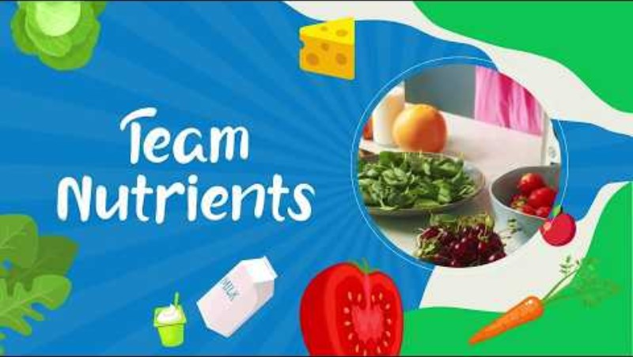

Slide 24
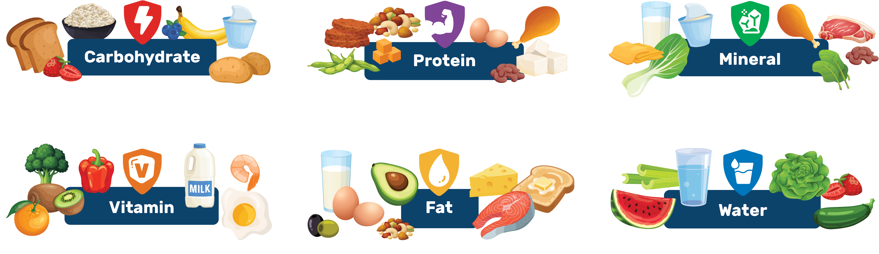
Meet the Nutrient Team!
TOPIC 1
LESSON 2
Think of nutrients as your body’s super team. Each one has a special job to help you grow, learn, play, and do your best.

Slide 25
Meet the Nutrient Team!
TOPIC 1
LESSON 2
Gives your body, muscles, and brain energy to move, think, and play
Examples: Bread, rice, berries, bananas, potatoes, corn, milk, yogurt

Slide 26
Meet the Nutrient Team!
TOPIC 1
LESSON 2
Builds, grows, and repairs muscles and other parts of the body
Examples: Eggs, meat, fish, beans, nuts, milk, yogurt, cheese, edamame, tofu

Slide 27
Meet the Nutrient Team!
TOPIC 1
LESSON 2
Helps all parts of the body work
Examples:
Calcium builds strong bones and healthy teeth
Milk, lactose-free milk, yogurt, cheese, leafy green vegetables
Iron helps the brain grow and learn and
fuels energy and muscles
Beef, chicken, fish, beans, spinach

Slide 28
Meet the Nutrient Team!
TOPIC 1
LESSON 2
Helps all parts of the body work
Examples:
Vitamin C heals the body and skin and fights sickness
Oranges, berries, kiwi, bell peppers, tomatoes, broccoli
Vitamin D helps make bones and muscles and fights off sickness
Milk, fish, eggs

Slide 29
Meet the Nutrient Team!
TOPIC 1
LESSON 2
Stores energy, helps the brain work,
and keeps the body warm
Examples: Whole milk, eggs, avocados, nuts, oil, cheese, fish,
meat, hummus, olives, seeds, butter

Slide 30
Meet the Nutrient Team!
TOPIC 1
LESSON 2
Helps your brain focus and your body keep the right temperature, plus keeps food and nutrition moving through your body
Examples: Water, milk, watermelon, strawberries, cucumbers, celery, zucchini, lettuce

Slide 31
Comic Strip:
Nutrients to the Rescue
TOPIC 1
LESSON 2
Directions: Create a comic strip using the nutrients as superhero characters that save the day. Examples: Powerful Protein, Cool Calcium, or Magnificent Minerals to the rescue!

Slide 32
TOPIC 1
LESSON 2
What is healthy eating?

Slide 33
LESSON 3
FOOD AROUND THE WORLD
TOPIC 1

Slide 34
TOPIC 1
LESSON 3
What kind of food culture influences what you eat?

Slide 35
TOPIC 1
LESSON 3
Food is part of celebrations, culture, family, and community.
Many of the same foods are enjoyed in more than one country or culture.
Trying and learning about food from different cultures can help people understand and respect one another.
Cultures around the world have nutritious foods with unique flavors and ingredients.

Slide 36
TOPIC 1
LESSON 3
Culture
the beliefs, behaviors, and ways of life that are unique to a group of people, a family, or a community

Slide 38
Class Poll and Discussion
TOPIC 1
LESSON 3
Do you enjoy food from different cultures at home, in restaurants, or at school?
What foods, practices, or traditions are important to your family or culture?

Slide 39
Where in the World?
TOPIC 1
LESSON 3
Directions: Look at each food picture, guessing the culture or country where it is popular and eaten often.
The slide after each food tells you the answer.

Slide 40
Where in the World?
TOPIC 1
LESSON 3
Where do you think it came from?
Spaghetti with tomato sauce

Slide 41
Where in the World?
TOPIC 1
LESSON 3
Where did it come from?
Italy
Spaghetti with tomato sauce

Slide 42
Where in the World?
TOPIC 1
LESSON 3
Where do you think it came from?
Tacos

Slide 43
Where in the World?
TOPIC 1
LESSON 3
Where did it come from?
Mexico
Tacos

Slide 44
Where in the World?
TOPIC 1
LESSON 3
Where do you think it came from?
Kefir or yogurt drink

Slide 45
Where in the World?
TOPIC 1
LESSON 3
Where did it come from?
Eastern Europe and Central Asia
Kefir or yogurt drink

Slide 46
Where in the World?
TOPIC 1
LESSON 3
Where do you think it came from?
Sushi

Slide 47
Where in the World?
TOPIC 1
LESSON 3
Where did it come from?
Japan
Sushi

Slide 48
Where in the World?
TOPIC 1
LESSON 3
Where do you think it came from?
Cheeseburger

Slide 49
Where in the World?
TOPIC 1
LESSON 3
Where did it come from?
United States
Cheeseburger

Slide 50
Where in the World?
TOPIC 1
LESSON 3
Where do you think it came from?
Dumplings

Slide 51
Where in the World?
TOPIC 1
LESSON 3
Where did it come from?
China
Dumplings

Slide 52
Where in the World?
TOPIC 1
LESSON 3
Where do you think it came from?
Arepas

Slide 53
Where in the World?
TOPIC 1
LESSON 3
Where did it come from?
South America (Columbia and Venezuela)
Arepas

Slide 54
Where in the World?
TOPIC 1
LESSON 3
Where do you think it came from?
Tandoori Chicken

Slide 55
Where in the World?
TOPIC 1
LESSON 3
Where did it come from?
India
Tandoori Chicken

Slide 56
Where in the World?
TOPIC 1
LESSON 3
Where do you think it came from?
Hummus and Pita Bread

Slide 57
Where in the World?
TOPIC 1
LESSON 3
Where did it come from?
The Middle East
Hummus and Pita Bread

Slide 58
TOPIC 1
LESSON 3
What kind of food culture influences what you eat?

Slide 59
LESSON 4
FOODS WORK TOGETHER
TOPIC 1

Slide 60
TOPIC 1
LESSON 4
What does a meal look like in your eating pattern?

Slide 61
TOPIC 1
LESSON 4
Healthy eating patterns have a variety of foods like dairy, vegetables, fruits, grains, and protein foods.
An eating pattern is the mix of foods and drinks a person usually eats over time.
A favorite meal probably has more than one food group.
A meal is like a chapter in a book. Many meals and foods make up an eating pattern, like chapters make up a whole story.
Meals can look different for different people because what a person likes, where a person lives and who provides the meals are unique.

Slide 62
TOPIC 1
LESSON 4
Eating Pattern
the mix of foods and drinks a person usually eats over time
Variety
Different types

Slide 63
Build a Meal
TOPIC 1
LESSON 4
Directions: Draw or write the parts of a favorite meal. Next, label each food in the meal. Then, label the food groups that are part of the meal: dairy, vegetables, fruits, grains, protein foods.
You do not have to fill in every dish.

Slide 64
Build a Meal
TOPIC 1
LESSON 4
Directions: Fill in the sentences after you build your meal.
This is my favorite meal because…
One meal I heard about in my class that I would like to try is…
Eating a variety (different types) of food supports my health because…
People may eat differently because…

Slide 65
TOPIC 1
LESSON 4
What does a meal look like in your eating pattern?

Slide 67
TOPIC 1
LESSON 1
WHAT IS A FOOD LABEL?

Slide 68
TOPIC 2
LESSON 1
What do you think you can learn about food from its package?

Slide 69
TOPIC 2
LESSON 1
Food labels give information about what is in a food package.
Packages and labels are designed to communicate information and may influence food choices.
Food labels can help people learn about ingredients and nutrition in foods.

Slide 70
TOPIC 2
LESSON 1
Have you ever noticed a label on any of the foods you eat?
Why might a food not have a label?
Have you ever noticed a family member looking at a package’s food label when grocery shopping?
Where have you seen a food label on a package?

Slide 72
TOPIC 2
LESSON 1
Added sugar
sugar that is put into food or drinks to add sweetness, improve texture or color, or help the food stay fresh longer
Calories
a measure of how much energy the body gets from food
Nutrition Facts label
a table printed on the outside of food packages that lists the nutrient content of the food inside

Slide 73
Nutrition Facts Label
TOPIC 2
LESSON 1
Directions: Complete these sentences using what you know about food labels.
The package gives me
to know more about the food.
Ingredients are listed on the
of the package.
The Facts label lists the vitamins in a food.

Slide 74
TOPIC 2
LESSON 1
Why do food packages need labels?
What can you learn from a label? What might be missing?
Why are ingredients listed on a label?

Slide 75
TOPIC 2
LESSON 1
What do you think you can learn about food from its package?

Slide 76
TOPIC 2
LESSON 2
FOOD LABEL DETECTIVES

Slide 77
TOPIC 2
LESSON 2
What clues can ingredients give you about foods?

Slide 78
TOPIC 2
LESSON 2
Food labels can help people learn about foods, but they do not tell the whole story.
Food labels and ingredients can give information about foods.
Being curious about food information can help people learn more about foods and nutrition.
Ingredients can give clues about how a food was made and what it contains.

Slide 79
TOPIC 2
LESSON 2
Where would you find the ingredients in the package?
What is an ingredient?

Slide 80
TOPIC 2
LESSON 2
Ingredient
one of the things that makes up a food or is part of a food
Think about it:
Why might it be important to know the ingredients in a food?

Slide 81
Guess the Mystery Label
TOPIC 2
LESSON 2
Directions: Try to guess the food just from its ingredients.
This food is

Slide 82
Guess the Mystery Label
TOPIC 2
LESSON 2
Answer
This food is
Milk
Vitamin D is often added to milk because it helps bodies absorb the calcium that is naturally in milk.

Slide 83
Guess the Mystery Label
TOPIC 2
LESSON 2
Directions: Try to guess the food just from its ingredients.
This food is

Slide 84
Guess the Mystery Label
TOPIC 2
LESSON 2
Answer
This food is
Applesauce
Ascorbic acid (or vitamin C) can be added to stop the apples from turning brown, to add nutrition and to help it stay fresh longer.

Slide 85
Guess the Mystery Label
TOPIC 2
LESSON 2
Directions: Try to guess the food just from its ingredients.
This food is

Slide 86
Guess the Mystery Label
TOPIC 2
LESSON 2
Answer
This food is
Whole-Wheat Bread
The ingredients in packaged bread help the bread stay soft, give it flavor and help it stay fresh longer.

Slide 87
TOPIC 2
LESSON 2
What clues can ingredients give you about foods?

Slide 88
TOPIC 2
LESSON 3
HOW DO WE KNOW IT’S TRUE?

Slide 89
TOPIC 2
LESSON 3
How do you know what information is true?

Slide 90
TOPIC 2
LESSON 3
Asking questions and finding answers can help to decide if information is true or useful.
People learn information in many ways and from many sources.
Information from the internet, advertisements, media, and other sources can influence what people think and do.
Not all information a person hears or sees is accurate or reliable.

Slide 91
Discussion
TOPIC 2
LESSON 3
Where do you learn new information?
Have you ever learned something and then later found out it was not correct?
How do you know if the information is true or not? How do you know if it is fact or opinion?

Slide 92
Where Do You Learn New Information?
TOPIC 2
LESSON 3
Directions: List the places where you learn new information.

Slide 93
Where Do You Learn New Information?
TOPIC 2
LESSON 3
Friends
Family
Books
Online Videos
Commercial
EXAMPLES
Teacher

Slide 94
TOPIC 2
LESSON 3
Influence
to affect the behavior of someone
Reliable
information that is accurate, trustworthy, and comes from a source that you can believe

Slide 95
Information Checklist
TOPIC 2
LESSON 3
The Moon Is Made of Cheese
Published January 10, 1955, by Cheezy McCheezerson, Professional Cheese Eater
Hello! I am Professor McCheezerson, self-proclaimed cheese eater, and I am here to tell you that the moon is made of cheese. Yes, it’s true. I know this because I was able to catapult mice into space, and they didn’t come back, which means they stayed on the moon and ate cheese. Also, the moon looks like cheese, so this must be true. And I love cheese. It is my favorite food so the moon must be made of it. What kind of cheese, do you ask? Well, a variety of cheeses, but I believe mostly my favorite cheese—cheddar. And finally, the moon sometimes looks full or not full, and when it looks smaller that means the space mice have eaten all of the cheese! Yes, this is completely 100% true.
Directions: Read the article then answer the questions on the checklist.

Slide 96
Information Checklist
TOPIC 2
LESSON 3
Directions: Read the article then answer the questions on the checklist.
Is the information current?
Is the information useful to you?
Is the author an expert?
Is the information accurate?
What is the purpose of the information?

Slide 97
Information Checklist
TOPIC 2
LESSON 3
Food Contains Nutrients that Help Our Body
Published June 16, 2026, by Rachel Rothman, Registered Dietitian, certified by the Commission on Dietetic Registration
My name is Rachel Rothman, and I am a registered dietitian. Over the past several decades, research articles have been published describing the various nutrients in foods like dairy, vegetables, fruits, grains, and protein (which are the 5 food groups). These nutrients include vitamins, minerals, and fiber, all of which have been shown to help our body in different ways, like supporting our brain, helping our heart, and helping us see. According to published research, the most popular fruit worldwide is the banana, the most popular cheese is Mozzarella (the kind that goes on pizza), and the most popular vegetables are potatoes and tomatoes. A tomato can actually be considered a fruit or a vegetable.
Directions: Read the article then answer the questions on the checklist.

Slide 98
Information Checklist
TOPIC 2
LESSON 3
Directions: Read the article then answer the questions on the checklist.
Is the information current?
Is the information useful to you?
Is the author an expert?
Is the information accurate?
What is the purpose of the information?

Slide 99
TOPIC 2
LESSON 3
How do you know what information is true?

Slide 101
TOPIC 3
LESSON 1
FOOD CHANGES FROM FARM TO YOU

Slide 102
TOPIC 3
LESSON 1
How and why does food change from the farm to you?

Slide 103
TOPIC 3
LESSON 1
Some foods need to be processed into a form that can be eaten, like when wheat is made into bread.
Foods can be changed before they are eaten. Some food processing helps make foods safe or easier to eat, protects or improves nutrition, or adds taste.
Some processing like freezing or canning helps food last longer.
Food may be washed, cut, bagged, canned, bottled, or frozen after leaving the farm.

Slide 104
TOPIC 3
LESSON 1
Food processing
the ways food is cleaned, changed, or prepared to be ready to eat

Slide 105
Let’s Make Predictions
TOPIC 3
LESSON 1
Grapes to Raisins
Directions: write what you think happens to change one food to the other. Then after you research or read the slides, write what actually happens.
What’s your prediction?

Slide 106
Let’s Make Predictions
TOPIC 3
LESSON 1
Grapes to Raisins
Directions: write what you think happens to change one food to the other. Then after you research or read the slides, write what actually happens.
What actually happens?
1. After grapes are ripe on the vines, they are picked. 2. Grapes get cleaned. 3. Then dried in the sun or by machines. 4. Then packaged.

Slide 107
Let’s Make Predictions
TOPIC 3
LESSON 1
Milk to Yogurt
Directions: write what you think happens to change one food to the other. Then after you research or read the slides, write what actually happens.
What’s your prediction?

Slide 108
Let’s Make Predictions
TOPIC 3
LESSON 1
Milk to Yogurt
Directions: write what you think happens to change one food to the other. Then after you research or read the slides, write what actually happens.
What actually happens?
1. Milk is heated and cooled. 2. Starter culture (live healthy bacteria) is added.
3. The culture eats the milk sugar and turns the milk into creamy thick yogurt (a process called fermentation). 4. The yogurt is cooled and packaged.

Slide 109
Let’s Make Predictions
TOPIC 3
LESSON 1
Carrots to Baby Carrots
Directions: write what you think happens to change one food to the other. Then after you research or read the slides, write what actually happens.
What’s your prediction?

Slide 110
Let’s Make Predictions
TOPIC 3
LESSON 1
Carrots to Baby Carrots
Directions: write what you think happens to change one food to the other. Then after you research or read the slides, write what actually happens.
What actually happens?
1. Carrots are picked out of the ground. 2. Carrots get sorted, cleaned, cut, peeled, and cleaned again. 3. Then packaged into bags for the store or school.

Slide 111
Let’s Make Predictions
TOPIC 3
LESSON 1
Grain to Crackers
Directions: write what you think happens to change one food to the other. Then after you research or read the slides, write what actually happens.
What’s your prediction?

Slide 112
Let’s Make Predictions
TOPIC 3
LESSON 1
Grain to Crackers
Directions: write what you think happens to change one food to the other. Then after you research or read the slides, write what actually happens.
What actually happens?
1. Wheat is harvested or cut from its plant. 2. Wheat is ground into a powder called flour. 3. Flour is made into dough by adding
other ingredients. 4. The dough is baked, cut, and boxed.

Slide 113
Let’s Make Predictions
TOPIC 3
LESSON 1
Nuts to Nut Butter
Directions: write what you think happens to change one food to the other. Then after you research or read the slides, write what actually happens.
What’s your prediction?

Slide 114
Let’s Make Predictions
TOPIC 3
LESSON 1
Nuts to Nut Butter
Directions: write what you think happens to change one food to the other. Then after you research or read the slides, write what actually happens.
What actually happens?
1. Nuts are harvested or picked from plants. 2. The shells are removed and nuts are cleaned. 3. The nuts get roasted or cooked, crushed and ground into a butter. 4. The nut butter is packaged into jars.

Slide 115
TOPIC 3
LESSON 1
How did your predictions
compare to the actual steps?

Slide 116

TOPIC 3
LESSON 1
How and why does food change from the farm to you?

Slide 117
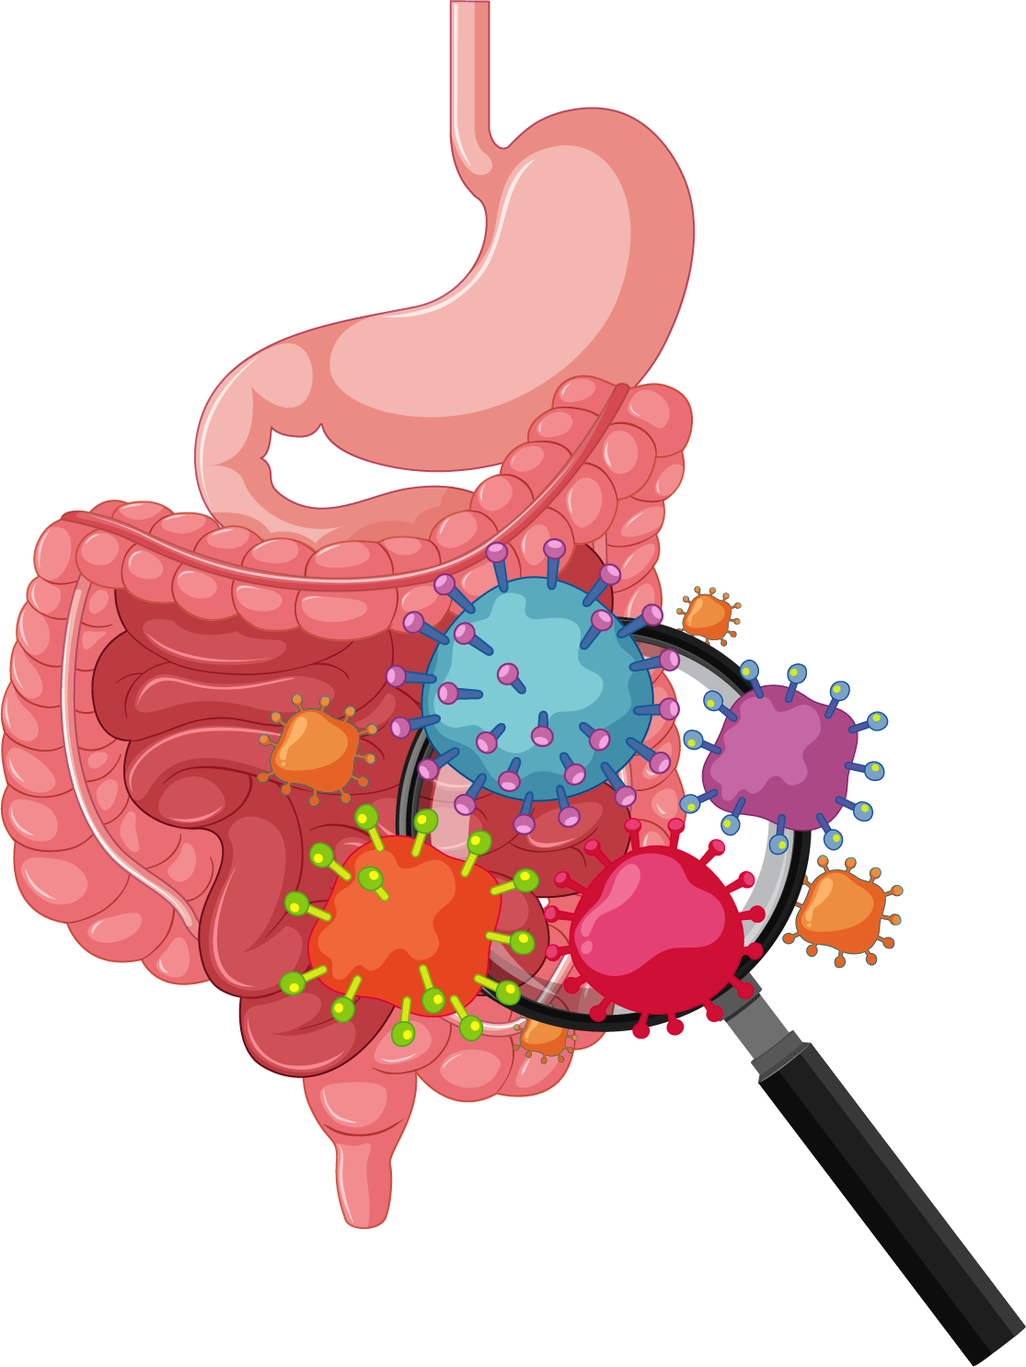
TOPIC 3
LESSON 2
GUT HEALTH

Slide 118
TOPIC 3
LESSON 2
How does nutrition impact gut health?

Slide 119
TOPIC 3
LESSON 2
Foods like yogurt, fruits, vegetables, whole grains, and some cheeses support healthy guts.
The gut is home to trillions of tiny living organisms that help digest food and support health.
Fermentation is a process that adds health benefits to a food. Tiny living organisms like bacteria or yeast help change a food like milk into yogurt or vegetables into kimchi.
The gut includes organs like the stomach and intestines and can affect the body in many ways, including energy, digestion, and mood.

Slide 120
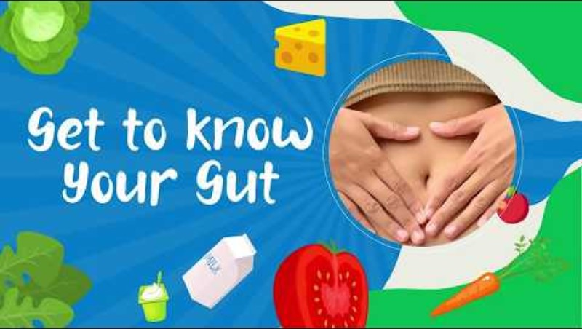
TOPIC 3
LESSON 2

Slide 121
TOPIC 3
LESSON 2
Fermentation
a process where helpful bacteria change a food’s taste, texture, how long it lasts, and add health benefits to some foods
Gut
the part of the body that digests food and helps the body use nutrients from food; the stomach and intestines

Slide 122
The Secret City inside the Gut
TOPIC 3
LESSON 2
Directions:
Star the main idea of the article.
Underline key details that support the main idea.
Put a question mark by words you do not know or understand.
What Is in the Gut?
Imagine a busy city full of life inside your belly where trillions of tiny creatures live and work. This city is called the gut. Don’t worry—those creatures are supposed to be there! This team is made up of teeny tiny workers that help break down food, fight off bad germs, and make sure the body is happy and healthy.
Continued

Slide 123
The Secret City inside the Gut
TOPIC 3
LESSON 2
Directions:
Star the main idea of the article.
Underline key details that support the main idea.
Put a question mark by words you do not know or understand.
How Does the Gut Affect Your Health?
Your gut is like a superhero protecting you from bad guys like viruses and breaking down the food you eat into smaller parts that your body can use for energy. This mighty hero even helps your brain stay sharp and heart stay strong. The gut can affect everything in your body—including your energy and happiness!
Continued

Slide 124
The Secret City inside the Gut
TOPIC 3
LESSON 2
Directions:
Star the main idea of the article.
Underline key details that support the main idea.
Put a question mark by words you do not know or understand.
What Foods Help Your Gut Stay Healthy?
To keep the gut happy, it needs lots of different types of foods. Here are some foods that help.
Yogurt and Kefir: A process called fermentation turns milk into yogurt and kefir. Yogurt and kefir are special because they add live creatures, or new workers, to your gut when you eat them!
Continued

Slide 125
The Secret City inside the Gut
TOPIC 3
LESSON 2
Directions:
Star the main idea of the article.
Underline key details that support the main idea.
Put a question mark by words you do not know or understand.
Fruits and Veggies: All kinds of fruits and vegetables have fiber, which feeds the gut and keeps food moving through the body. Examples would be avocado, apples, and broccoli. Kimchi and sauerkraut are vegetables that give the city an extra boost of workers because they go through a fermentation process like yogurt.
Whole Grains: Foods like oatmeal, corn tortillas, and whole-wheat bread give your gut the energy it needs to do its job and keep clean.
Source: Ferranti E, Dunbar SB, Dunlop AL, Corwin EJ. 20 things you didn’t know about the human gut microbiome. J Cardiovasc Nurs. 2014; 29(6):479-481. doi:10.1097/JCN

Slide 126
The Secret City inside the Gut
TOPIC 3
LESSON 2
Directions:
Answer then discuss after you read the article.
What is the gut? How would you describe the gut?
What are 3 ways the gut helps your body?
Name 2 foods that may help your gut.

Slide 127
TOPIC 3
LESSON 2
How does nutrition impact gut health?

Slide 128
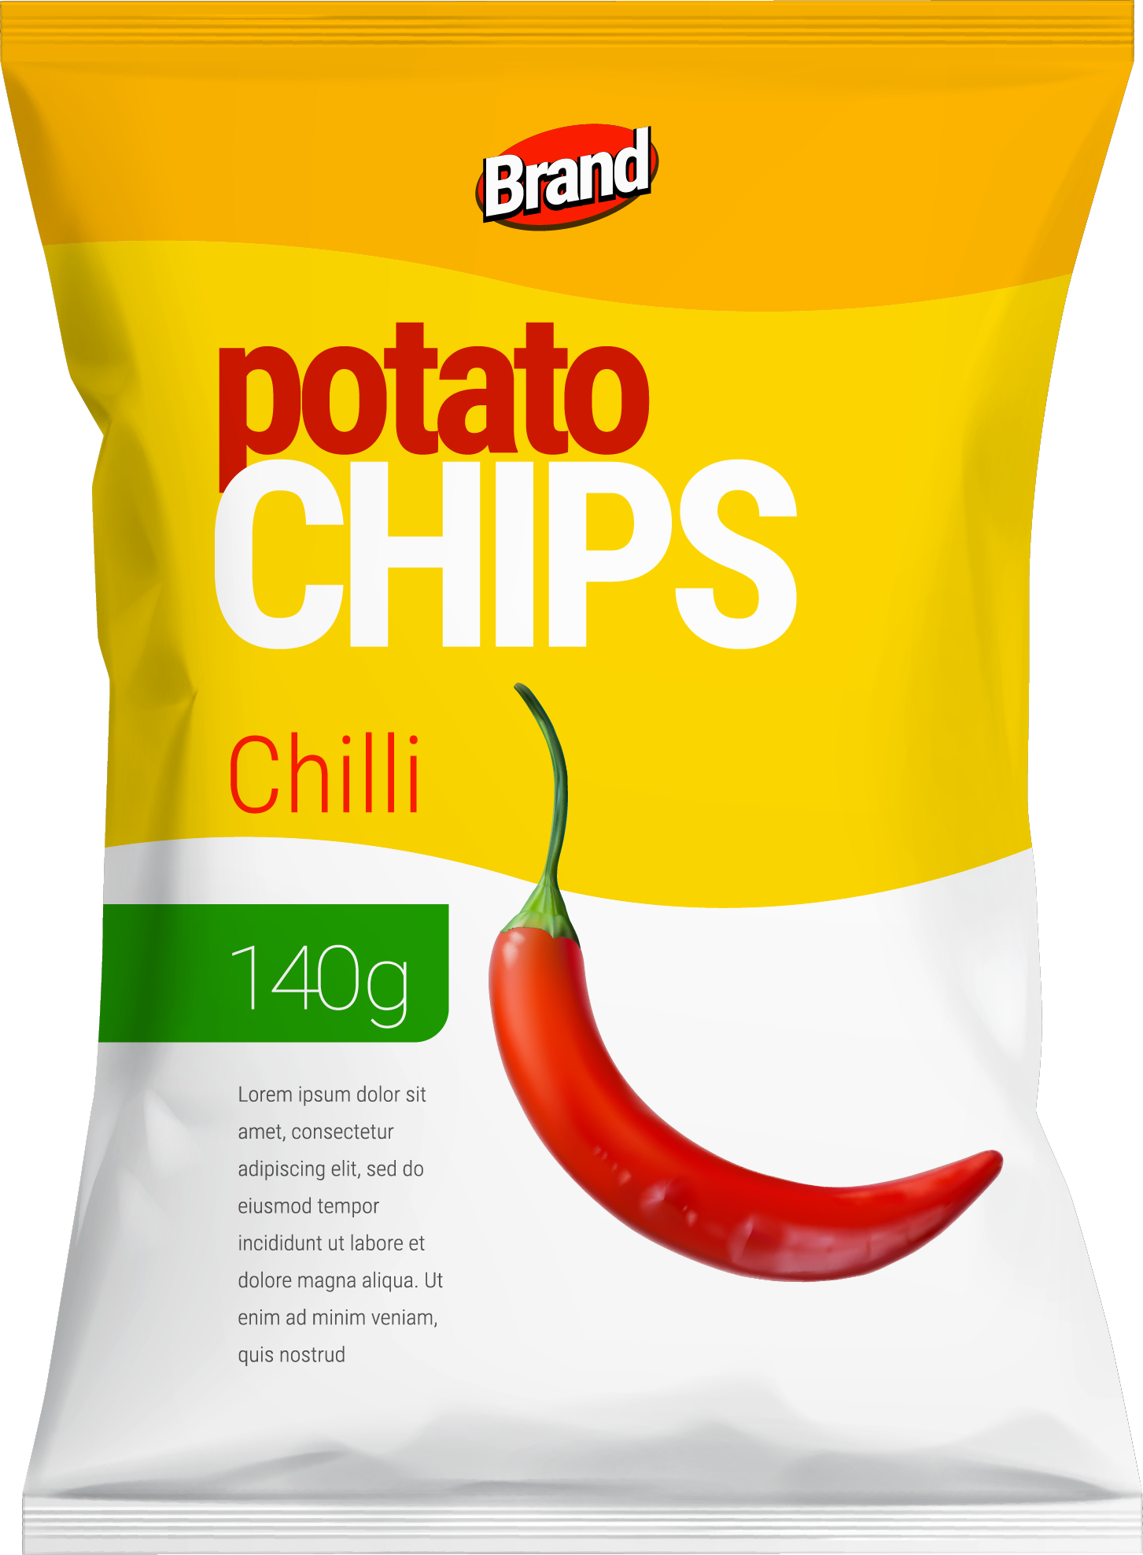
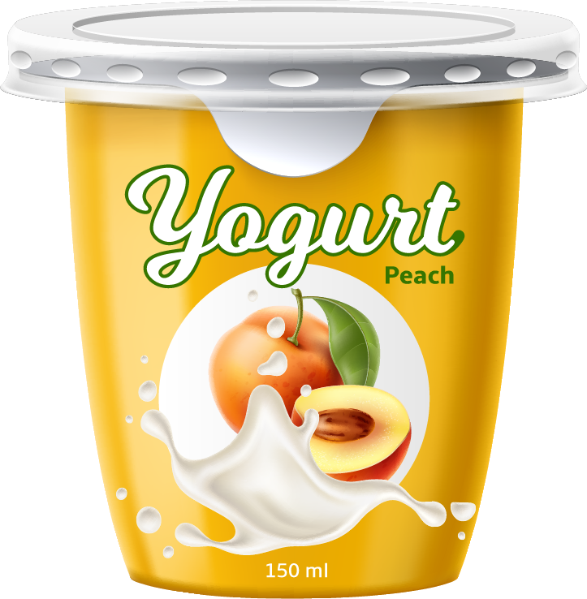
TOPIC 3
LESSON 3
FOOD PACKAGE INVESTIGATION

Slide 129
TOPIC 3
LESSON 3
How can food packaging influence the choices people make?

Slide 130
TOPIC 3
LESSON 3
Food packaging and advertisements can influence how people think and feel about food.
Foods are processed into different packages like bags, cans, boxes, cartons, or bottles.
Packaging and advertisements are designed to catch people’s attention. Learning to notice these messages and decide how they make people think or feel will help with making informed choices.
Food packages can make storage, carrying, and eating easier.

Slide 131
TOPIC 3
LESSON 3
Do you know why foods come in the packaging they do?
Can you think of a food that doesn’t have a package?
Can you name some types of packages that foods come in?

Slide 132
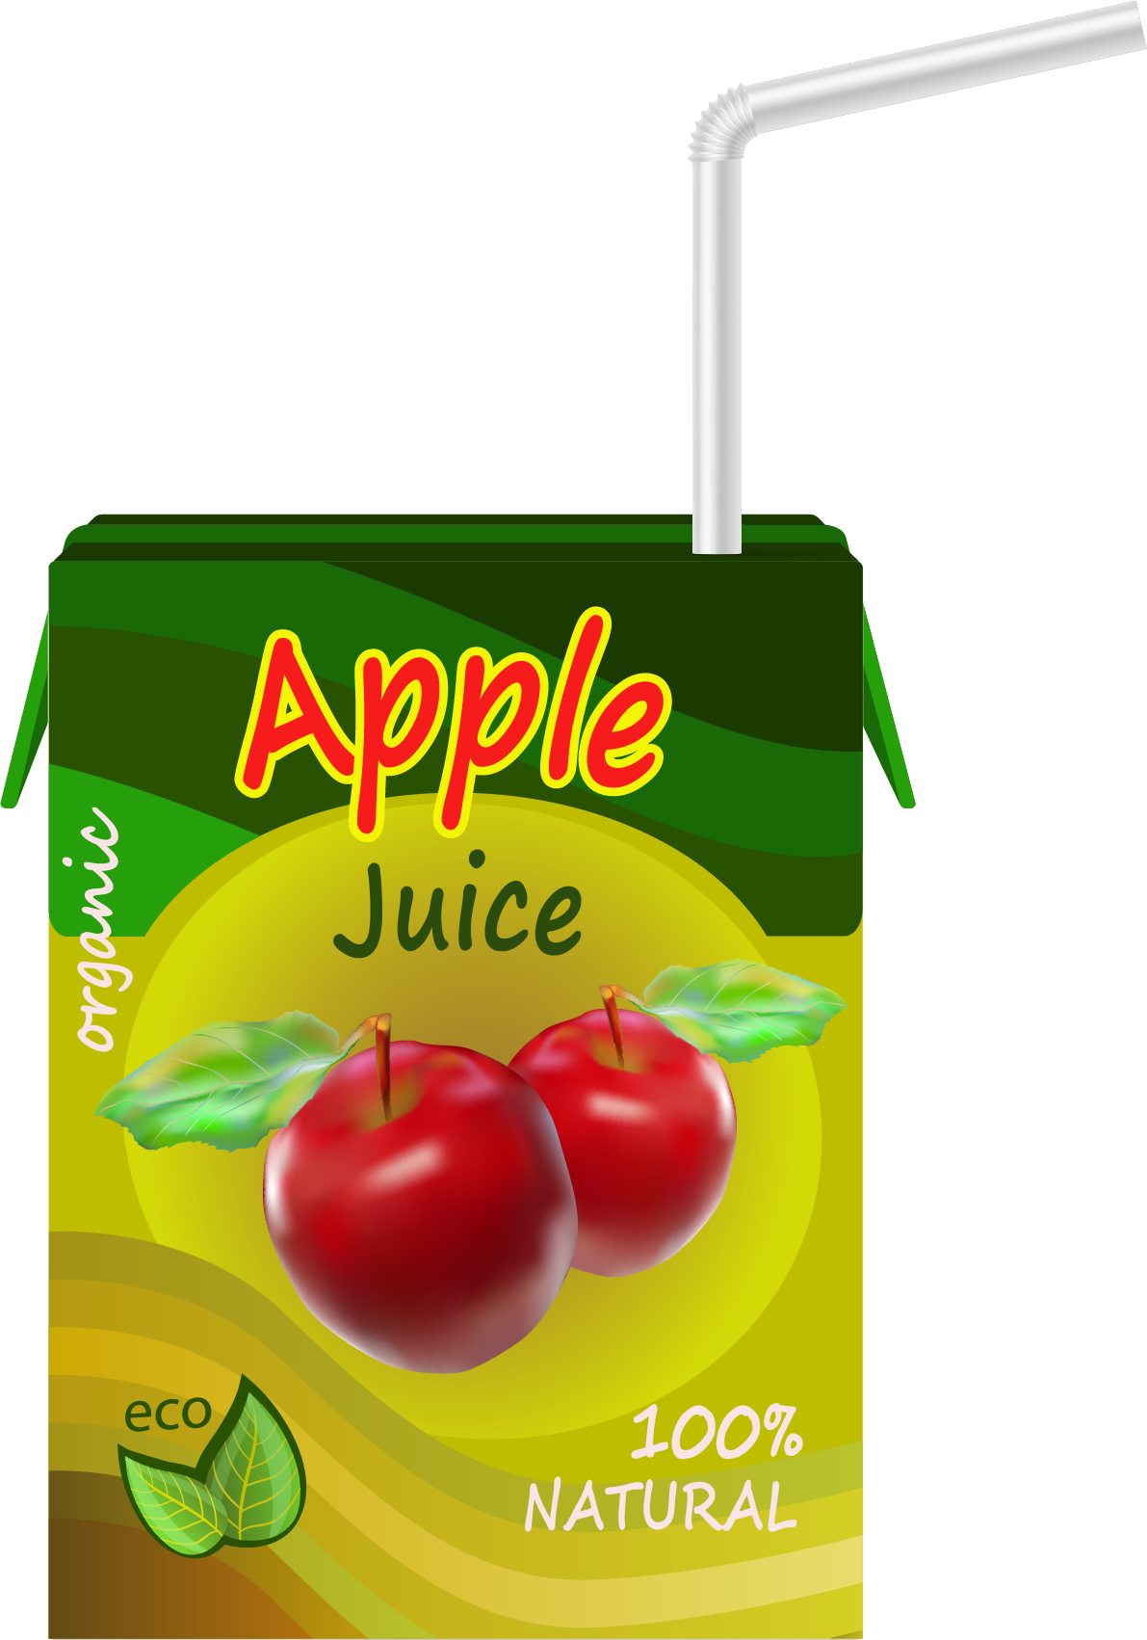
Food Package Investigation
TOPIC 3
LESSON 3
Directions:
Answer these questions in the workbook while you look at different types of packages
What do you notice about the colors and words on the package?
Does the package mention anything about ingredients in the food?
Are there any pictures on the package? What are they?
How does the package design make you feel about the food?

Slide 133
Food Package Investigation
TOPIC 3
LESSON 3
Packaging makes me
want to try the food
Packaging makes me
not want to try the food
Directions:
Use the Venn diagram below to record colors, pictures, words, design, or anything on the package that makes you want to try the food or not try the food.
Question: Do you feel like you are more likely or less likely to try the food based on the packaging? Why? Use details you wrote to explain your answer.

Slide 134
Reflect
TOPIC 3
LESSON 3
Do you feel like you are more likely or less likely to try the food based on the packaging?
Why?

Slide 135
TOPIC 3
LESSON 3
Advertisement
information that tries to get people interested in a product or encourage them to buy it
Persuade
to encourage or convince someone to think, feel, or do something

Slide 136
TOPIC 3
LESSON 3
How can food packaging influence the choices people make?

Slide 137
TOPIC 3
LESSON 4
FOOD’S JOURNEY FROM FARM TO YOU

Slide 138
TOPIC 3
LESSON 4
What can you learn about food by exploring its journey?

Slide 139
TOPIC 3
LESSON 4
Many people and steps get food from the farm to you, from farmers and ranchers to truck drivers, grocery workers, and cooks. The story behind food makes it too good to waste!
Nutrition and agriculture are connected. Understanding where food comes from helps make informed food choices and builds a stronger connection to food and community.
California produces an amazing amount of food from a diverse group of farmers. It is worth exploring top crops (milk, grapes, almonds, and many others). Over 1/3 of the country's vegetables and over 3/4 of the country's fruits and nuts are grown in California.
Sources: usda.gov and cdfa.ca.gov
Food doesn’t begin at the grocery store or the table – it is grown, raised, harvested, and more.
Agricultural involves traditions, communities, cultures, jobs, history, science, math, and more!

Slide 140
Resources
TOPIC 3
LESSON 4
Available at DairyCouncilofCA.org/DAL

