Slide 4
Mark done in the box when finished reading.
Snacks are like mini meals that can help fuel your body throughout the day.
A healthy snack has foods from at least 2 of the 5 food groups. For example, a granola bar and fresh fruit or vegetables includes foods from the Grains group and the Fruits or Vegetables group.

Slide 5
Mark done in the box when finished reading.
Cookies and chips are high in salt, sugar, and fat. Instead, reach for foods from the food groups as a healthy snack choice.
You can help shop for healthy snacks. Talk to your parents about making healthy snack choices together.

Slide 6
Snacks are mini meals that give you energy and help you learn, play, and grow. Explore how snacks from the food groups help you stay focused and fill you up between meals by following the link to watch the Why Eat Healthy Snacks video.

Slide 7
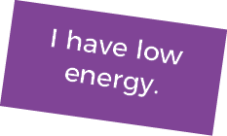
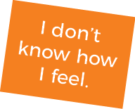
How do you feel BEFORE you eat a snack?
Drag your choices to the box on the right.
When you are finished put a check mark in the box.

Slide 8
Think about your snack choices, what you chose either today or yesterday. On the next slide, fill in what you ate and how you felt after you ate your snack.

Slide 9
Drag an emoji that shows how you felt after eating your snack.
Type your answer into the boxes.
What did you eat? | When did you eat it? | Where did you eat it? | How did you feel after eating it

Slide 10
A smart snack has 2 or more food groups in it. A mix of food groups gives your body the most health benefits.

Slide 11
Celery and
peanut butter
Look at the pictures of the snacks. Pick 2 food groups that are in the snack. Drag and drop the food groups next to the pictures. When you are finished put a check mark in the box.
Yogurt and
berries

Slide 13
Snacks are mini meals. A complete snack has 2 of the 5 food groups (for example, whole-grain crackers and hummus or apple slices and cheddar cheese).
Packaged snacks like chips and candy can give quick energy but will make you tired quickly, too. Healthy snacks give you an extra boost of long-lasting energy to help you learn, play, and grow.

Slide 14
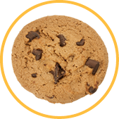
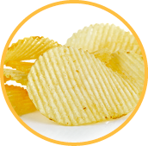
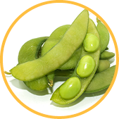
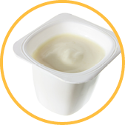
Instructions
Move foods from the food groups to the thumbs-up box.
Then move the remaining foods to the thumbs-down box.
When you are finished put a check mark in the box.

Slide 15
How do you decide which snacks to eat?
Write what you learned about smart snacking in the box.

Slide 18
Fill in why
I will eat a snack because it helps me .
My favorite healthy snack combines these 2 foods:
and . I will eat a smart snack at
.
Fill in food
Fill in food
Fill in where
Fill in when

Slide 19
STEP 1: Perform the following circuit as many times as you can in 2 minutes and record how many you completed:
5 squats
5 squat jumps
5 jumping jacks
STEP 2: Rest for 5 minutes.
STEP 3: Now run in place as fast as you can for 1 minute without stopping.
STEP 4: Repeat Step 1 for 2 minutes and record how many you completed.
STEP 5: Compare your results.
Number completed
Number completed

Slide 20
The first 2 minutes were easier than the second. You had more energy the first time since you did not run in place to start. This is similar to choosing snacks. Snacks from the food groups will give you energy that lasts a long time, while foods high in sugar, salt, and fat will give you quick energy but leave you feeling tired shortly afterward.

Slide 22
Take this short Knowledge Check to share what you learned.

