Slide 1
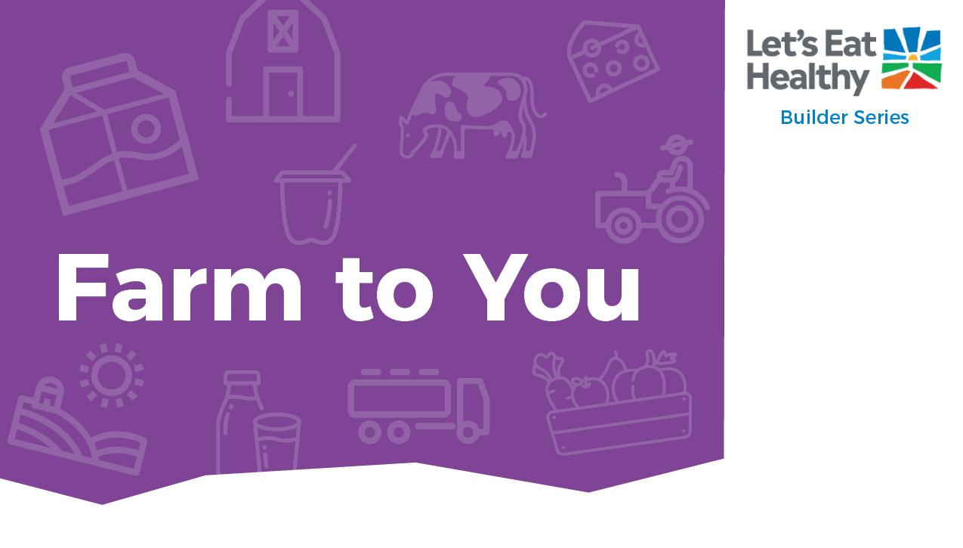

Notes:
Note for Educator: slides 2-5 are specifically for you. They include info on getting started with this activity, standards alignments, and fast facts on the topic. For students, copy slides 6-33 as a new slide deck, which can be shared as a file for each student in your Google classroom assignment or other digital platform.

Slide 2

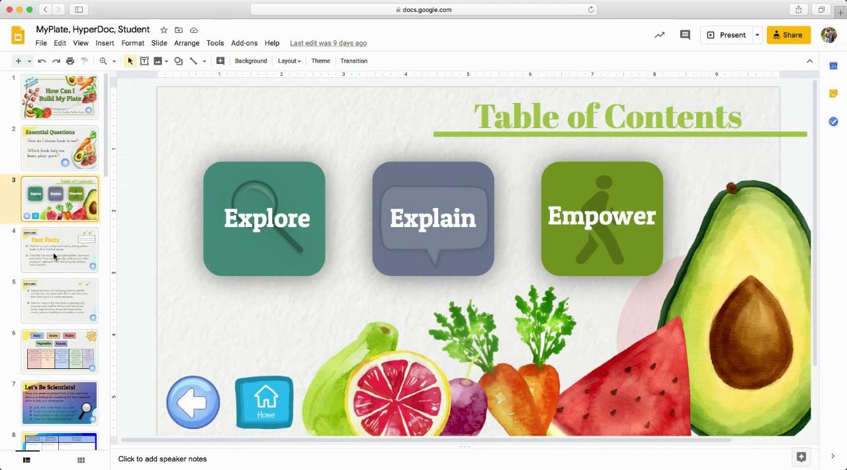

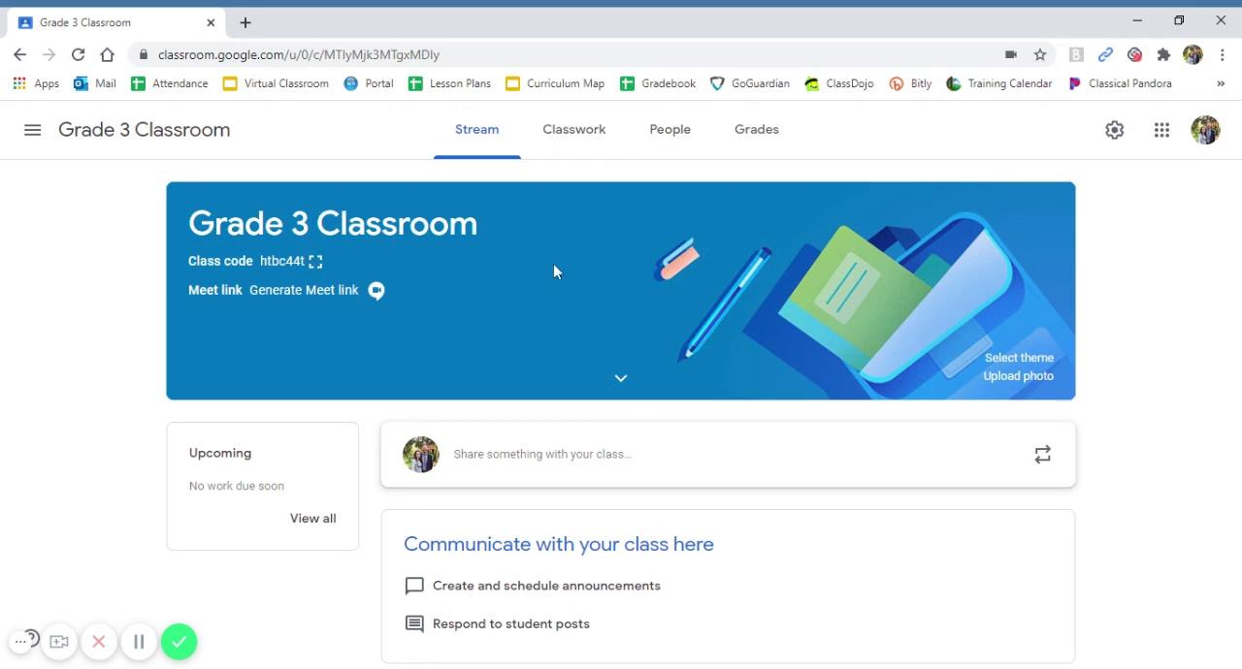


Navigating Digital Google Slides
Using HyperDoc:
You are using the Educator Guide, which includes notes and instructional videos.
Watch these 2 videos as an introduction to using the Builder Series.
The Builder Series is an interactive HyperDoc that includes aligned standards, facts, and slides labeled “Educator Guide” that are hidden from student view when presenting this material.
To make hidden slides viewable, simply select the slides, right click, and deselect Skip Slide.
Adding HyperDoc to Google Classroom:
Notes:
Note for Educator: slides 2-5 are specifically for you. They include info on getting started with this activity, standards alignments, and fast facts on the topic. For students, copy slides 6-33 as a new slide deck, which can be shared as a file for each student in your Google classroom assignment or other digital platform.

Slide 3
Section | Supported Standards CCSS-ELA | Rationale | RFM* CCSS – ELA | Supported Standards Health | Rationale | RFM* Health | Supported standards PE | Rationale
Explore | CCSS.ELA- LITERACY .RI.3.1 | Ask and answer questions to demonstrate understanding of a text, referring explicitly to the text as the basis for the answers. | Providing students time to view videos embedded in hyperdoc will allow students to answer the follow question, Which dairy foods are your favorites?
Explain |  |  |  | 3.1.6.P | Discuss how reducing, recycling, and reusing products make for a healthier environment. | Students could create an anchor chart where they list actions that could be listed as a way to either: Reduce, Reuse, or Recycle
Apply | CCSS.ELA- LITERACY .RI.3.7 | Use information gained from illustrations (e.g., maps, photographs) and the words in a text to demonstrate understanding of the text (e.g., where, when, why, and how key events occur). | Review the topic of how Dairy Farmers reduce waste, reuse water, and recycle materials in order to help the environment. This will help students formulate ideas for their writing.
Physical Activity |  |  |  | Grade 3: 3.2, 3.3, 3.4, 3.7, 3.8, 4.8, 5.1 Grade 4: 3.1, 3.3, 3.4, 3.7, 4.12, 5.1 Grade 5: 3.3, 3.5, 3.7, 5.2 |  |  | Grade 4: 1.3.N, 1.6.N, 5.1.N, 5.2.N, 7.1.N, 7.2.N, 7.4.N Grade 5: 1.3.N, 1.6.N, 1.8.N, 5.1.N, 5.2.N, 7.1.N
Notes:
Note for Educator: slides 2-5 are specifically for you. They include info on getting started with this activity, standards alignments, and fast facts on the topic. For students, copy slides 6-33 as a new slide deck, which can be shared as a file for each student in your Google classroom assignment or other digital platform.

Slide 4
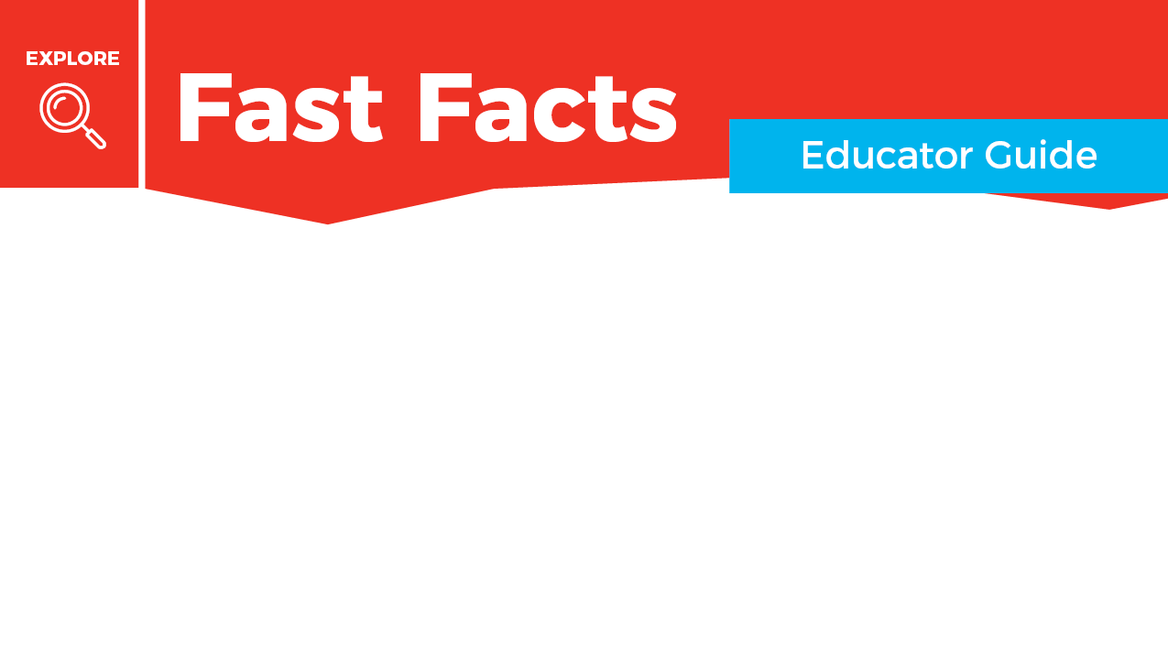
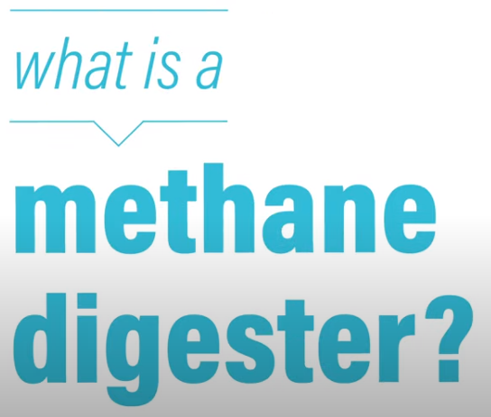


Videos to Watch
California is the leading agricultural state in the nation, producing more than 400 commodities at farms in all 58 counties across the state. California produces nearly 20 percent of the nation’s supply of milk.
The food system includes all steps from farm to you: producing, processing, storing, transporting, purchasing and preparing food. People access food from many sources: farms, community and home gardens, farmers markets, produce stands, grocery stores and school cafeterias. Milk goes from the farm to the grocery store or school in just two days.
Notes:
Note for Educator: slides 2-5 are specifically for you. They include info on getting started with this activity, standards alignments, and fast facts on the topic. For students, copy slides 6-33 as a new slide deck, which can be shared as a file for each student in your Google classroom assignment or other digital platform.

Slide 5

Dairy farmers care for their animals’ needs by providing food, water, shelter and veterinary care. They also care about their local communities and demonstrate this by ongoing efforts to recycle on the farm, reuse waste products generated and reduce their environmental footprint. Americans throw away about 40% of the food produced. Food, water and manure are examples of resources that can be recycled and reused in different ways.
Cow manure can produce energy. Digesters convert manure into methane gas, which convert it into electricity, which then power homes and farms. Digesters help reduce carbon emissions which helps our environment.
Visit the Mobile Dairy Classroom to explore cows and to take a virtual field trip!
Notes:
Note for Educator: slides 2-5 are specifically for you. They include info on getting started with this activity, standards alignments, and fast facts on the topic. For students, copy slides 6-33 as a new slide deck, which can be shared as a file for each student in your Google classroom assignment or other digital platform.

Slide 6
Notes:
Student slides begin

Slide 7
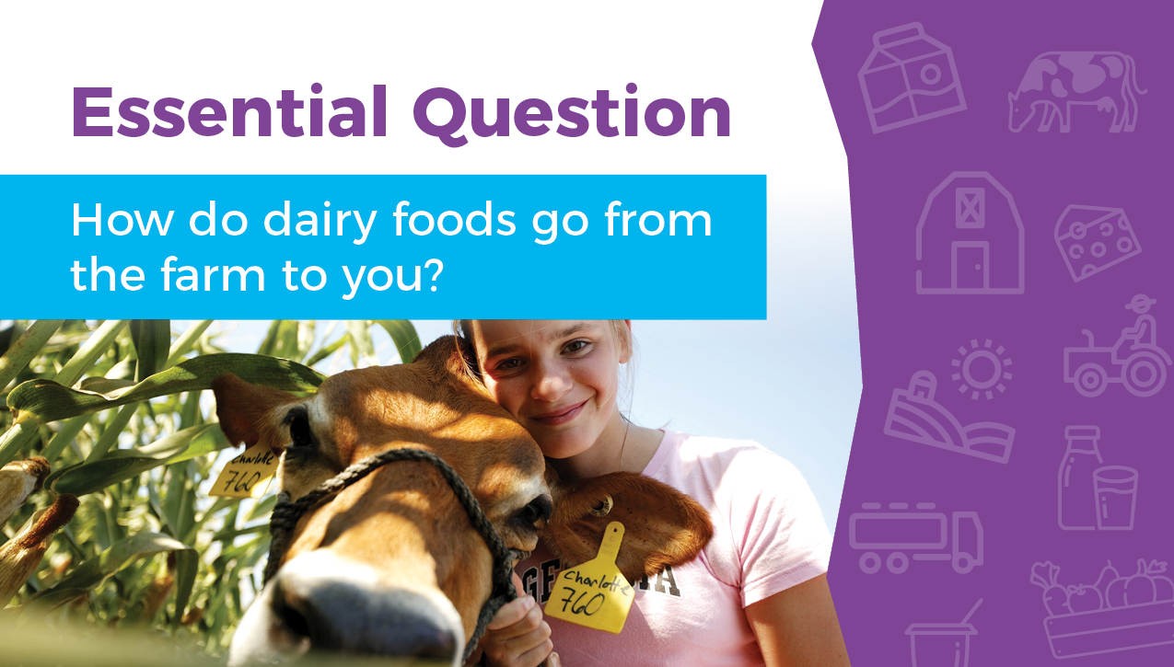

Slide 8
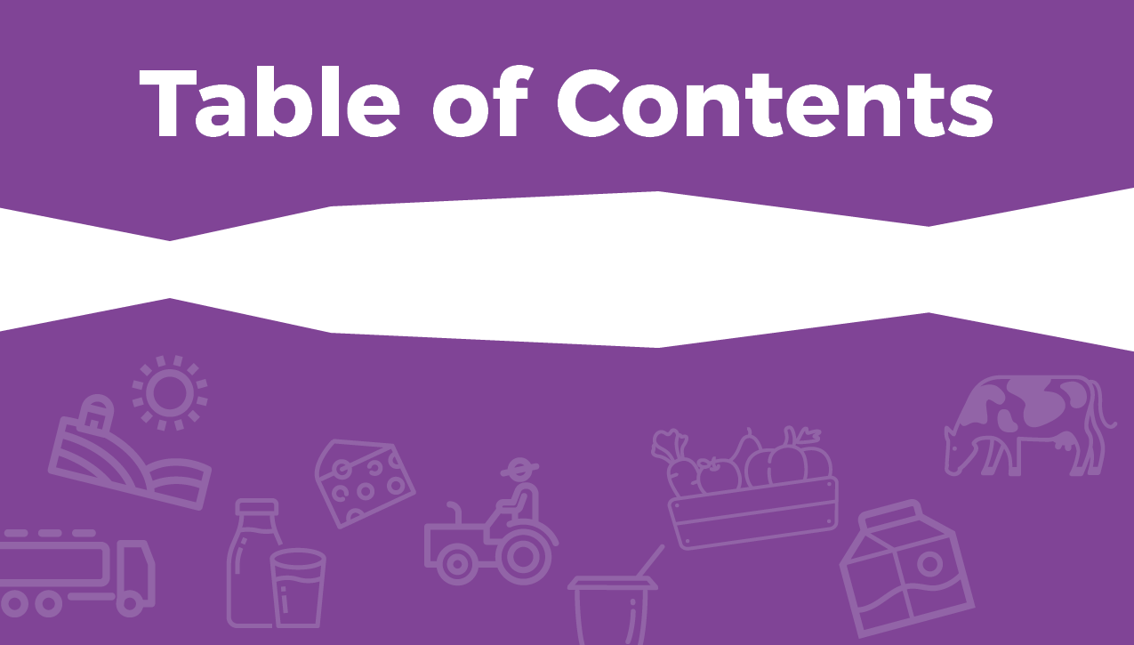





Slide 9
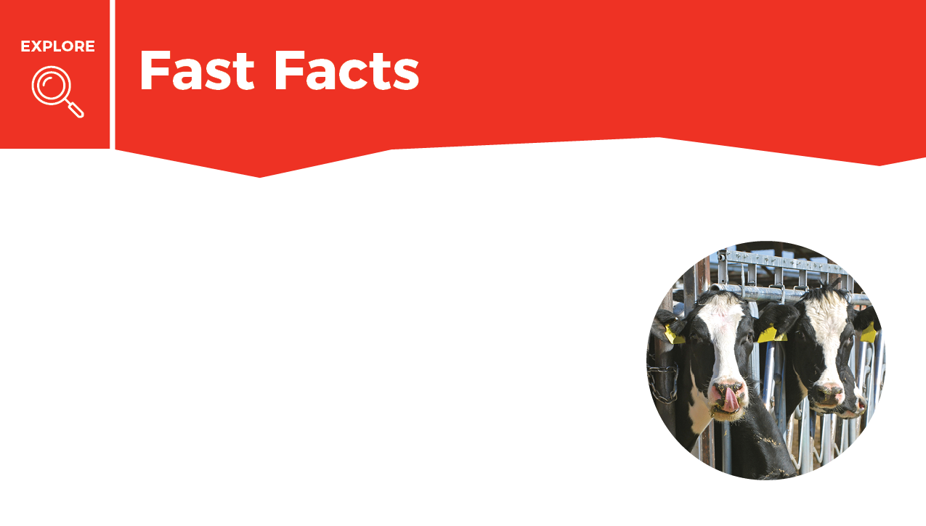


Mark done in the box when finished reading.
California produces much of the country’s food, including nearly 20% of the nation’s supply of milk.
The dairy industry plays an important role in California’s economy.
The food system includes all steps from farm to you: producing, processing, storing, transporting, purchasing, and preparing food.

Slide 10
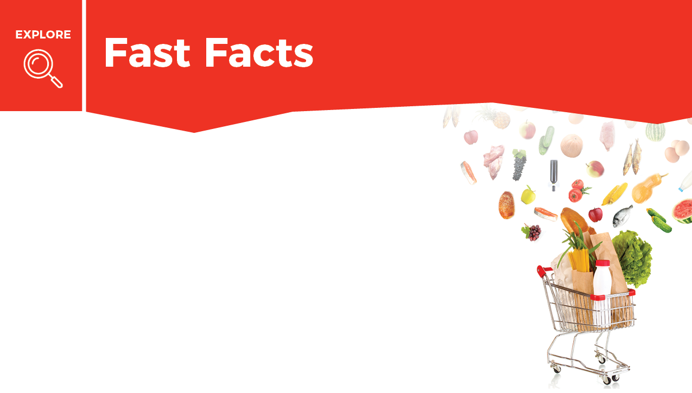
Mark done in the box when finished reading.
People access food from sources such as farms, community and home gardens, farmers markets, produce stands, grocery stores, restaurants, and school cafeterias.
Dairy farmers care for their animals by providing food, water, shelter, and veterinary care. Farmers also care about their local communities by recycling on the farm, reusing waste products, and reducing their environmental footprint.

Slide 11
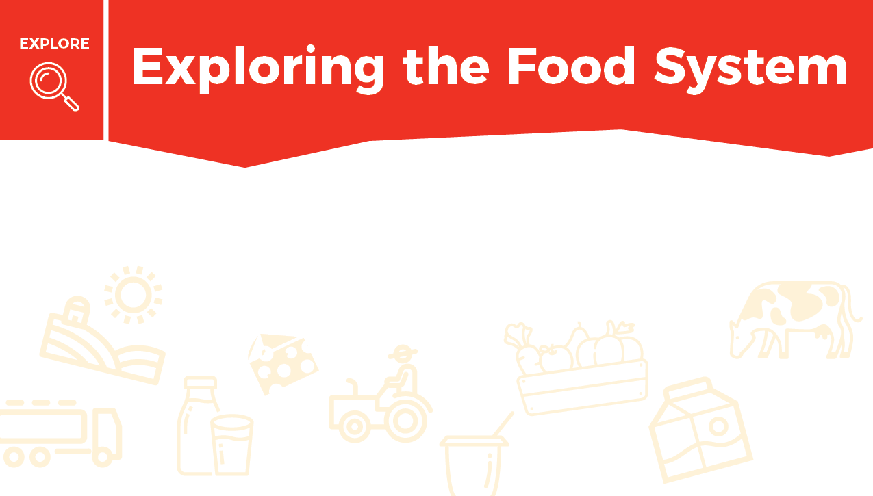


Follow the path your dairy foods take from the farm to your own refrigerator.
Notice all of the steps taken to make sure your milk and dairy foods are safe and fresh.

Slide 12
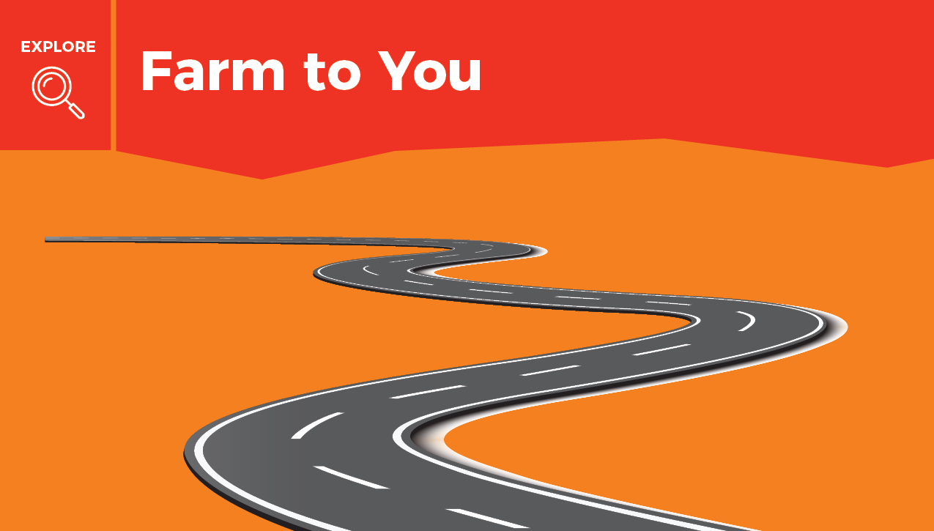
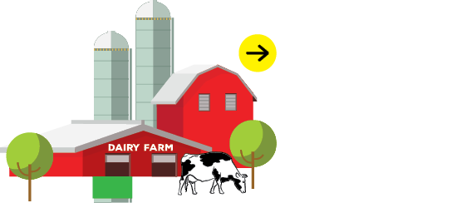
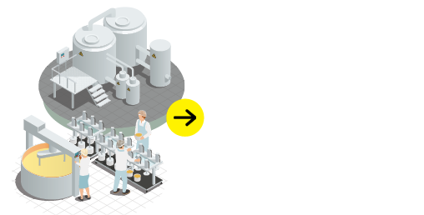
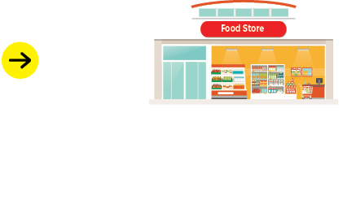
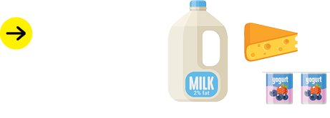
Click on the different places to learn more!

Slide 13
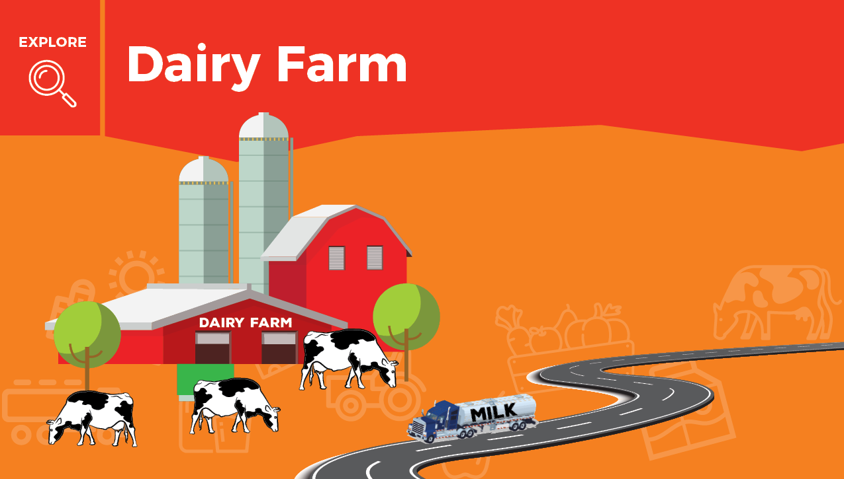


Milk comes from dairy farms where farmers take care of their cows.
Milk is tested for quality then travels in a refrigerated truck from the farm to a creamery.

Slide 14
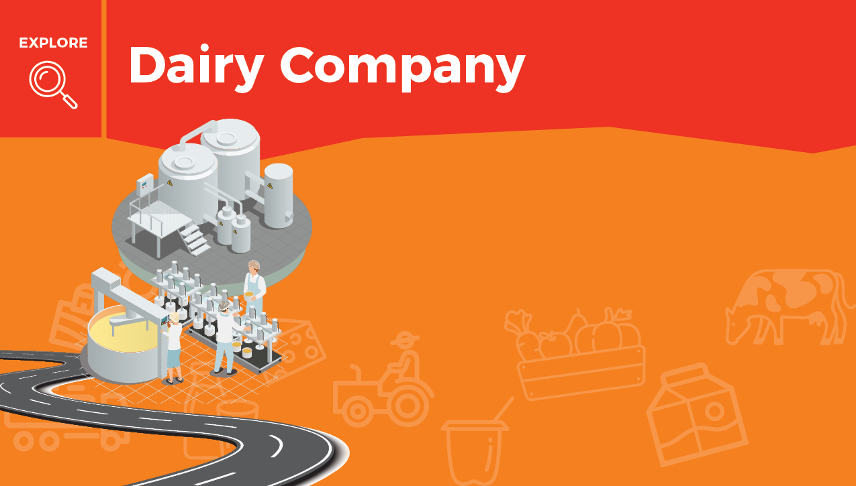



Milk is pasteurized—heated up then cooled quickly—to destroy any germs and make it safe to drink.
Milk is homogenized or mixed up to make it smooth and creamy.
Milk is put into cartons or made into other dairy foods such as yogurt and cheese.

Slide 15
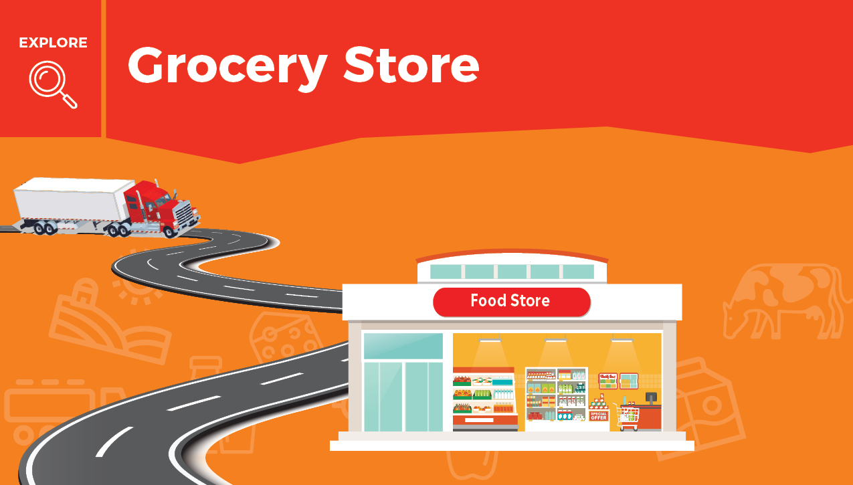

Milk arrives at the grocery store or your school cafeteria quickly, just 2 days after it leaves the farm.

Slide 16
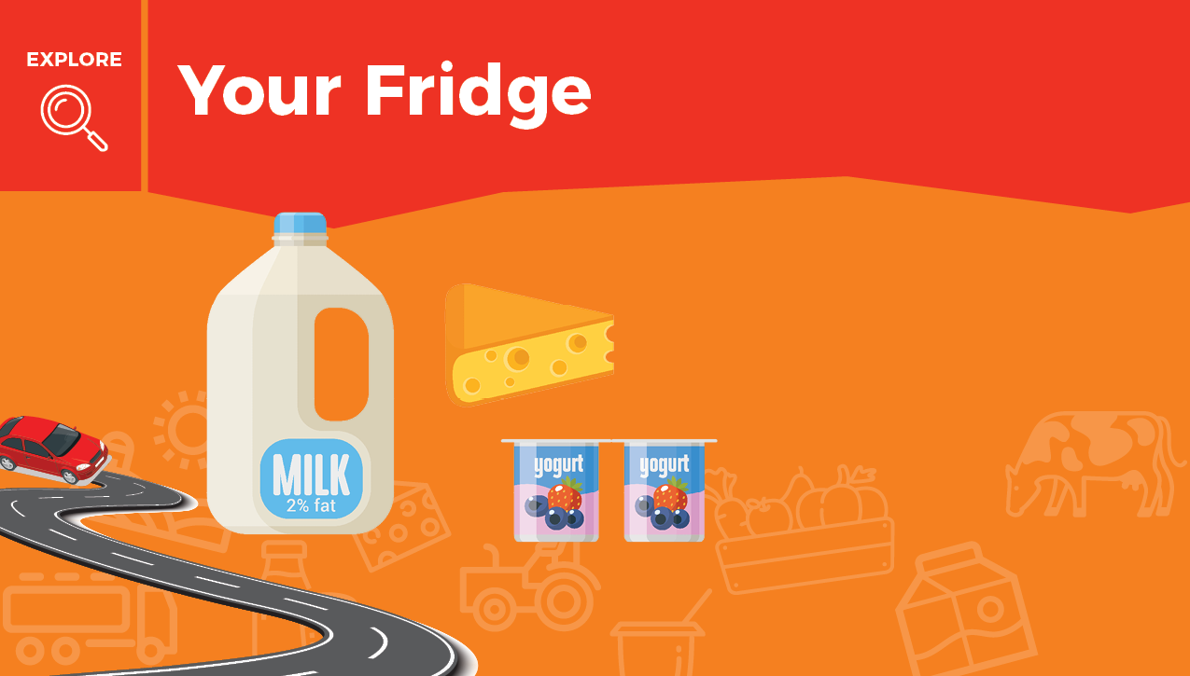

A variety of milk and dairy foods help your body learn, play, and grow.

Slide 17

Which dairy foods are your favorites?
There are many kinds and flavors of milk, yogurt, and cheese.
Type some of your favorites below!

Slide 18


Slide 19
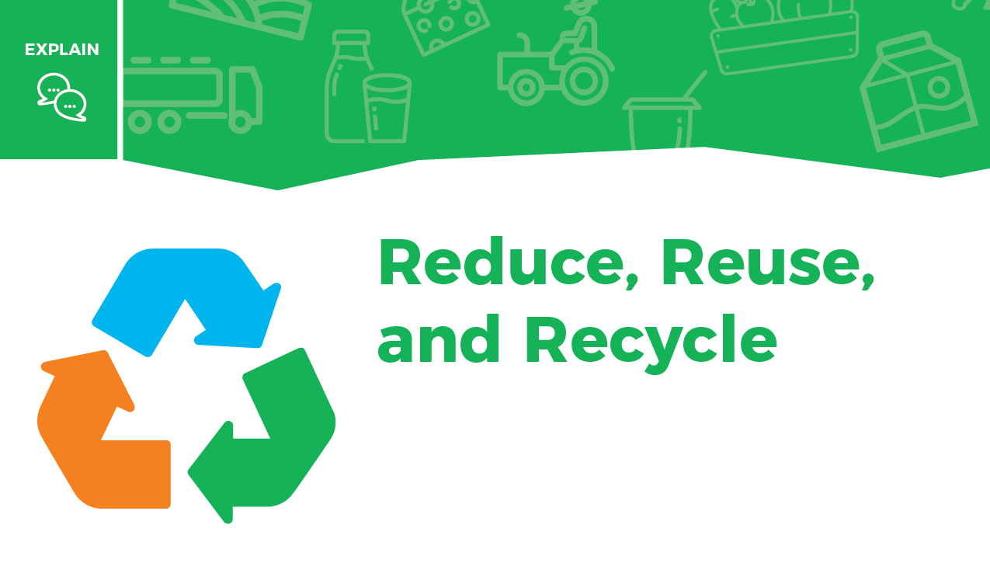
Did you know that dairy farmers and the cows they care for are very good recyclers?

Slide 20
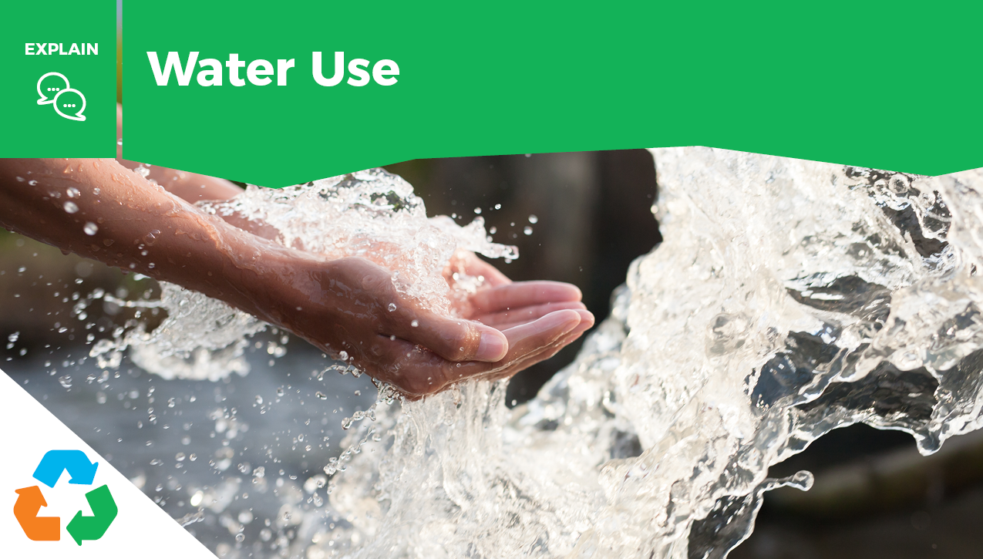
Farmers recycle and reuse water 3–5 times on the dairy farm. Water is used to clean the milking parlor, barn alleys, and walkways. The same water is used to grow crops that feed the cows.

Slide 21
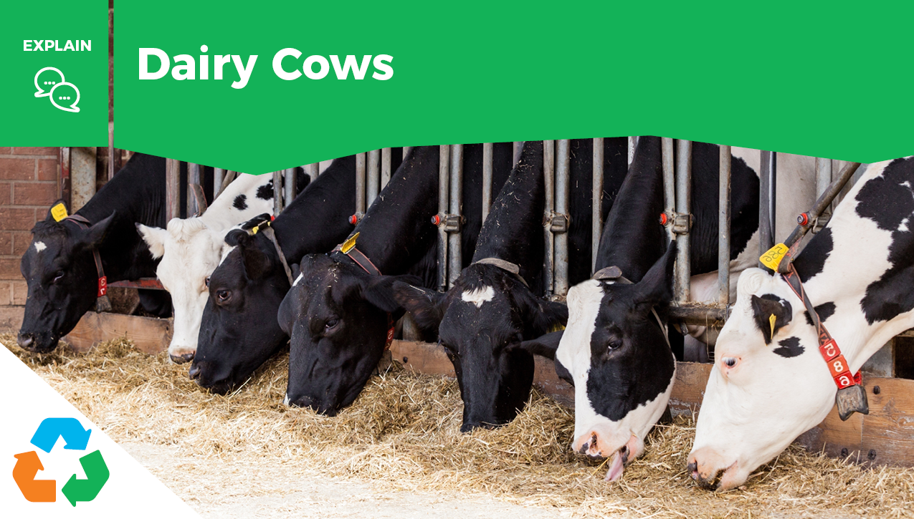
Having a stomach with 4 compartments means cows can eat food that people cannot.
A cow’s diet is 75% food by-products that humans cannot eat, like citrus pulp, cottonseed, or almond hulls. This also reduces the waste that goes into landfills.

Slide 22
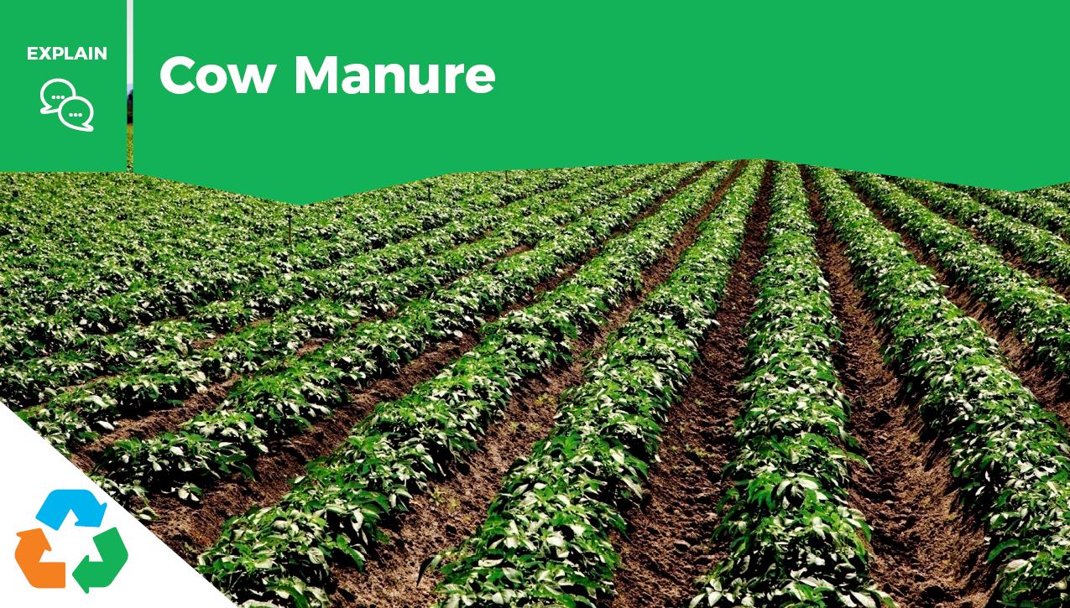
Manure from cows can be reused in many ways:
As fertilizer for crops
As energy to power, like electricity, for the dairy or nearby homes
As fuel for cars and trucks

Slide 23
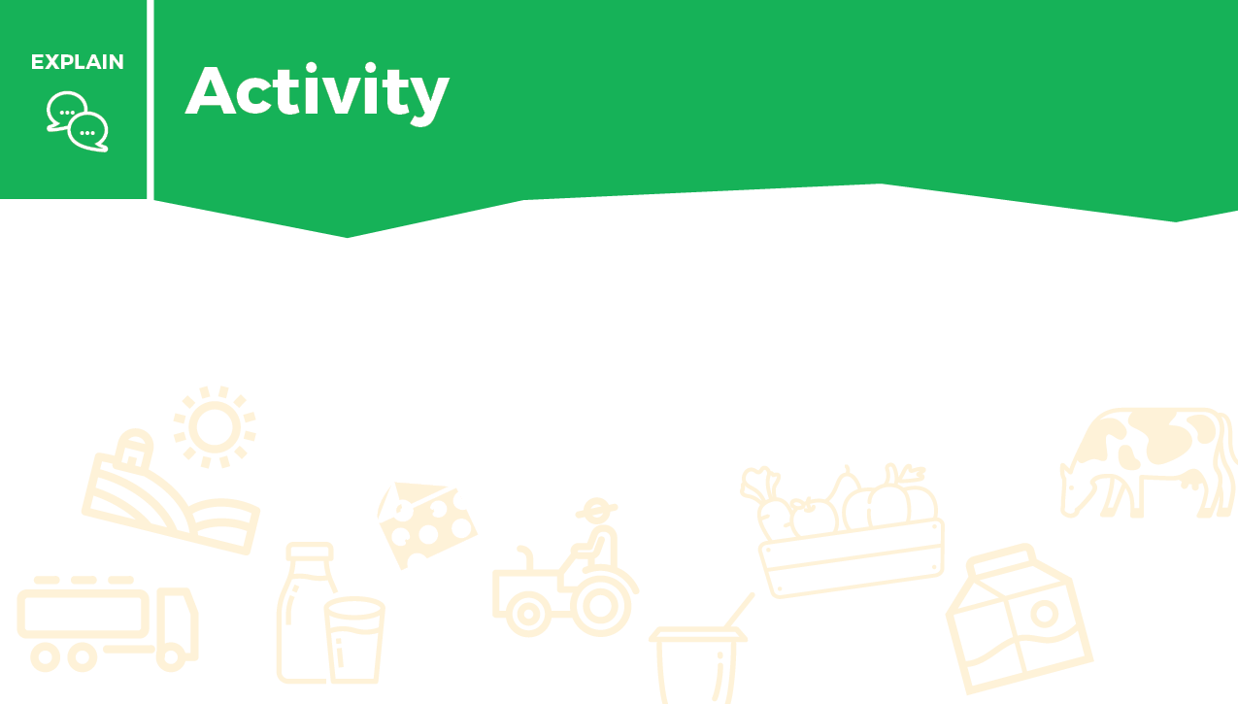
Write about the most interesting way that cows and dairy farmers reduce, recycle, or reuse. Use the box to complete this activity.

Slide 24


Slide 25
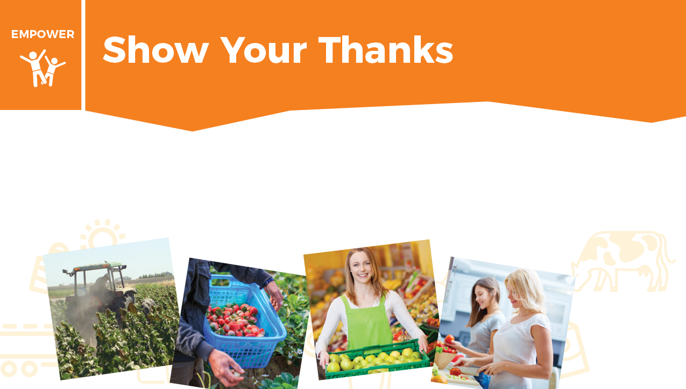
Many people work in our food system to make sure that you and your family have safe and nutritious food.

Slide 26
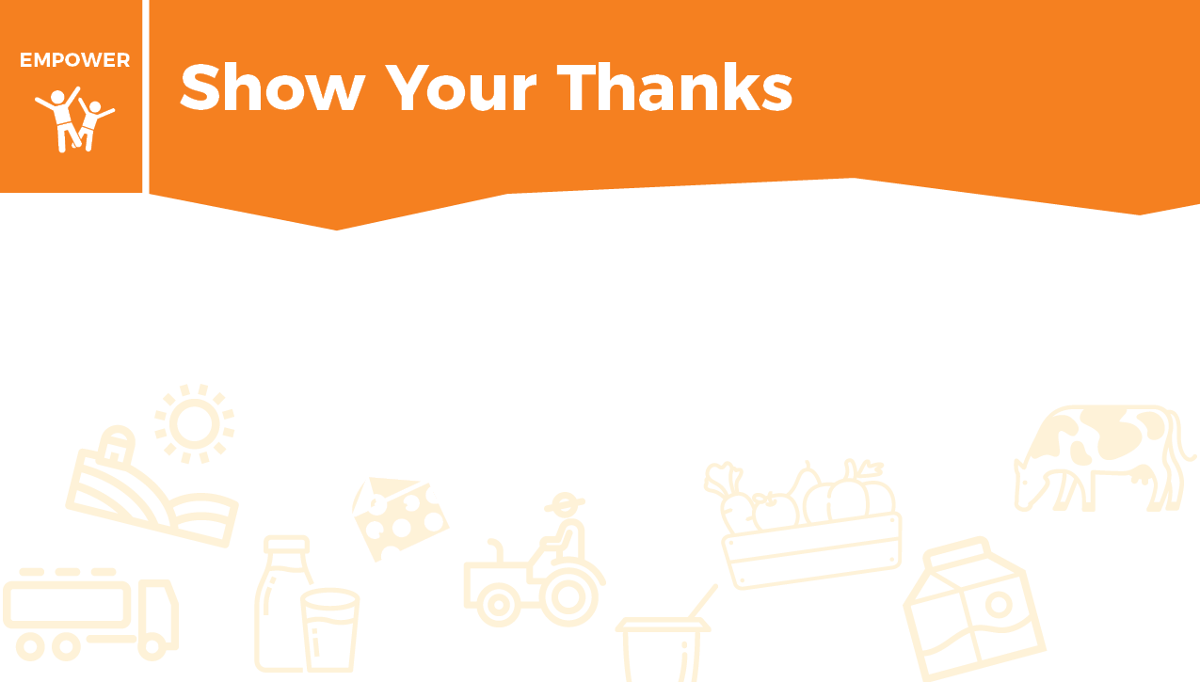
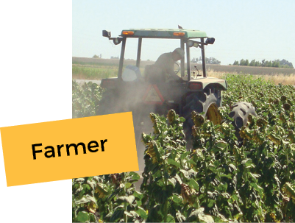
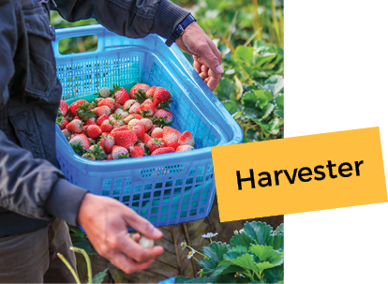
“I work on a farm growing the crops.”
“I pick the fruits and vegetables in the orchards or the fields.”

Slide 27
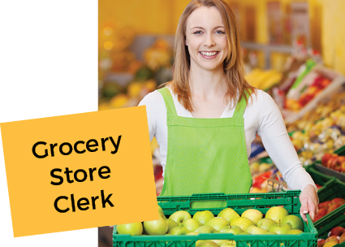

“I put the food on the grocery store shelves.”
“We plan and cook meals for our family.”

Slide 28

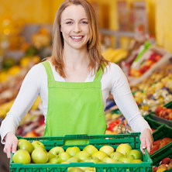
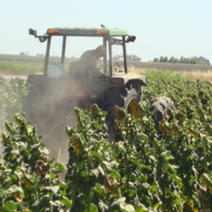
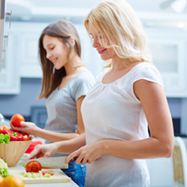
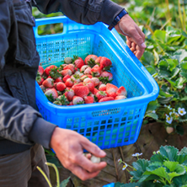
Drag each image to the correct box.
Grocery
Store
Clerk
Farmer
Harvester
Family
Cooks

Slide 29
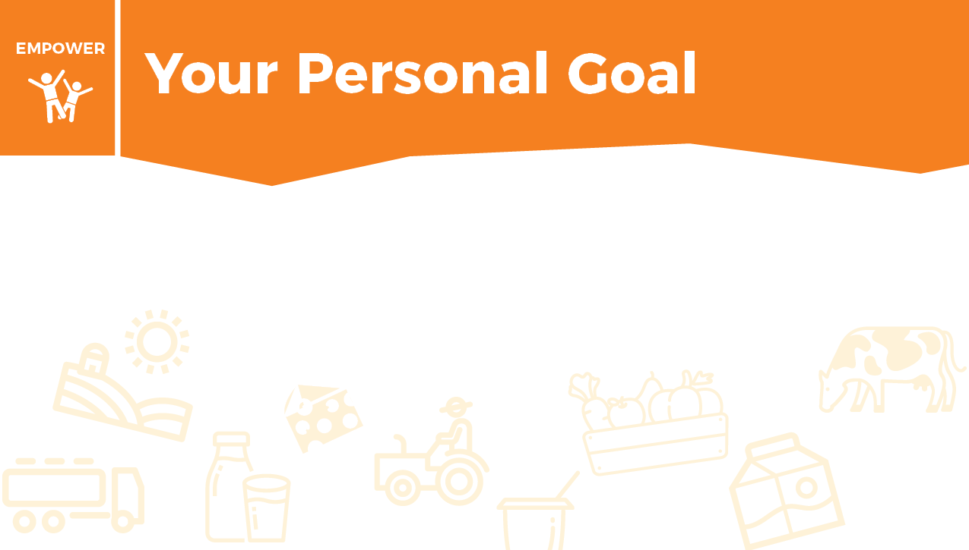
How can you show gratitude to the many people involved in bringing you delicious and safe food? Write your personal goal below. Who will you thank? What will you do?

Slide 30


Check the box when you complete each exercise.
California is an agriculture-rich state. Foods from each of the 5 food groups are produced across the state.
Dairy: Dairy foods come from cows. Cows move slowly in the pasture. Mimic a cow’s movement by walking with your hands and feet for 2 minutes. Make sure your knees do not touch the ground. Try to move as slowly as possible.
Vegetables: Vegetables grow in the ground. Hold a deep squat for 2 minutes and mimic pulling carrots from the ground.
Fruits: A majority of fruits grow on trees. Hold a tree pose for 1 minute on each side. See which side you can hold longer.

Slide 31

Check the box when you complete each exercise.
Grains: Grains come from plants like wheat, barley, and oats. Your body digests grains and makes glucose, which gives you energy. Perform as many burpees as you can for 2 minutes. Burpees require a lot of energy because they are a whole-body movement.
Protein: Animal protein comes from animals like cows, pigs, or chickens. Plant protein comes from plant parts like beans, nuts, and seeds. Find 1 or 2 big, heavy books and walk around for 2 minutes carrying those books with only your fingers touching them. Try not to drop the books. If you do, pick them up quickly and continue.

Slide 32


Slide 33
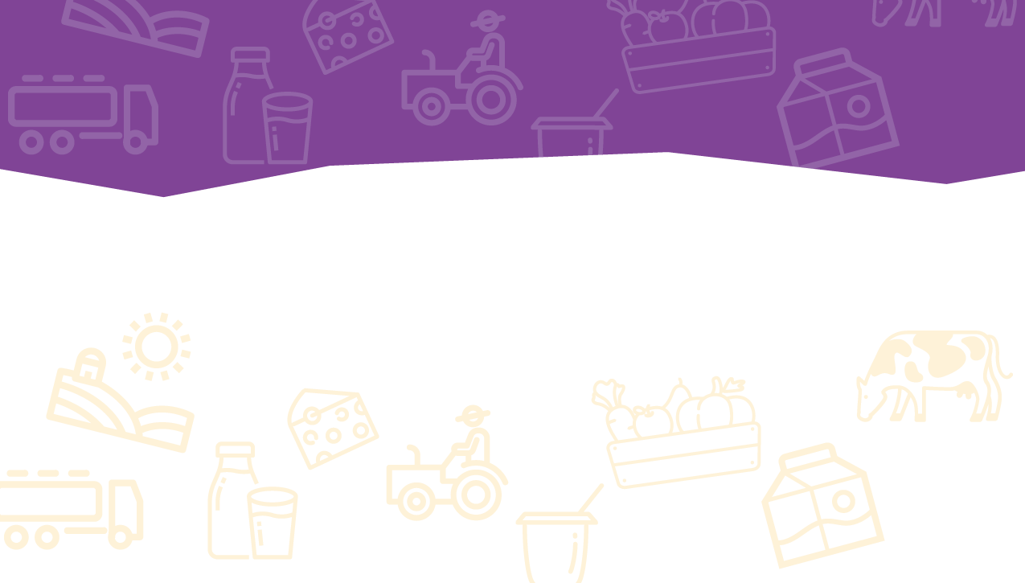
Take this short Knowledge Check to share what you learned.

