Slide 2
Milk + Dairy in Healthy Eating Patterns
Parenting Workshop
HealthyEating.org

Slide 3
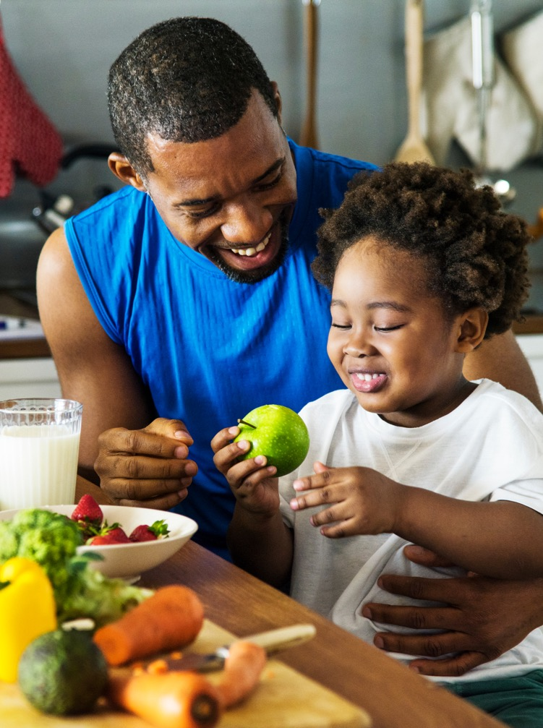
You Will Learn
What are the basics of healthy eating?
What is a balanced meal?
What are nutrient-rich foods?
Protein and other nutrients in milk help kids grow and build strong muscles.
HealthyEating.org

Slide 4

A Balanced Diet
HealthyEating.org

Slide 5
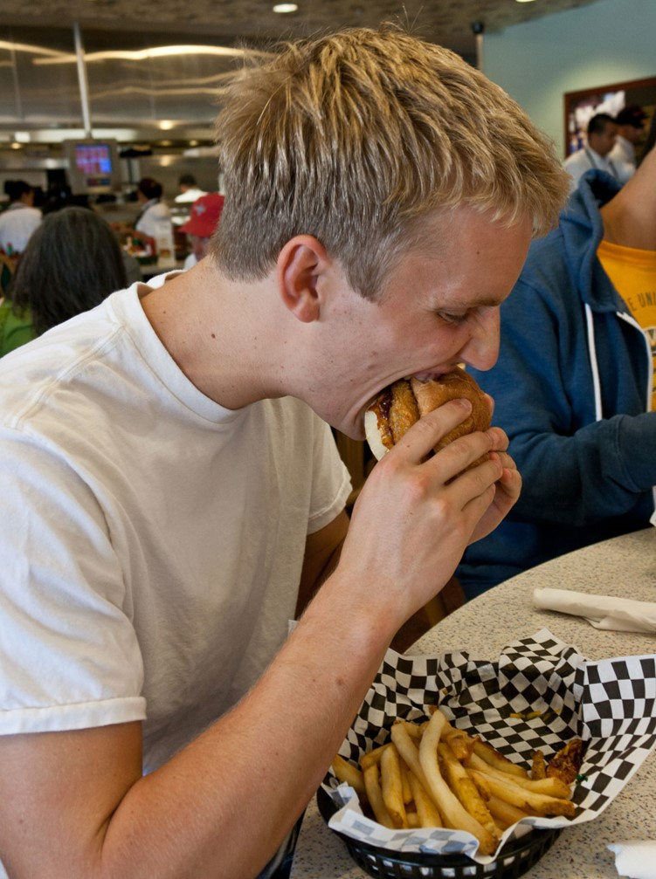
All food and beverage choices matter!
Encourage foods and beverages lacking by most Americans:
  Dairy
  Vegetables
  Fruits
HealthyEating.org

Slide 6

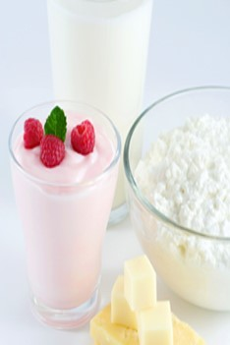

Calcium for Growing
The most important time to build your bones starts at 9 years old
9 out of 10 girls and 6 out of 10 boys don’t get enough calcium
Tips to stay healthy
  Include food that is an excellent source of calcium at breakfast
  Drink milk with meals
HealthyEating.org

Slide 7
Thank You!
HealthyEating.org

