Slide 1

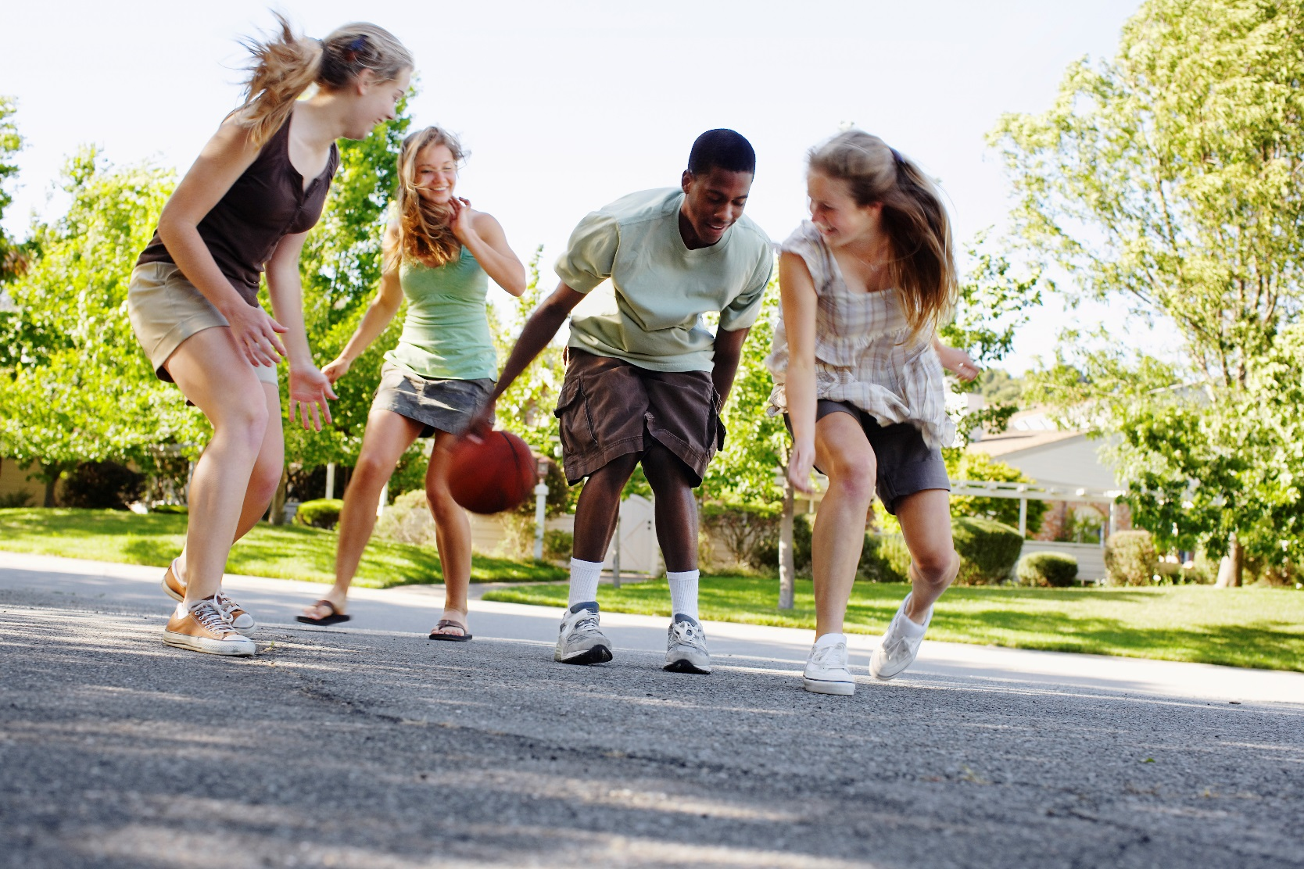

Slide 2
Did you know?
To look good, feel good and perform well, you need to eat well and be active. Take the only body you have and move more while feeding it so that it’s the best it can possibly be.
Notes:
Teacher Instruction
Read the slide aloud to students.
Talking Points
This lesson is about the small steps students can make for themselves to achieve long-term results.

Slide 3
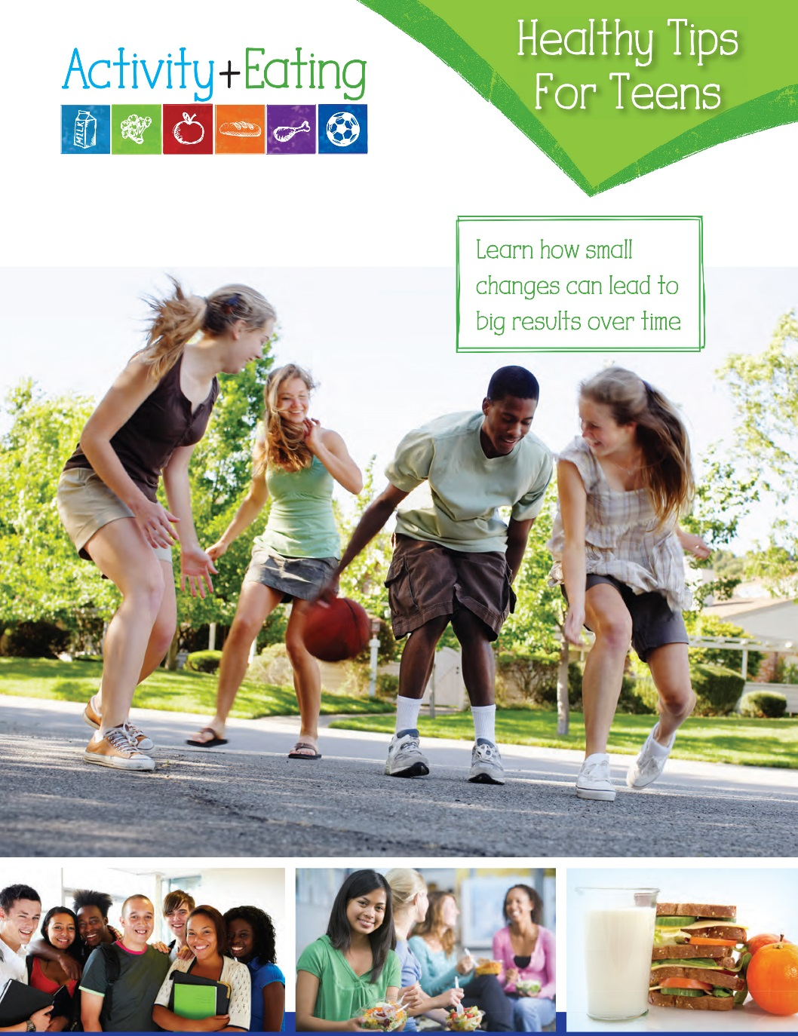
Cover
Cover
Notes:
Teacher Instruction
Hand out the Activity + Eating for Teens workbooks to students.

Slide 4
Group Discussion
1
Eating well affects how you feel.
FACT
How does eating well make you feel?
2
A healthy diet includes
some extra foods.
FACT
Name some foods from the food groups that you should eat most often.
Cover
Notes:
Teacher Instruction
Ask the probing questions on slides 4 – 6 to start a classroom discussion to help determine students’ awareness of healthy eating patterns.
Talking Points
1. How does eating well make you feel? If students are struggling with this question, ask them how they feel after they eat fast food. Answers might include bloated, uncomfortably full or lethargic. Now, ask again how they might feel after eating a healthy, balanced meal. Answers might include having more energy, being able to concentrate, or being in a good mood.
2. A healthy diet can include “extras,” however the foods that you eat most often should be food-group foods. Name some. Answers might include milk and yogurt from the Dairy group, broccoli and carrots from the Vegetables group, apples and oranges from the Fruits group, oatmeal and brown rice from the Grains group, and chicken breast and black beans from the Protein group. Explain to the students that by eating most of their foods from the food groups, which are nutrient-rich foods, they have room to enjoy the “extras” like cookies or french fries because all foods fit. There are no good or bad foods. In addition, the more physically active the students are, the more room for “extras” they can enjoy in moderation.

Slide 5
Group Discussion
3
It’s best to lose weight quickly.
FICTION
Why is it risky to lose weight too quickly?
4
Physical activity gives you
an energy boost.
FACT
Discuss how this energy boost
might feel.
Cover
Notes:
Talking Points
3. Why is it risky to lose weight too quickly? Answers might include being malnourished; may lead to an eating disorder due to the easy, quick fix; the weight will come back as soon as they return to their old eating habits; and they have a higher chance of losing muscle mass.
Ask students if they know the healthy amount of weight to lose per week. 1 – 2 pounds per week is healthy and maintainable for a long period of time.
Remind students that a long-term goal is to eat nutrient-rich foods and be physically active while their bodies are still growing as teenagers.
4. Discuss how this energy boost might feel. Answers may include happy, a feeling of being able to accomplish anything at that moment, or wanting to continue being active to have that feeling again.

Slide 6
Group Discussion
5
You need to stop eating bread
to lose weight.
FICTION
Is there any single food that you could eliminate to lose weight?
6
Milk is a sports-recovery beverage.
FACT
What intense activities could you do before consuming your recovery beverage?
Cover
Notes:
Talking Points
5. Is there any single food you could eliminate to lose weight? No is the correct answer; all foods can fit in a healthy diet in moderation. Often times when you tell yourself you can’t have a certain food, you want it more and are more likely to overeat on that food. By eating foods from all food groups, your body has the nutrients it needs to sustain energy for everyday activities.
6. Drink low-fat or chocolate milk after activity to replace important nutrients such as protein and electrolytes. Drinks like milk help you recover and build muscles. What intense activities could you do before consuming your recovery beverage? Answers may include running, swimming or strength training.

Slide 7
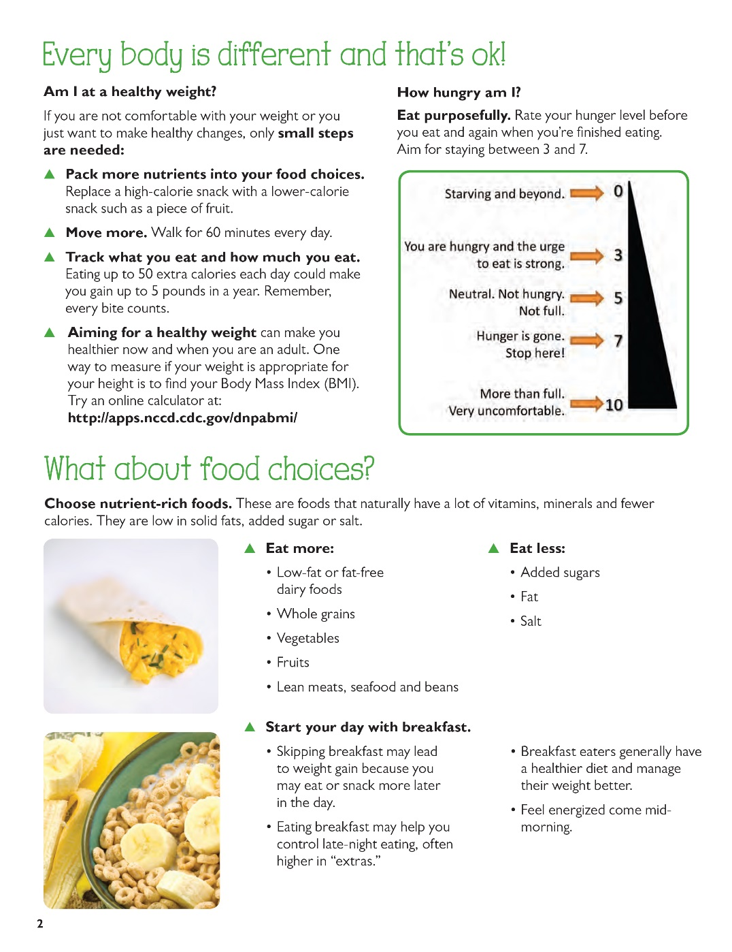
Page 2
Page 2
Notes:
Teacher Instruction
Have students turn to page 2 in their student workbooks and read the page to themselves.

Slide 8

Am I at a healthy weight?
Small steps are needed:
Pack more nutrients into your food choices.
Move more.
Track what you eat and how much you eat.
Aim for a healthy weight.
Page 2
Notes:
Teacher Instruction
Read the slide aloud to students.
Talking Points
Explain to students that they have the choice to make changes in their lives to be healthier. Being healthy means different things to everyone, which could mean getting down to a healthier weight or increasing muscle strength for everyday activities.
By packing more nutrients into their food choices, they will stay full longer, which will help curb unhealthy snacking.
By being physically active for 60 minutes a day, they will improve their muscle tone and endurance for activities they enjoy on a daily basis.
Keeping track of what they eat will help when deciding what foods are missing in the diet and what foods to eat less of and trade for healthier options.
Everyone has different body types; there is no one size fits all when it comes to how much a person weighs.
Ask if they have ever tried to run while carrying a 10-pound bag of potatoes. If they did, they would find they tire more quickly. Excess weight can be like that 10-pound bag of potatoes, which makes it harder to be active today and may lead to health problems when they are adults. Before they do anything, they need to determine if they are at a healthy weight.

Slide 9
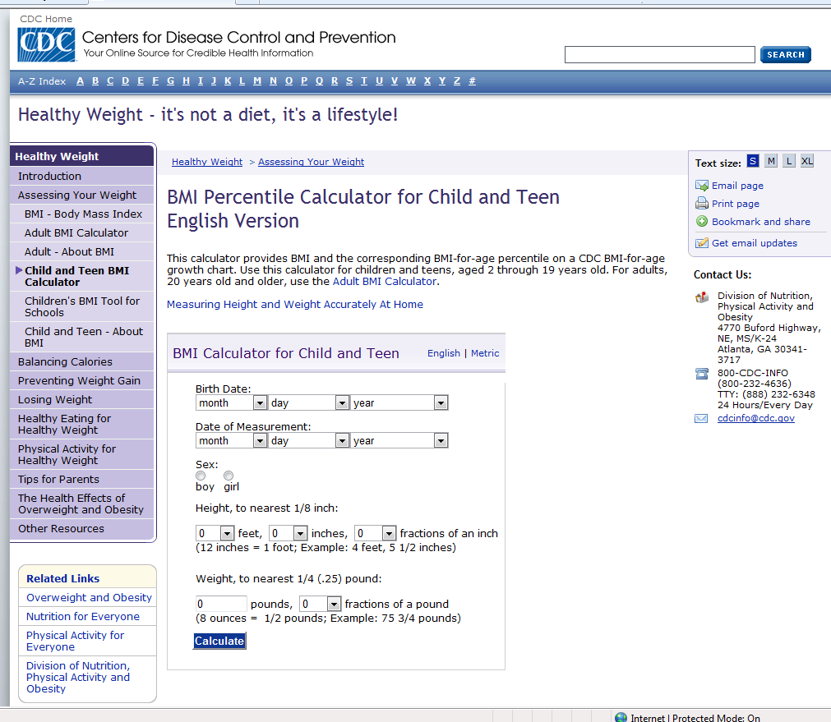
Internet Connection
http://apps.nccd.cdc.gov/dnpabmi/
Notes:
Teacher instruction
Refer to sections of the calculator as talking points are discussed.
Talking Points
Tell students that aiming for a healthy weight can make them healthier now and when they are adults. One way to measure if their weight is appropriate for their height is to find their Body Mass Index (BMI).
Suggest they use an online calculator like the one shown on the slide.
Point out how they can enter in their age, height, weight and gender into the calculator.
Once they fill in the information, their BMI will be given Depending on the range they are in, low BMI or high BMI, they then can choose the small steps to make healthy choices.

Slide 10
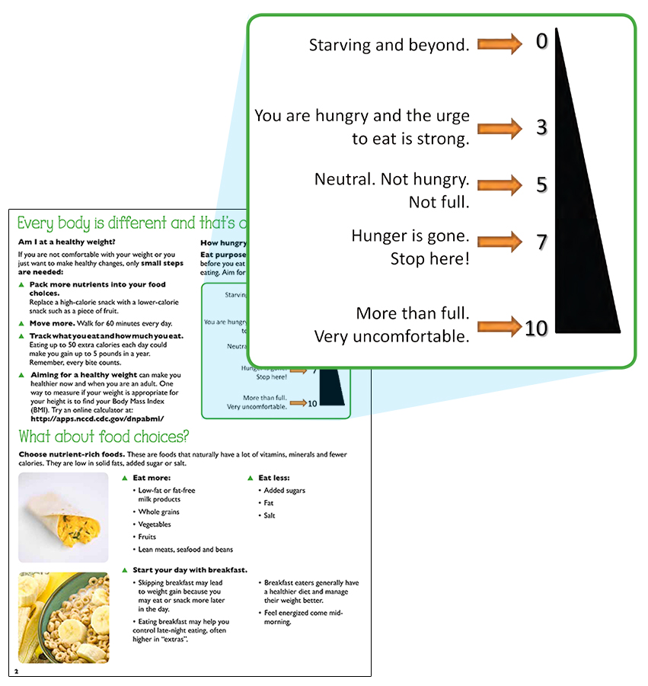
How hungry am I?
Eat purposefully and when you are hungry.
Page 2
Notes:
Teacher Instruction
Read slide aloud to students.
Talking Points
Eating purposefully helps you avoid mindless eating. For example, eating because you are bored or because you are upset are not reasons to eat food, especially if you are not actually hungry.
Explain to students that everyone should become familiar with their hunger scale.
Asking yourself how hungry you are before each time you eat will help with controlling the quantity of food eaten.
It takes the body roughly 20 minutes to realize it is full, eating slowly and enjoying each bite will also help with eating purposefully.

Slide 11
What about food choices?
Choose nutrient-rich foods.
Calories
Solid fats
Added sugar
Salt
Vitamins
Minerals
Page 2
Notes:
Teacher Instruction
Have students turn to pages 4 and 5 in their student workbooks to look at the five food groups and the list of foods in each group.
Talking Points
Explain to the students that foods found in the five food groups are more nutrient-rich and should be eaten more often.
For example, the foods in the Dairy group are high in calcium; the foods in the Protein group are high in protein; the foods in the Grains group are high in B vitamins; the foods in the Vegetables group are high in vitamin A; and the foods in the Fruits group are high in vitamin C. Explain to students that foods that have empty calories or no nutrients should be eaten less. That doesn’t mean never, but foods from the food groups are high in vitamins and minerals and should be eaten first. Foods high in calories, solid fats, added sugar and salt should be eaten less often.

Slide 12
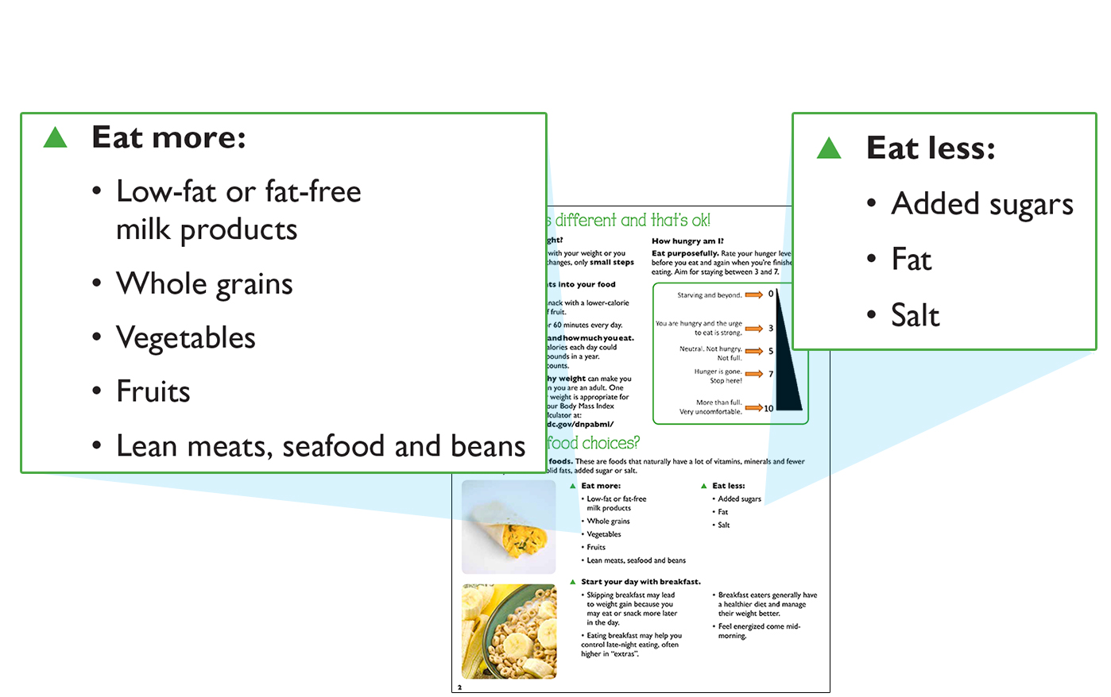
Nutrient-Rich Foods
Eat more:
Eat less:
Page 2
Notes:
Teacher Instruction
Read the slide aloud to students.
Talking points
Ask the students what foods they can eat more of in each of the five food groups.
Ask students what foods are high in added sugars, fat and salt.
Ask students if all fat should be avoided.
Many low-fat foods have high amounts of added sugar to replace the taste that fat gives to food.
Added sugar can be found in many beverages such as soda and energy drinks, as well as cereal.
Most fast food and processed food like chips have high amounts of added salt.
Not all fats should be avoided; healthy fats that are found in avocados, olive oil and nuts are needed for healthy skin, hair and nails and also keep us feeling full longer.

Slide 13
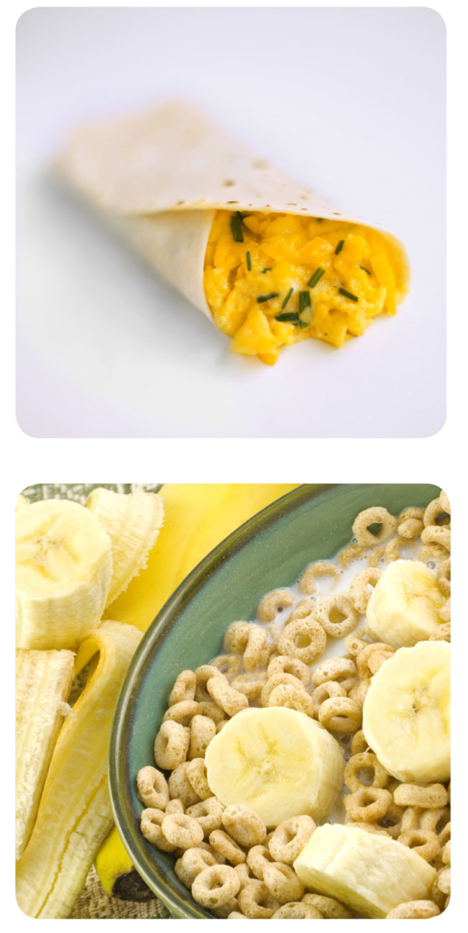
Start Your Day With Breakfast
Eating breakfast:
  Benefits your body, your brain and your attitude;
  Can make you feel happy come mid-morning;
  Makes you less likely to overeat in the afternoon and evening.
How do you feel when you skip breakfast?
Page 2
Notes:
Teacher Instruction
Read the slide aloud to students.
Ask students to raise their hands if they ate breakfast today.
Ask the students what they had for breakfast. Was this a nutrient-rich meal?
Ask the students how they feel when they skip breakfast.

Slide 14
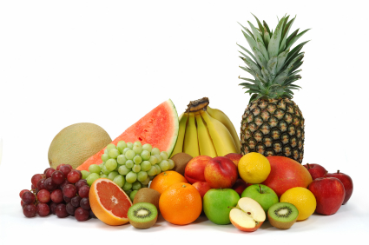
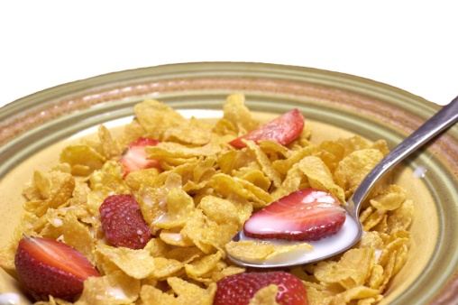
What makes a healthy breakfast?
Choose One
Grains
Choose One
Vegetables or Fruits
Choose One
Dairy or Protein
Page 2
Notes:
Teacher Instruction
Explain to students that their breakfast choices should include 3 out of the 5 food groups.
Ask the students to give examples of breakfast using the “3 out of 5” model.

Slide 15
Don’t have time for breakfast?
These meals can be prepared in less than 3 minutes and contain 3 of 5 food-group foods:
  Bagel with light cream cheese or peanut butter and small orange juice
  Cereal with low-fat milk and banana
  English muffin with melted cheese and a sliced pear
  Low-fat yogurt topped with almonds and an apple
  Instant oatmeal with low-fat milk and box of raisins
Page 2
Notes:
Teacher Instruction
Ask students why they skip breakfast. Is it lack of time, not hungry or don’t like breakfast foods?
Talking Points
The sample breakfast foods on the slide can be made in a hurry or the night before. A healthy breakfast does not have to be traditional breakfast foods.

Slide 16
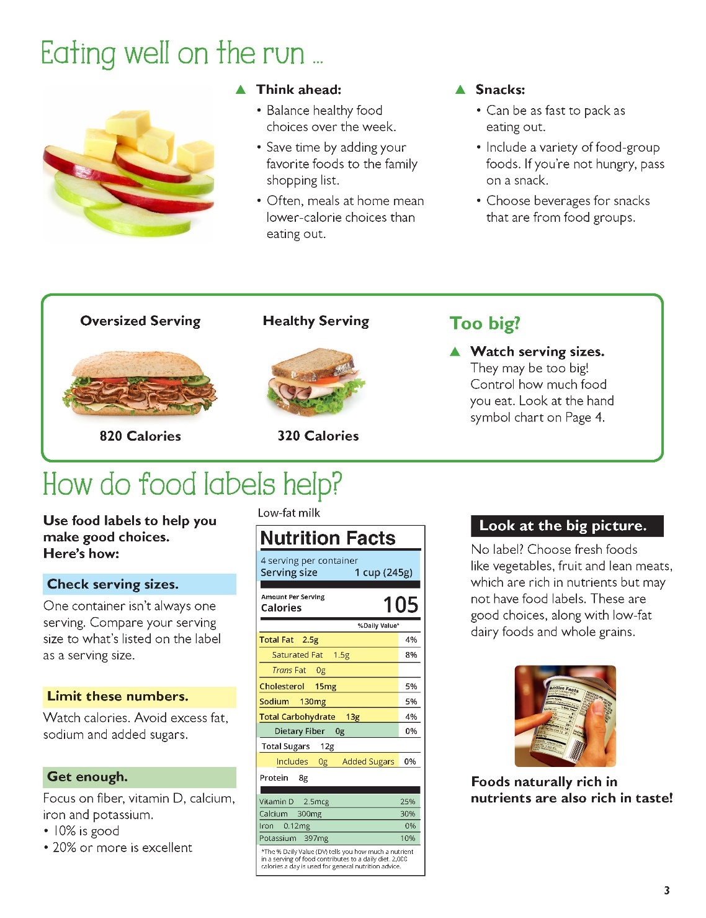
Page 3
Notes:
Teacher Instruction
Have students turn to page 3 in their student workbooks and read the page to themselves.

Slide 17
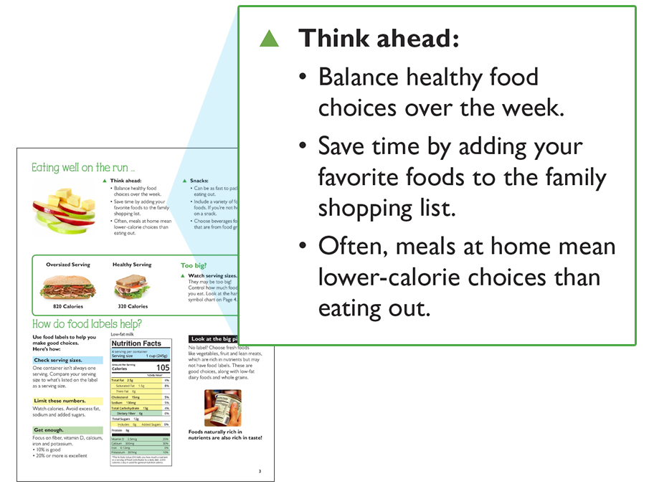
Eating well on the run
Page 3
Notes:
Teacher Instruction
Read the slide aloud to students.
Talking Points
Explain to students that come Monday the school week starts, which means homework, tests, after-school jobs or sports. Finding time to make healthy eating choices can be hard in a time crunch. That’s why thinking ahead about what you are going to eat will save you money and empty calories that will leave you low on energy and hungry again before you know it. When you are out and starving everything looks good, and you will no doubt over-order and overeat. Instead, pack a piece of fruit, nuts, a granola bar or string cheese, because packing a snack is just as fast as eating out.

Slide 18
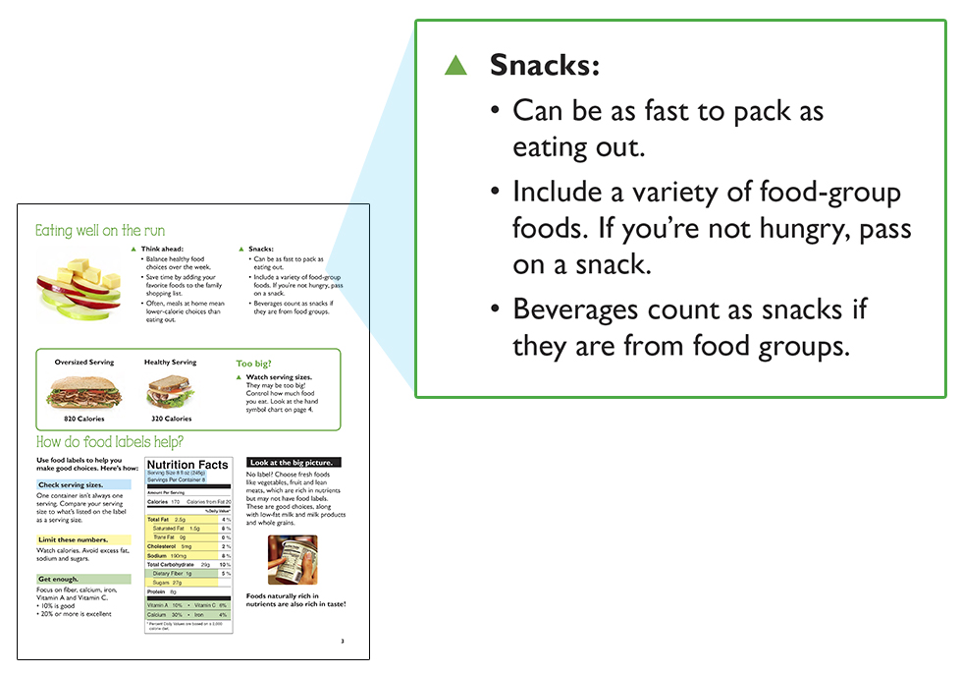
Snacking
Page 3
Notes:
Teacher Instruction
Read the slide aloud to students.
Talking Points
Explain to students that snacks aren’t just for little kids; they keep you from getting too hungry between meals.
Rather than grabbing from a box or bag until it is empty, put your snack of choice in a bowl or on a plate.
Snacks should also come from food groups rather than “extras,” like chips or candy.
Beverages count as snacks as well. For example, milk and 100% juice.

Slide 19
Beverages Make an Impact on Our Diets
30 – 40% of daily calories are consumed in beverages.
Food Calories
Beverage Calories
Yet, we often overlook beverage calories.
Page 3
Notes:
Teacher Instruction
Read the slide aloud to students.
Ask the students how many of them think about what they are drinking as part of their meals.
Talking Points
Beverages can be looked at in three categories:
Food groups: 100% fruit or vegetable juice
Neutral: water, unsweetened iced tea
Extras: soda, diet soda, lemonade, sweetened iced tea, energy drinks

Slide 20
What are you drinking?
The leading beverage choices are low in nutrients.
Teens
13-18 Years Old
 | Water (Bottled/Tap) |  | Soft Drinks |  | Coffee |  | Juice/Fruit Drinks |  | Milk (Stand Alone Only) |  | Tea |  | Other
________
*Based on past day stand alone beverage consumption
Q.3a-20c: Please indicate how many ounces of each type of (insert beverage) you drank.
MilkPEP 2010 Consumption Tracker
Q3 2010 – Q1 2011
Page 3
Notes:
Teacher Instruction
Read the slide aloud to students.
Point out to students that after water, soft drinks are the second-highest beverage consumed by teens. Ask if they are surprised by this.
Talking Points
Explain to students that water provides excellent hydration and is what they need the most of throughout the day. Milk includes nine essential nutrients such as calcium, protein and vitamin D, so three servings is best for good health, and 100% juice can provide vitamin C, but they can also get it from whole fruit or vegetables.

Slide 21
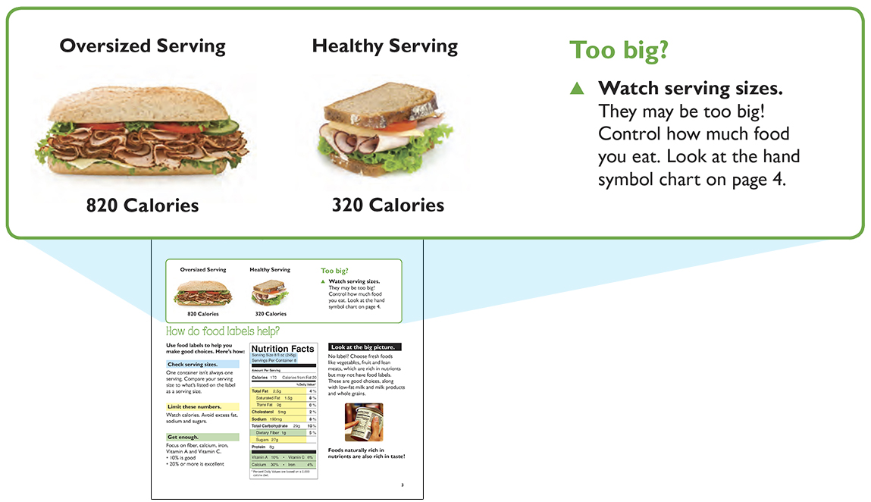
Beware of Extra-Large Servings
Page 3
Notes:
Teacher Instruction
Read the slide aloud to students.
Talking Points
Explain to students that the serving sizes served at restaurants and fast-food places, as well as when we serve ourselves, are usually two to three times bigger than one serving.
It is important to look at the food before eating to see how big it really is and to ask yourself how hungry you really are.
It is very easy to eat the oversized serving because it is in front of you, even if you aren’t that hungry.

Slide 22
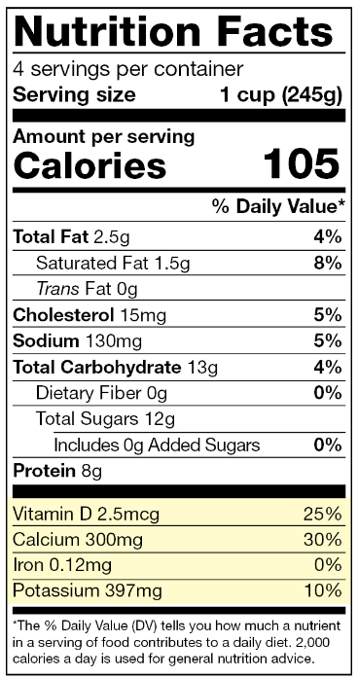
How do food labels help?
  Check serving sizes.
  Limit these numbers.
  Get enough.
Page 3
Notes:
Teacher Instruction
Read the slide aloud to students.
Ask students how often they look at food labels.
Ask students why they should look at food labels.
Talking Points
Most processed and packaged foods have a food label, allowing you to get the best nutritional value for your food. Fruits, vegetables and meat do not require a label but are nutrient-rich.
Begin by checking serving sizes and servings per container. All information is for a single serving.
Limit those nutrients highlighted in yellow, and make sure to get enough of those in green.
While food labels are important to read, they do not always tell the whole story. Many food labels may appear healthy but are fortified and processed. For example, protein bars may have low calories, low fat and high protein, but have high amounts of sugar and ingredients that are not natural.

Slide 23
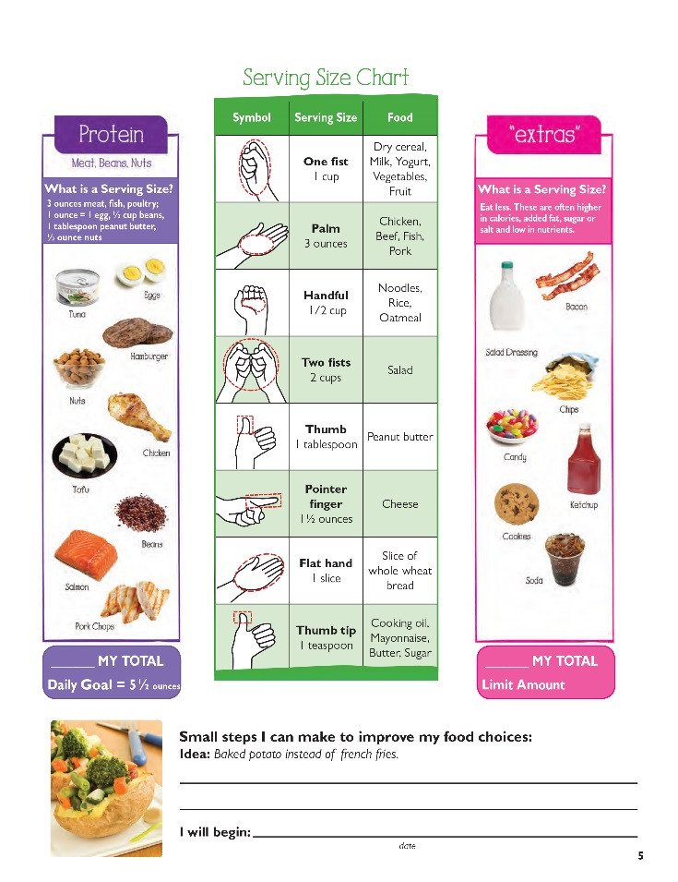
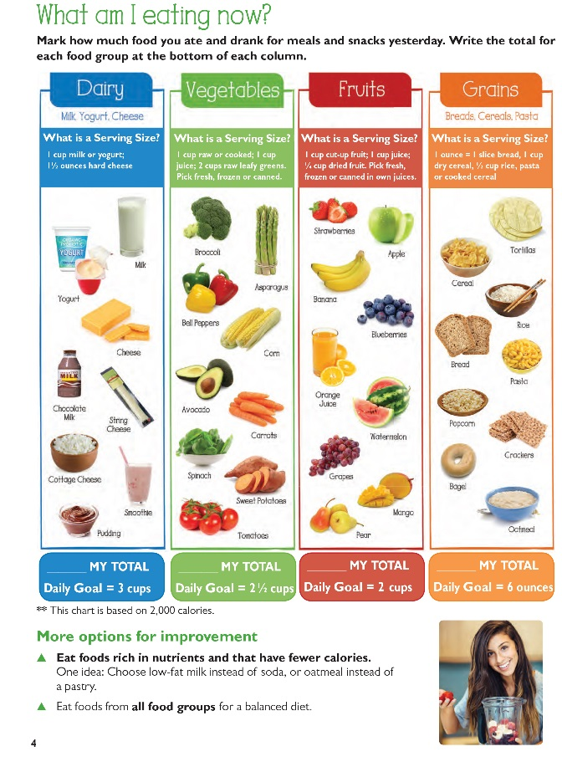
Pages 4 – 5
Notes:
Teacher Instruction
Have students turn to pages 4 and 5 in their student workbooks.

Slide 24
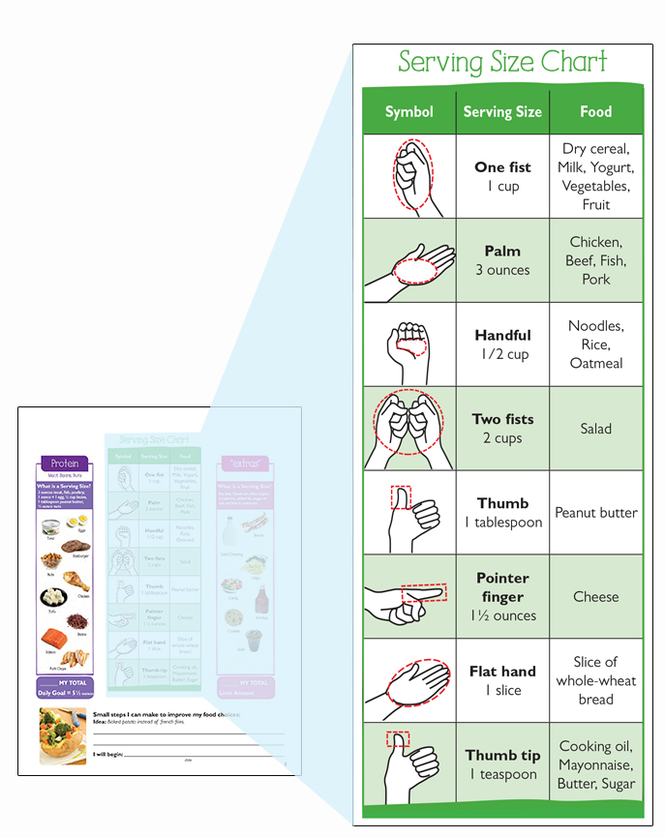
It’s all in your hands …
Estimate your serving size using this hand symbol chart.
Page 4 & 5
Notes:
Teacher Instruction
Read the slide aloud to students.
Explain to students that most foods can be measured using hands as measuring symbols.
Ask students why it would benefit them to use their hand to check serving sizes before they ate the food.
Ask students to show using their hands what the serving size of a cup of milk is. Answer is a fist.
Ask students to show using their hands what the serving size of a slice of bread is. Answer is a flat hand.
Continue with as many examples as time allows or if the class needs more practice.
Talking Points
Keeping track of how many servings of food groups consumed in a day or week helps to know if they need to add or balance any meals, such as not getting 3 servings of Dairy each day.

Slide 25
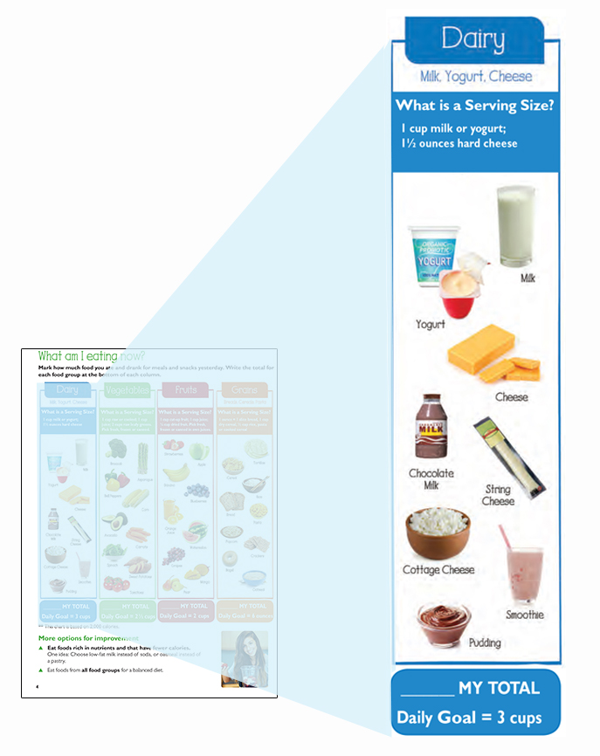
Instructions
Mark how much food you ate and drank for meals and snacks yesterday.
Write the total for each food group at the bottom of each column.
Page 4 & 5
Notes:
Teacher Instruction
Read the slide aloud to students.
After students finish filling out pages 4 and 5, ask what foods they are not getting enough of.
What food groups are they getting more than others?

Slide 26
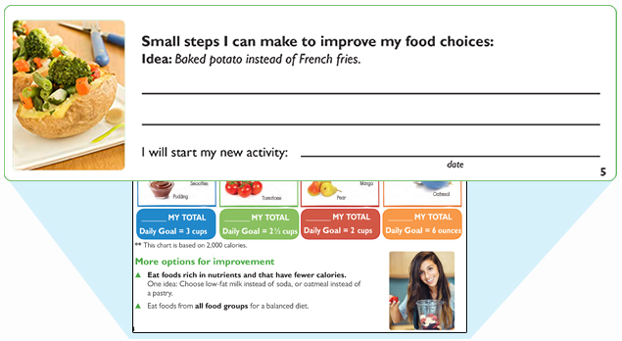
What small step will you make?
After completing your chart and adding up your totals, write an idea for a small step you can make.
Page 4 & 5
Notes:
Teacher Instruction
Read the slide aloud to students.
Ask students to share what small steps they plan to make.

Slide 27
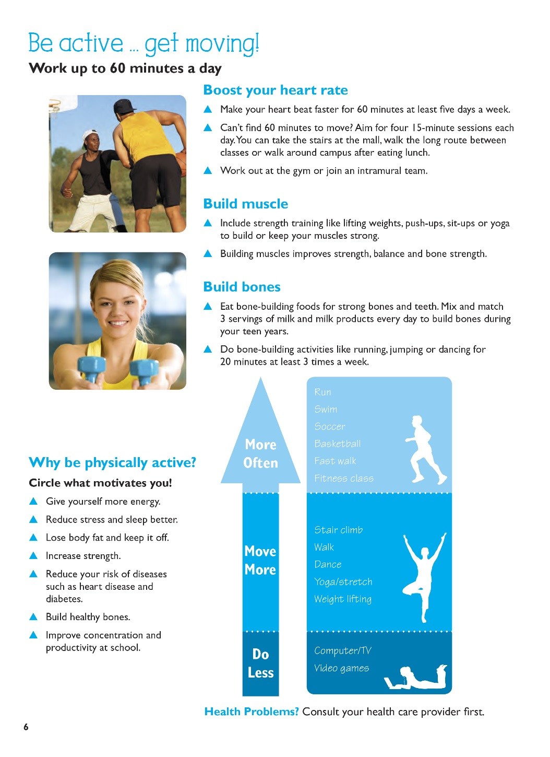
Page 6
Notes:
Teacher Instruction
Have students turn to page 6 in their student workbooks and read the page to themselves.
Talking Point
The other half of making healthy choices is being physically active.

Slide 28
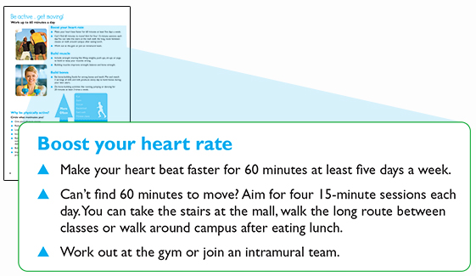
Boost your heart rate
Page 6
Notes:
Teacher Instruction
Read the slide aloud to students.
Ask students for some excuses why teens might not be physically active.
Discuss some ways to overcome those obstacles.

Slide 29
Boost Your Heart Rate With Intensity
Easy
Can talk normally
(e.g., slow walking)
Heart pumping faster, a little hard to talk (e.g., fast walking)
Heart pumping very fast and difficult to talk (e.g., running)
Moderate
Challenging
Page 6
Notes:
Teacher Instruction
Read the slide aloud to students.
Ask students to share examples of activities they do in each level.
Talking Points
Explain to students the higher the intensity of the activity, the faster your heart will beat, which helps strengthen your heart and burn calories.
Students should vary their activities to get their heart to reach each of these levels throughout the week.

Slide 30
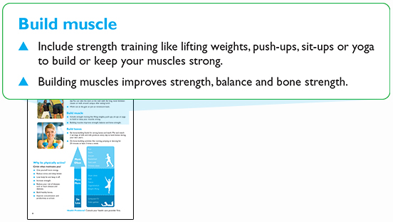
Build Muscle
Fact: Strength training improves focus and concentration, which may result in better grades.
Page 6
Notes:
Teacher Instruction
Read the slide aloud to students.

Slide 31
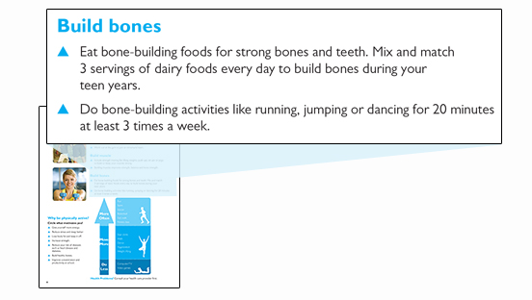
Build Bones
Mix and match 3 servings of Dairy foods every day to build bones during your
teen years.
Page 6
Notes:
Teacher Instruction
Read the slide aloud to students.
Talking Points
Ask students why it is important to have strong bones and teeth. Answers may include because they won’t break bones if they fall and they can eat food.
Ask students what disease is caused from lack of calcium. Osteoporosis is a bone-thinning disease that causes bones to become fragile and break.
Ask students to give examples of how they can mix and match their 3 servings of Dairy foods in a day. Examples include milk, yogurt and string cheese or milk, chocolate milk and yogurt.

Slide 32
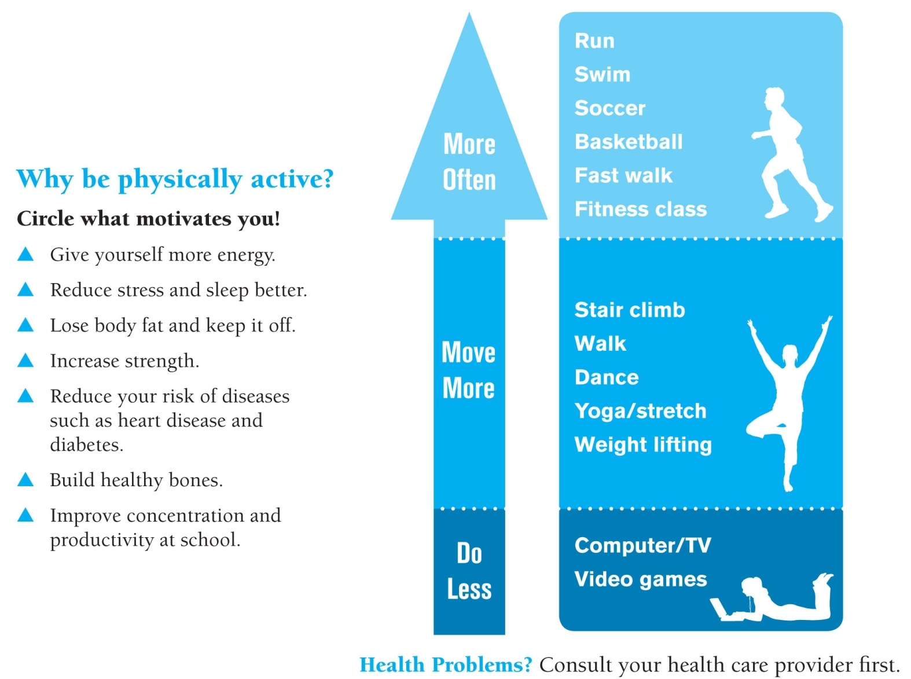
Why be physically active?
What will motivate
you?
Page 6
Notes:
Teacher Instruction
Read the slide aloud to students.
Have students circle in their workbooks what motivates them to be physically active.
Talking Points
When reviewing the slide, encourage the “more often” activities versus watching TV or going on the computer.

Slide 33
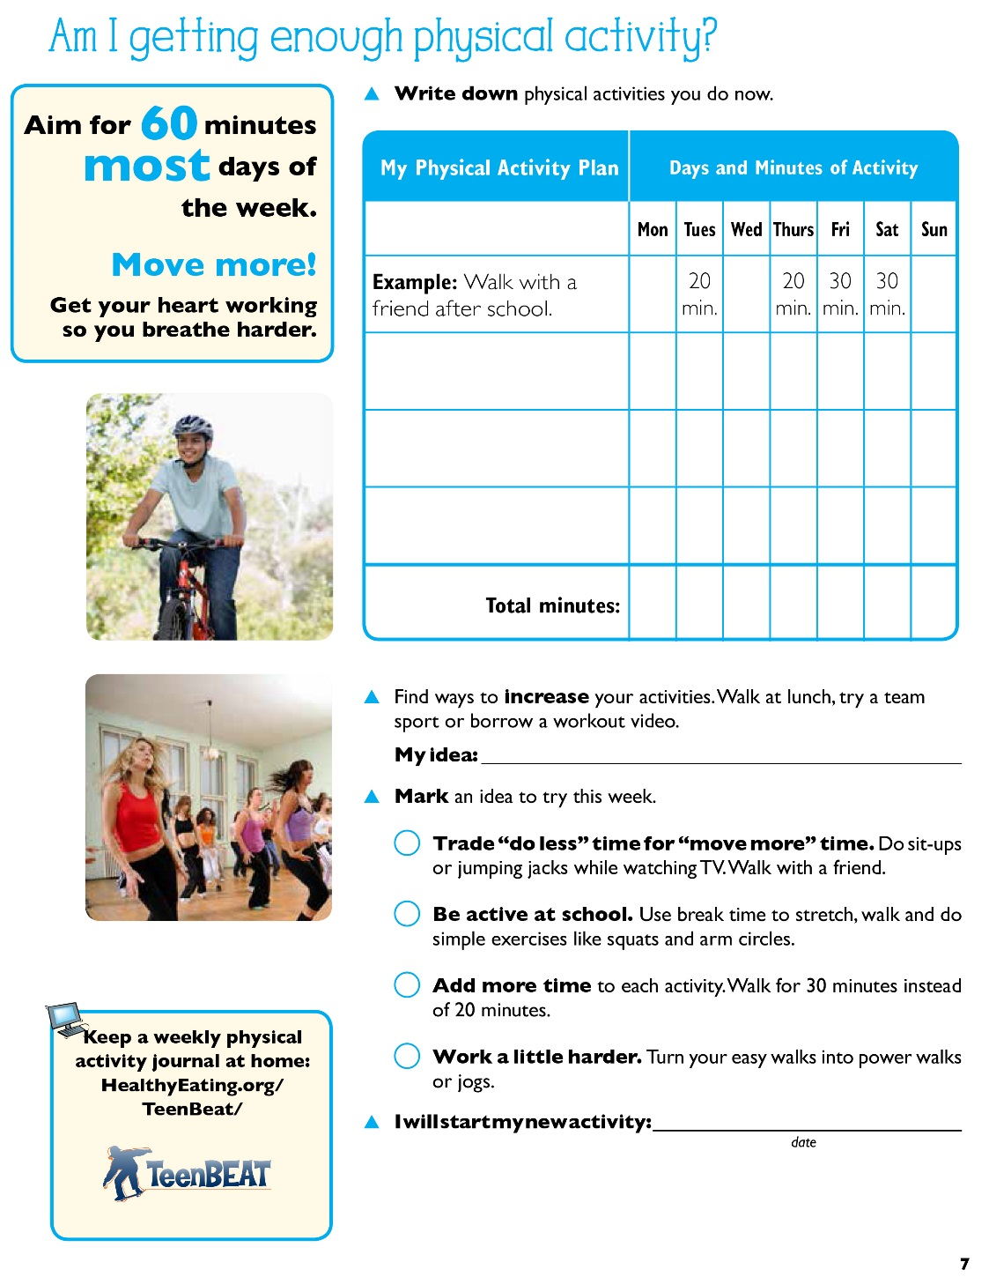
Page 7
Notes:
Teacher Instruction
Have students turn to page 7 in their student workbooks and read the page to themselves.

Slide 34
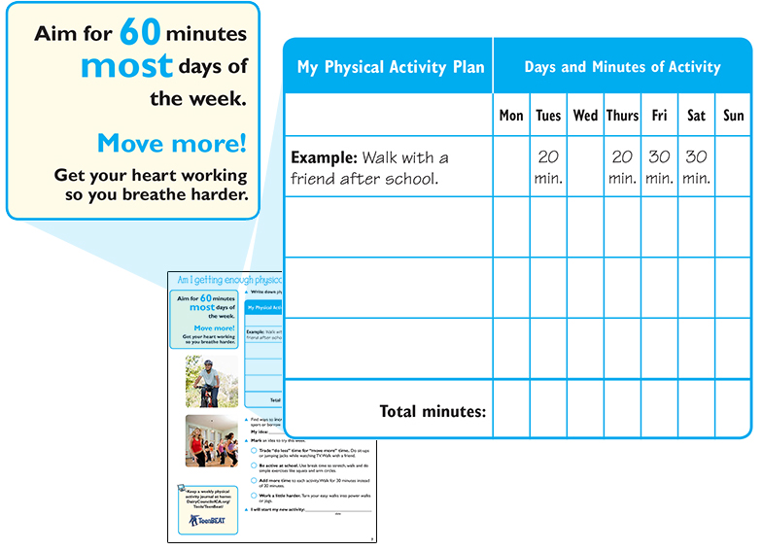
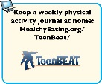
Are you getting enough physical activity?
Page 7
Notes:
Teacher Instruction
Read the slide aloud to students.
Ask students to fill out page 7.
Once students are finished filling out page 7, start a discussion on ideas they plan on trying this week.
What can you do to “move more” at school?
What can you do to “move more” at home?
What can you do to “move more” on the weekends?
Have students total their minutes to see if they have reached 60 minutes a day.
Talking Points
60 minutes of physical activity can be broken up throughout the day, it doesn’t have to be done all at once.

Slide 35
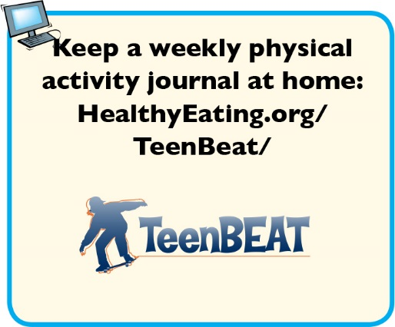
Internet Connection
Page 7
Notes:
Teacher Instruction
Encourage students to logon to this website to keep a weekly physical-activity journal. This will help them stay on track with the healthy steps they are choosing to make.

Slide 36
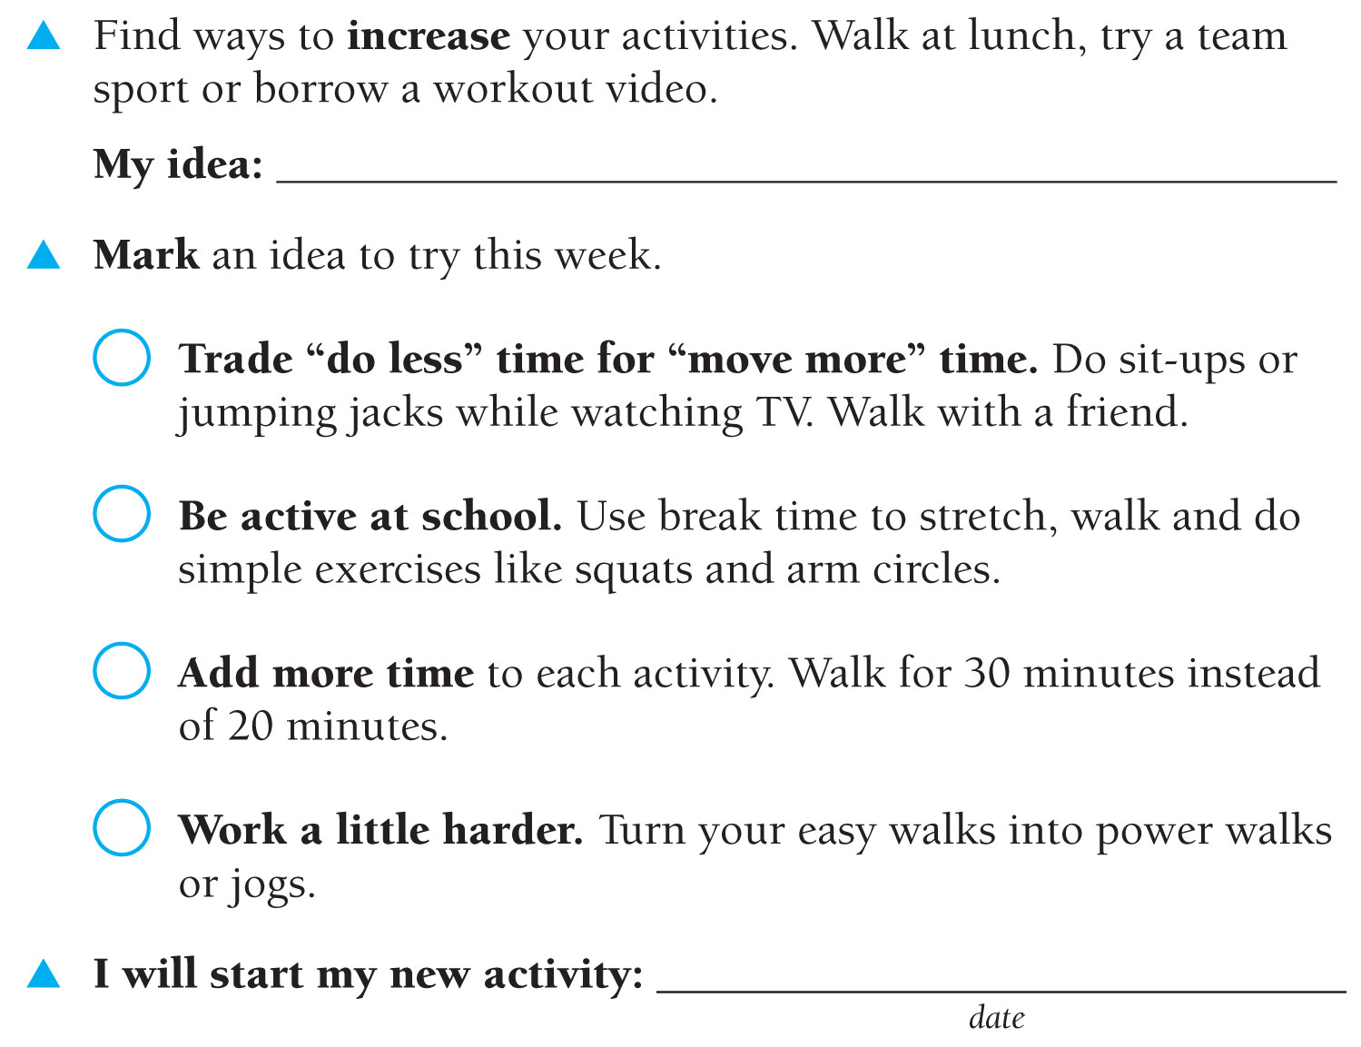
How will you increase your activity?
Page 7
Notes:
Teacher Instruction
Have students complete this page.
Ask students to share what they have planned.

Slide 37
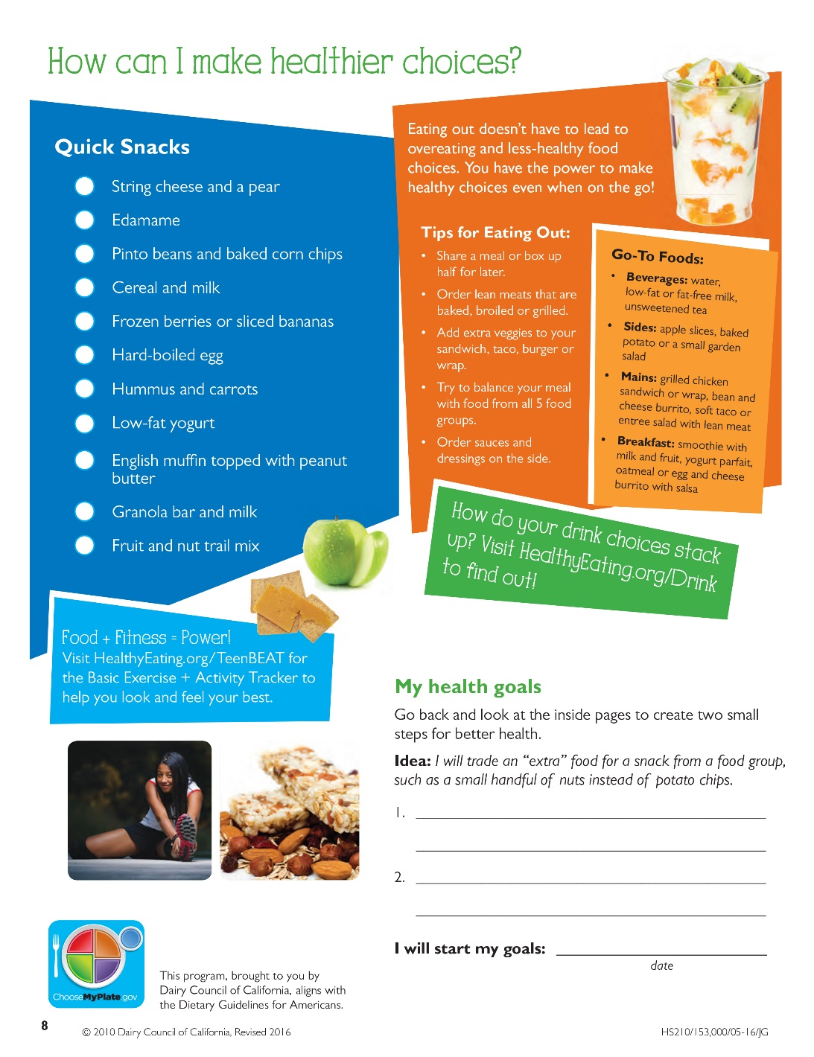
Page 8
Notes:
Teacher Instruction
Have students turn to page 8 in their student workbooks and read the page to themselves.

Slide 38
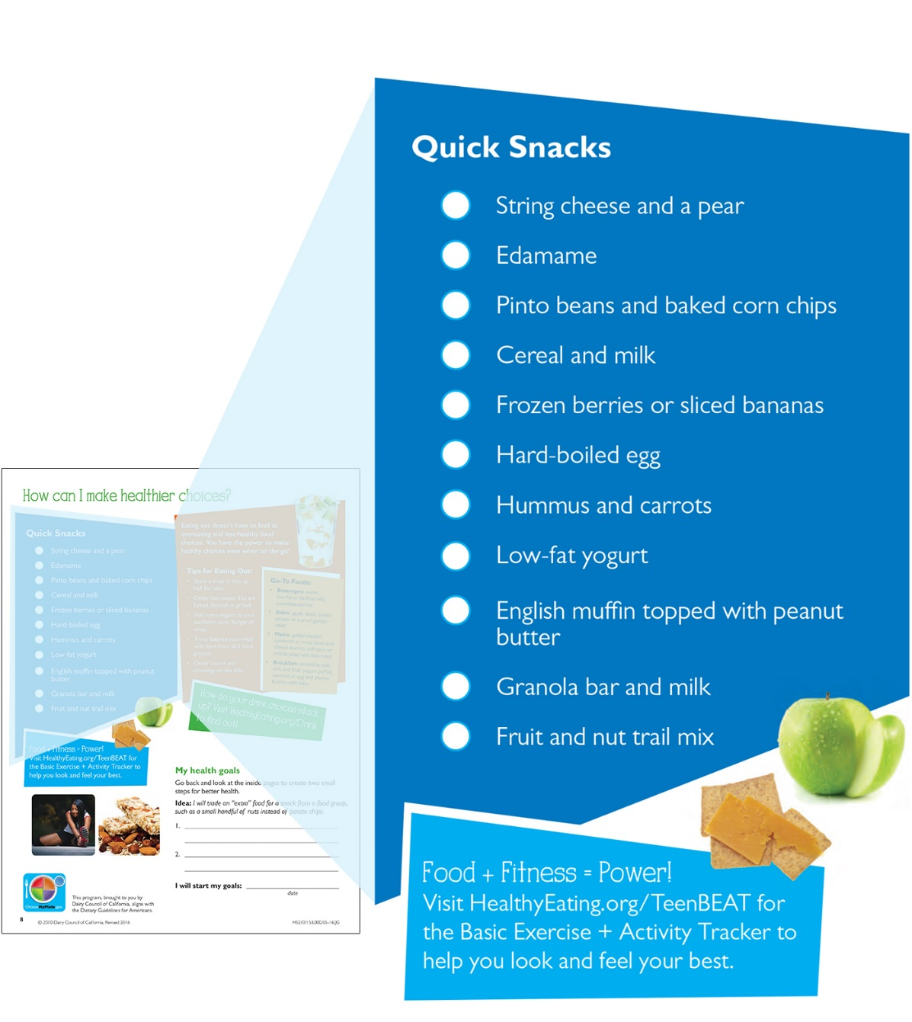
Quick Snacks
Page 8
Notes:
Teacher Instruction
Read the slide aloud to students.
Ask students to give the important points on snacking.
Ask students what they will start to incorporate into their daily snacks from the list on page 8 in their workbooks.
Ask students if they eat any of these snacks now. If not, what do they snack on now?
Talking Points
Important points on snacking include choosing snacks from the food groups, snacks help you not get too hungry and overeat at meals, put snacks on a plate or bowl so the serving size isn’t too big and be aware of what you are eating so you can enjoy what you chose.

Slide 39
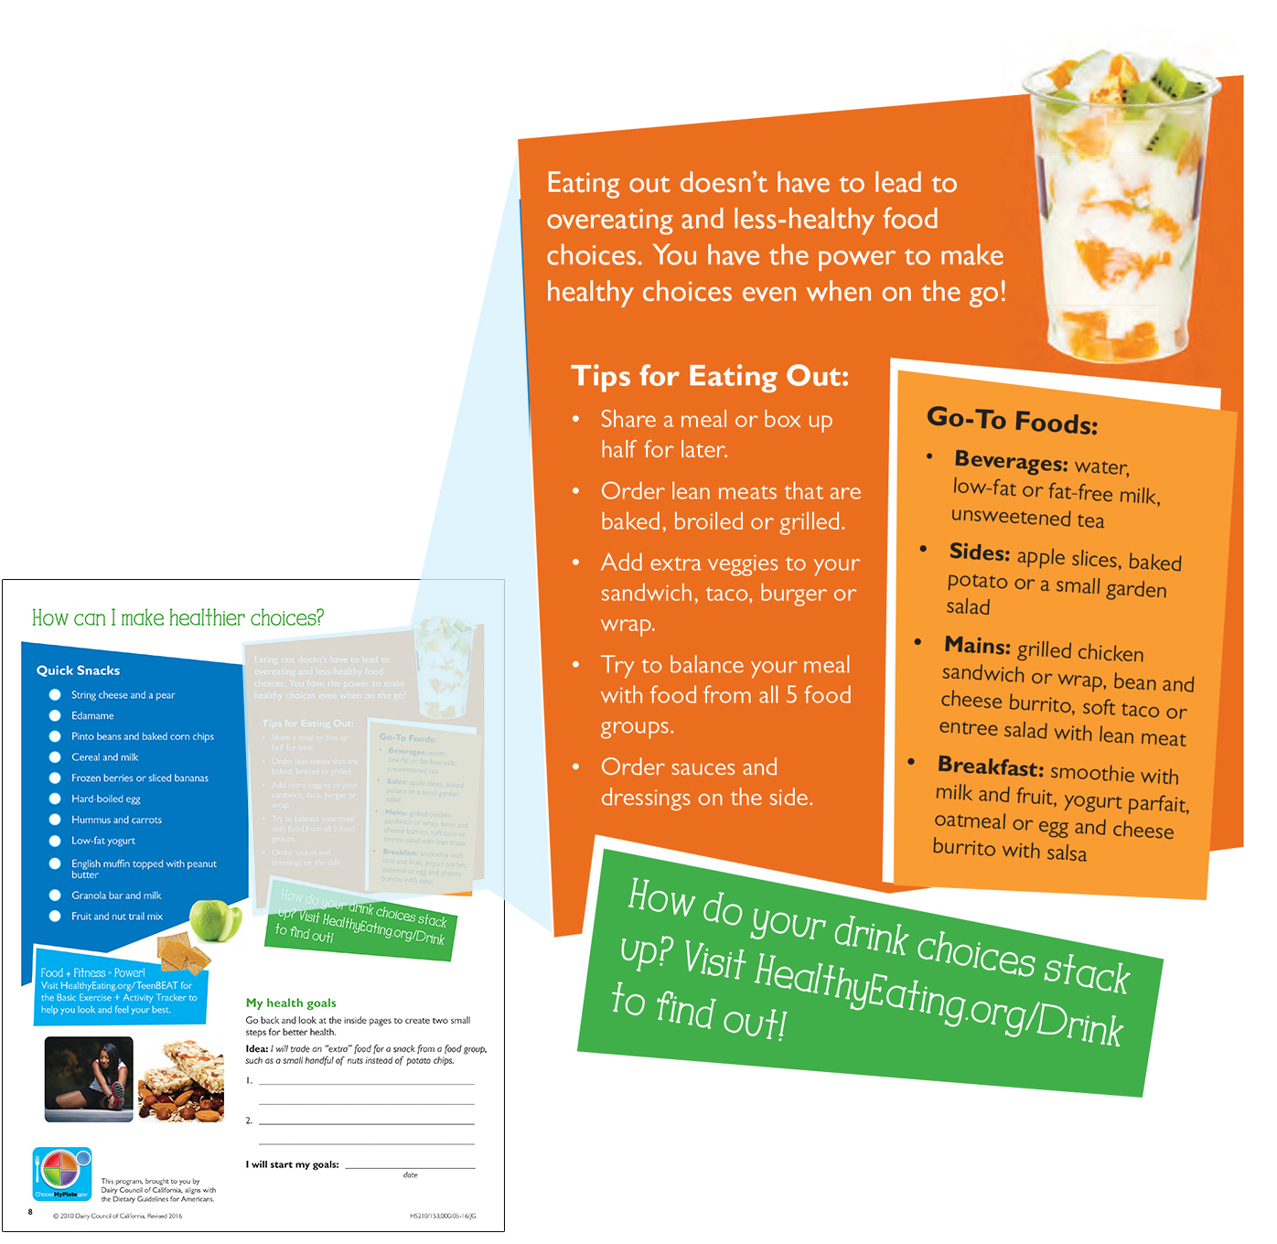
Tips for Eating Out
Page 8
Notes:
Teacher Instruction
Read the slide aloud to students.
Ask students what restaurants they go to and what they typically order.
Could they split that with a friend or family member? Is it enough food for them to eat half and take the other half home?
Talking Points
Remind students to stop halfway through the meal and check to see if they are still hungry or if they are satisfied.
Explain to students that enjoying your food and the company you are sharing it with is important.

Slide 40
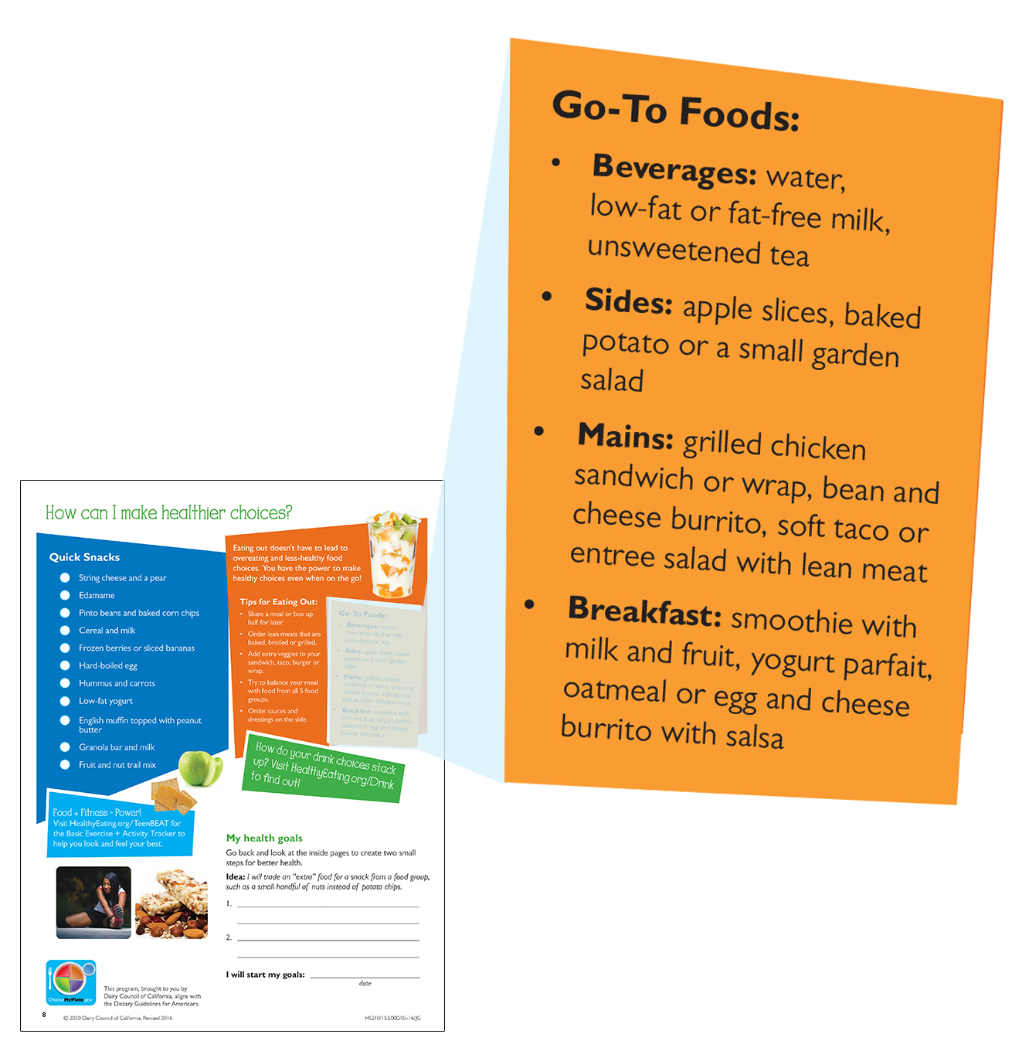
Go-To Foods: Make the nutritious choice
Page 8
Notes:
Teacher Instruction
Read the slide aloud to students.
Ask students which of these foods they could see working for them.
These are easy, simple food and beverage choices that pack a nutritional punch. These good-tasting foods are rich in nutrients and low in extra calories!

Slide 41
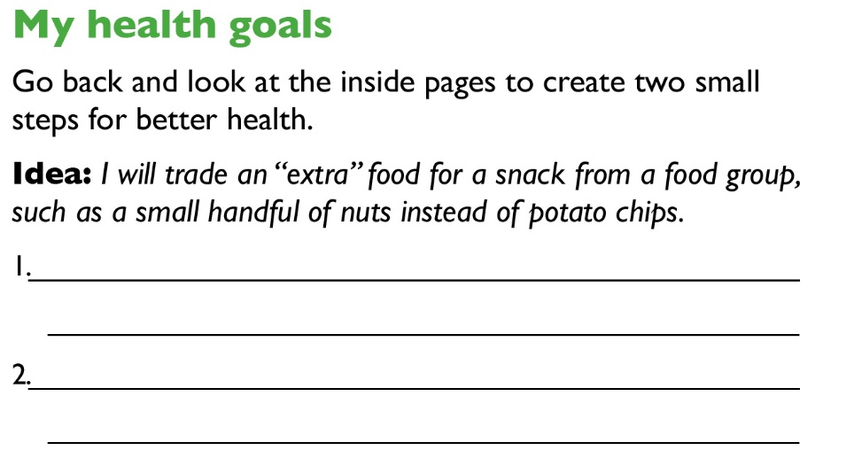
Your Health Goals
Page 8
Notes:
Teacher Instruction
Have students fill out their health goals.
Ask students to share what they have set for themselves.

Slide 42
Small Steps to a Healthier You
The self is not something ready-made, but something in continuous formation through choice of action.
— John Dewey
Notes:
Teacher Instruction
Read the quote to the students.
Ask the students what the quote means to them.
Talking Points
Explain to students that change doesn’t occur overnight, and that there may be bumps in the road, but set small goals to make them achievable.

Slide 43
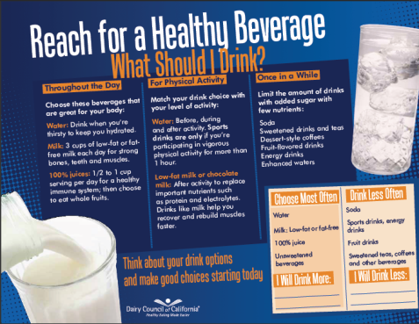
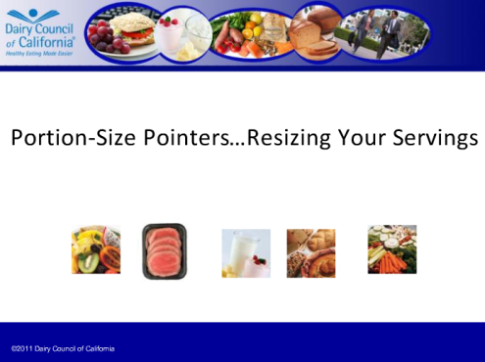

Other Tools & Resources
  “Healthy Beverages” Tip Sheet
  Portion-Size Webinar
  “Bone up on Milk” Quiz
  And more at: HealthyEating.org
Notes:
Teacher Instruction
Read slide aloud to students.

