Slide 1
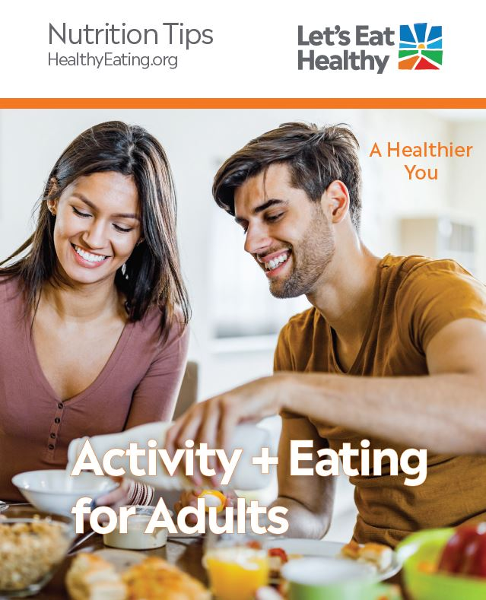
Activity + Eating
for Adults
A user-friendly presentation guide
Notes:
This presentation is designed to complement the Activity + Eating booklet, which can be downloaded as a digital file or ordered as a printed booklet at HealthyEating.org/AE.
The talking points are intended to help you in your conversations and/or group classes. We encourage you to add interactive components that allow your audience to get involved in ways that are appropriate for your setting.

Slide 2
Answer the questions on your own:
Over the last 12 months, how often are these statements true for you or your household?
We (I) worried whether our food would run out before we (I) got money to buy more.
  Often true Sometimes true Rarely True
The food that we (I) bought just didn't last and we (I) didn't have money to get more.
Often true Sometimes true Rarely True
Notes:
Teacher Instruction
Before starting a nutrition intervention, it is important to identify the context in which people are making their food decisions and help connect them to resources if they cannot get enough healthy food.
This slide provides an opportunity to screen your audience for food insecurity—meaning your audience can’t get enough healthy food.
Households are at risk of food insecurity if the response is “often true” or “sometimes true” to either or both statements. Someone may still be in need of, and qualify for, food assistance even if the response is “never true” to both statements.
For food insecurity assessment tool and resources, visit: https://www.ihs.gov/MedicalPrograms/Diabetes/HomeDocs/Resources/InstantDownloads/FoodInsecurityAssessTool.pdf
Talking Points
There’s a few important questions we should all ask ourselves before getting into a lesson about healthy eating.
I will read aloud these 2 question and I ask you to think quietly about how you would answer.
No answers will be shared as they are personal to your situation.
If you answer “often true” or “sometimes true” to either statement, accessing food may be a challenge.
There are food assistance programs to help you get healthy food. These supporting resources can help make what we’re about to talk about more achievable.
Examples: regional food banks and food pantries, or federal nutrition programs like the Supplemental Nutrition Assistance Program (SNAP); Special Supplemental Nutrition Program for Women, Infants, and Children (WIC); child care meals; school meals; afterschool snacks and meals; and summer food.
What we eat is driven by not only our individual choices, but also the environment and our individual situations.

Slide 3
Self-Reflection:
What are you currently doing to keep your body healthy?
Notes:
Teacher Instruction
Open a discussion with your students to engage them on the topic of healthy eating.
This first question is a self-reflection question to get students thinking about nutrition and physical activity.
Additionally, it will allow people to think positively about a small thing they are already doing to contribute to their health.
Encourage students to think about their answers.
Talking Points
Today we’re going to talk about some ways to keep your body healthy, including how eating and physical activity play a role in our overall well-being.
What are you doing to keep your body healthy?
[Teacher to give some examples to help start the thinking process for students. Examples could include: taking daily walks with your family, keeping healthy snacks on hand, eating breakfast regularly, cutting back on soda.]

Slide 4
Discussion:
What does healthy eating mean to you?
Notes:
Teacher Instruction
Acknowledge that there are many ways to focus on health and a variety of healthy habits one can build.
This question opens a group discussion—ask students to write the answer in the chat if using a virtual meeting platform.
Talking Points
What does healthy eating mean to you?
[After discussion]: All of the areas mentioned are important to overall wellness, but today we're going to focus on nutrition and physical activity and their role in supporting health.

Slide 5
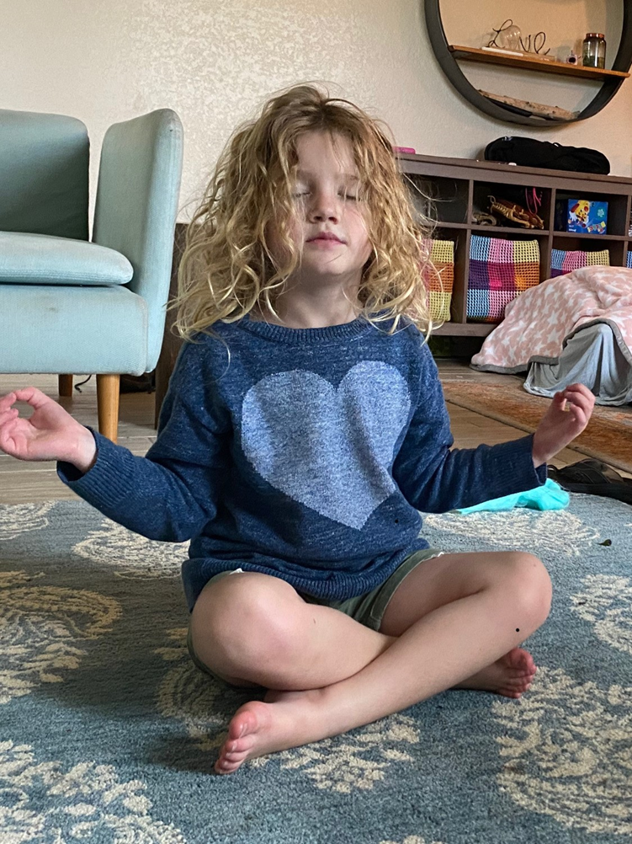
Practicing Self-Care
Self-care means paying attention to and supporting one’s own physical and mental health.
“What research tells us is that sleep, exercise, nutrition, mindfulness and a nurturing environment can reduce stress hormones and enhance the ability of the brain to recover.”
-Dr. Nadine Burke, Surgeon General of CA
Notes:
Teacher Instruction
Though not covered in the booklet, this slide transitions the audience to thinking about nutrition as a means of self-care.
Nutrition supports social, mental and emotional health as well as physical health.
Talking Points
What is self-care? In a Harvard Medical School article self-care is described as simply meaning paying attention to and supporting one’s own physical and mental health.
How does nutrition play a role in self-care? According to the surgeon general of CA, nutrition is one of the 5 important self-care strategies she recommends to cope with stress and take care of our physical and mental health which is critical during times adversity.
Self-care is something different for everyone, some of us exercise, some do meditation, some do yoga, but what we all have in common is the need to fuel our bodies every day so we can thrive and function. Research shows that the food we put in our body directly impacts what we feel physically and emotionally.

Slide 6
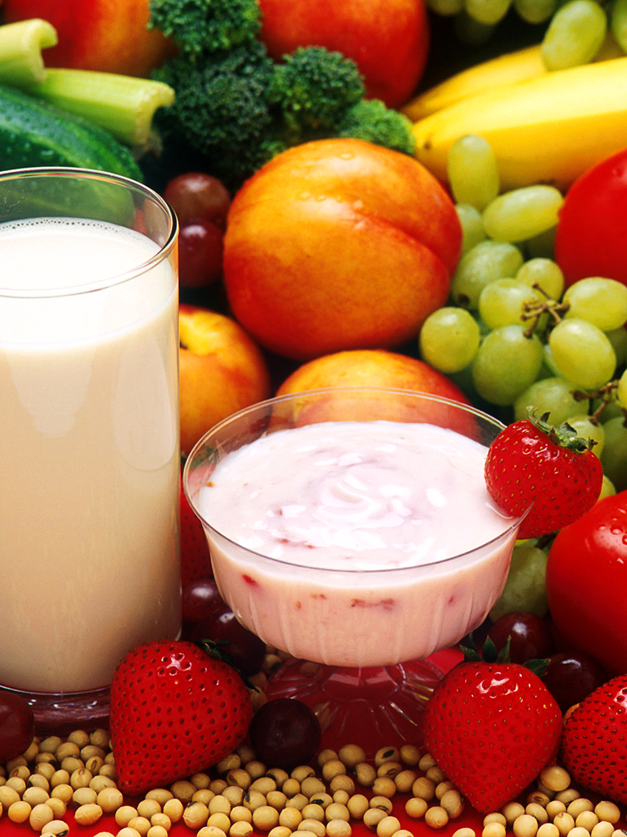
Good Nutrition is Self-Care
Nutrition plays an important role in self-care to help buffer adversity, build physical and mental resilience and improve overall health.
Wholesome foods + healthy eating patterns
support physical + mental health
2015 Dietary Guidelines Advisory Committee. Health.gov. https://health.gov/dietaryguidelines/2015-scientific-report/
Notes:
Teacher Instruction
This is an intro slide introducing the concept of healthy eating, which will be described more throughout the following slides.
Talking Points
During stressful times and seasons of life, we may not prioritize self-care. However, it is an important strategy to help navigate life’s challenges.
Research confirms that eating wholesome nutrient-rich foods (vs. heavily-processed foods) and choosing to consume a healthy eating pattern (vs. focusing on individual nutrient sources) are key components for maintaining both physical and mental health.
Today we will explore more about healthy eating and identify small steps to improve health.

Slide 7
Notes:
Teacher Instruction
Instruct the audience to reference their handout for this presentation.
Talking Points
This booklet will guide our discussion on healthy eating and physical activity.
We will do some of the activities together as a group and/or I will ask you to complete independent work.

Slide 8
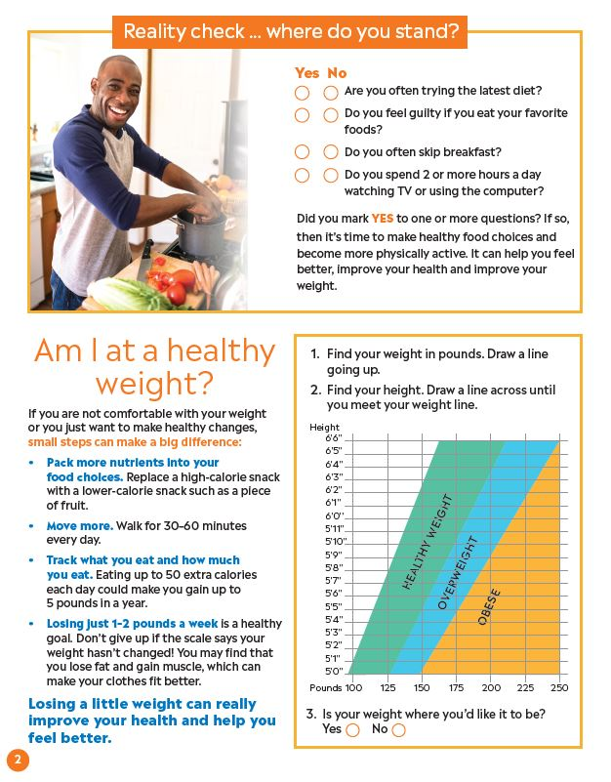
Page 2
Notes:
Teacher Instruction
Instruct the audience to turn to page 2 of the handout to begin.
Talking Points
We’ll start with page 2 as we discuss some reasons we might want to consider making nutrition and physical activity changes to improve our overall health.

Slide 9
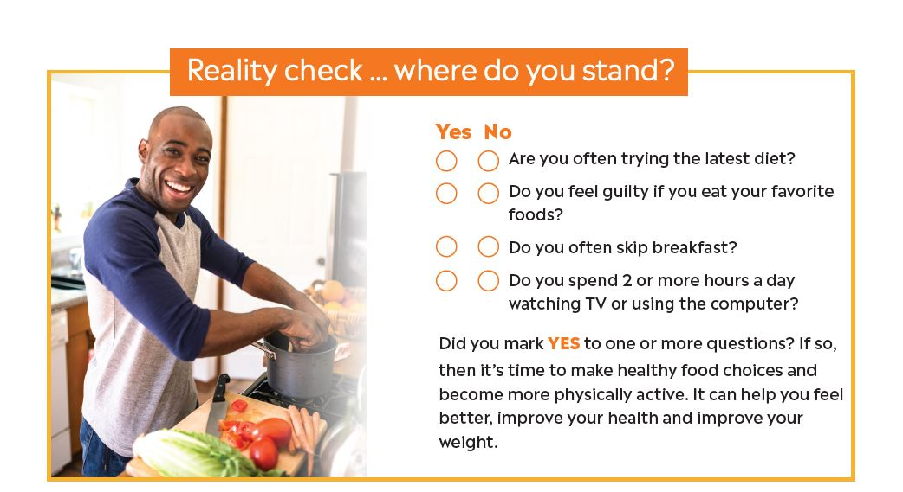
Page 2
Notes:
Teacher Instruction
Ask students to complete the “reality check” questions on their own. You may decide to read the questions aloud.
These questions are personal and the answers should be kept private so as to not create feelings of judgment.
Talking Points:
Healthy eating is a pattern of nutritious and wholesome food choices that people make over time.
Healthy eating is personal and how one person arrives at their healthy eating journey may be different from another.
Consider your own habits, barriers and goals related to health as we go through the following topics.
If you marked “yes” to one or more of these questions, you may feel ready to make healthy changes and become more physically active.
Making healthy lifestyle changes not only helps to improve your health and weight, but can help you feel better and improve sleep too.

Slide 10
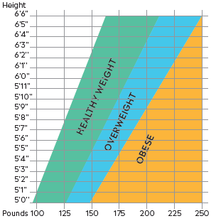
Am I at a Healthy Weight?
Weight is only one indicator of health, but it can be a useful tool in determining if we need to make changes.
Small changes that can make a big difference in improving overall health include:
    Eating wholesome foods
    Moving more
    Prioritizing self-care and well-being
Page 2
Notes:
Teacher Instruction
Weight is a complex and sensitive issue, and conversations about weight can be challenging.
Activities focused on weight are personal and should be kept private through independent work.
Talk the students through using the graph to determine if they are at a healthy weight.
If not in a healthy weight range, it is best to focus on lifestyle factors over the weight number.
Often food insecurity is linked to overweight and obesity. Use discretion to guide the learner to identify their own challenges, goals and solutions. Link to meal programs when needed.
Talking Points
Keep in mind that while weight is one indicator of health, overall eating patterns and lifestyle factors are also important for health.
A person’s weight is a result of many factors including predisposition, availability of wholesome food choices, quality of the regular eating pattern, sleep, and more. It is complex and challenging.
What does my weight category tell me about my health? Excess weight can be unhealthy for you and strain your body, making it work harder than it needs to work. Excess weight also increases your risk for diabetes, heart disease, high blood pressure, stroke, and cancer. It can impact your quality of life by impacting your mood, energy and ability to be physically active.
The graphic is a tool to help you know if you’re at what is considered to be a healthy weight.
To figure this out, use the chart in your booklet (also shown on the presentation screen):
Find your weight in pounds along the bottom of the graph and draw a line going up.
Next, find your height along the left side of the graph and draw a line across until you meet your weight line.
Note to yourself which weight category you fall into.
If you feel that you’re ready to make healthy changes in your life, choose one small change you want to make. Some examples:
Focus on eating foods that are wholesome and nutritious.
An example is replacing a highly processed snack (like chips and soda) with one that is less processed (like apples and cheese).
Engaging in healthy eating patterns support long-term health, well-being and reduced risk of chronic diseases.
Move more.
All movement throughout the day counts, with a goal of moving for 30-60 minutes per day.
An example is taking a walk instead of sitting while you’re on the phone.
Take care of yourself: Focus on mental well-being.
Anxiety, stress and lack of sleep can influence your health and weight.
Identify one small act of self-care you can take (like deep breathing for 30 seconds or going to bed 15 minutes earlier).
If your weight doesn’t fall within a health weight range, losing even a little bit of weight can help improve your energy, health and mood.
It may surprise you to find out that a healthy weight loss goal is to lose just 1-2 pounds per week.
We’ll explore more about healthy eating and physical activity.

Slide 11
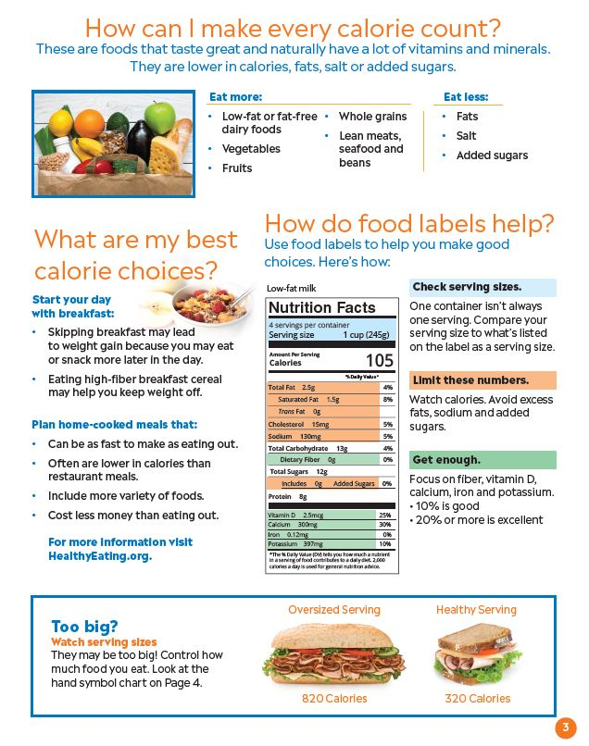
Page 3
Notes:
Teacher Instruction
Instruct the audience to turn to page 3 of the booklet.
Talking Points
We’ll now move on to page 3 of the booklet where we’ll talk about choosing foods that have a lot of nutrients for not a lot of calories.

Slide 12
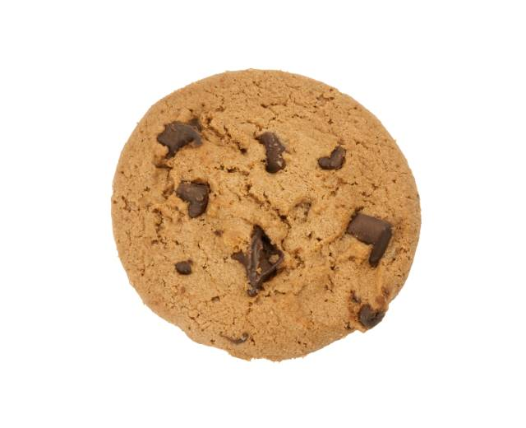
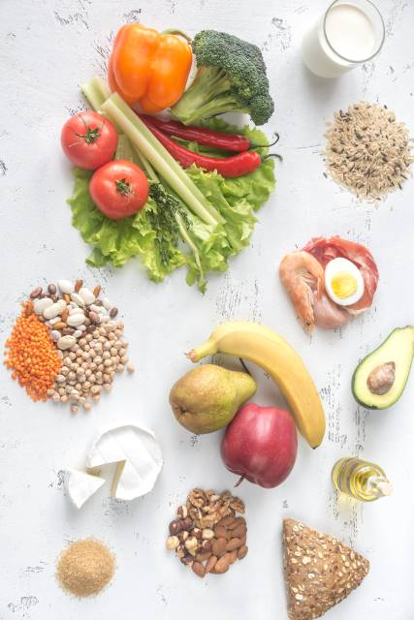

Focus on Food Quality
Eat More
Eat Fewer
Refined starches
Added sugars
Processed meats
Other highly processed foods
Whole and minimally processed foods
Milk, cheese, yogurt
Vegetables
Fruits
Whole grains
Lean meats, seafood, bean and nuts
Page 3
Notes:
Teacher Instruction
This slide will help teach students about diet quality - choosing foods that are higher in nutrients.
You may review or show this 2-minute video on diet quality: https://www.youtube.com/watch?v=SVa0D81yalo&t=5s
To read more about how to define healthy eating: https://www.healthyeating.org/our-cause/nutrition-philosophy
Talking Points
A healthy eating pattern can include a variety of nutritious foods that meet your personal values, preferences and cultural needs.
Overall quality of your eating patterns matter more than just looking at calories or single nutrients alone.
There are many food options that naturally have a lot of healthy vitamins and minerals. These foods also tend to be lower in calories, fats, salt or added sugars.
You can improve the quality of your eating pattern by including a variety of foods from each of the food groups listed on the “eat more” portion of this slide. It’s an easy way to know that you’re eating nutrient-rich foods.
Each of these foods contain important nutrients that work together to promote overall health.
On the other hand, foods that have a lot of calories but not very many important nutrients should be eaten less often.
This doesn’t mean that you have to avoid these types of foods completely, but your focus should be on creating patterns of nutritious food choices.
Whether eating at home or at a restaurant, being intentional about the foods and drinks you choose is a way to help improve the quality of your eating pattern.
All food and beverage choices matter.

Slide 13
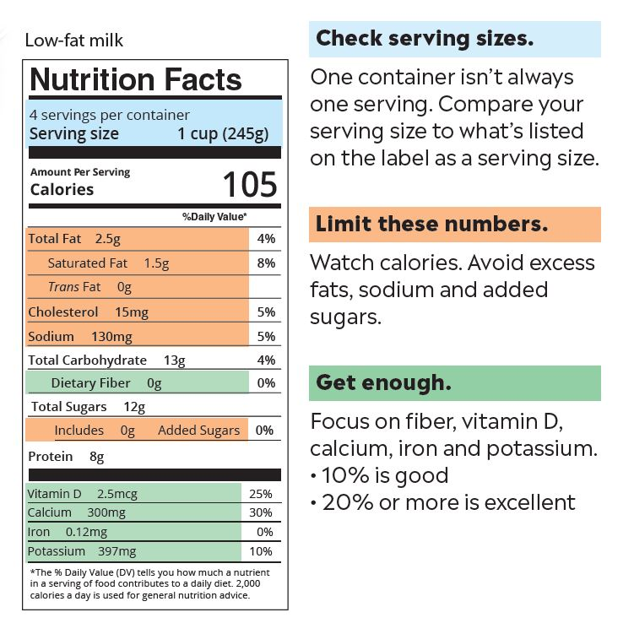
Food Labels Help Guide Choices
Page 3
Notes:
Teacher Instruction
Instruct students to reference the example food label on their handout to learn how food labels can help guide healthy eating.
Talking Points
Think about how often you use a food label to help you decide whether to buy or eat a certain food.
Food labels are a tool that can help you choose high quality foods. Keep in mind that fruit, vegetables and lean meats do not require a nutrition label but are nutrient-rich types of food.
The label may look overwhelming at first glance, but we’re going to walk through the most important pieces to pay attention to.
The first thing you always want to do is to check the serving size, which is noted at the very top of the label.
In your handout you’ll see a nutrition label for low-fat milk, and you’ll see the serving size is 1 cup.
The rest of the information on the nutrition label applies to drinking 1 cup of milk from the container.
If you were to drink more than 1 cup of milk, you’ll need to adjust the nutrition facts information accordingly. For example, if you drink 2 cups of milk, you’ll need to multiply the nutrition facts by 2, because you will have consumed 2 servings of the milk.
To find out how many servings are in the whole container, you’ll see the servings per container listed just above the servings size. This milk container has 4 servings. It’s important to pay attention to serving size and number of servings per container especially in snacks and beverages. A snack-sized package of chips, for instance, may appear to be a single serving, but may actually be 2 or more servings if you look at the nutrition label.
The items in orange are areas to limit, especially if there are no other nutrients in the food or drink. Food choices that are high in calories, fat, sodium and added sugars without other nutrients are lower quality food choices.
Look for foods that have fiber, vitamin D, calcium, iron and potassium (the items in green). If any of these nutrients is listed at 10% or greater it means the food is at least a good source of that nutrient.
Under the Daily Value column on the right side of the label, any nutrient listed as 10% is considered good; anything listed at 20% or more is excellent.
While food labels are important to read, they don't necessarily convey all the information about a foods healthfulness. For example, a label doesn't always differentiate between nutrients naturally present in a food or those added. And it also doesn't provide information on how nutrients in the food may or may not work together to promote health in our bodies. That is why the food label is an important tool, but not the only tool in making healthy eating choices.

Slide 14

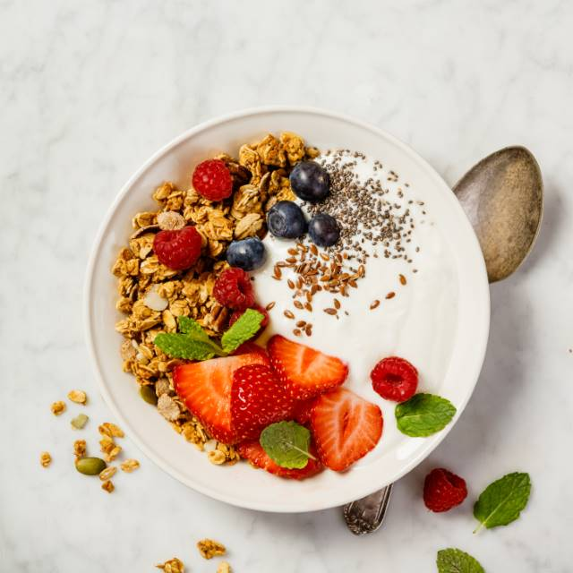
Start Your Day with Breakfast
Eating a nutritious breakfast can have a positive impact on:
  Weight loss + maintenance
  Overall quality of eating patterns
  Attention + focus
Sources:
Smith KJ et al. Am J Clin Nutr, 2010
CDC, 2014
Page 3
Notes:
Teacher Instruction
Review with students the importance of eating a healthy breakfast, and the benefits on weight, quality of the overall eating pattern, and overall health that can result from eating a healthy breakfast daily.
Talking Points
Starting each day with breakfast is a healthy habit that can have a positive impact on weight loss, weight maintenance, overall diet quality and ability to pay attention.
A healthy breakfast includes foods from a variety of food groups, for example whole grains, fruit and dairy as seen in the picture of the yogurt parfait on this slide.
Research suggests that adults who eat breakfast, especially breakfast that includes whole grains, cereals, lower-fat milk, and whole fruit or 100% fruit juice, have better diet quality and weight status compared with those who skip breakfast.
Good diet quality means that you are getting a wide variety of nutritious foods that provide a mix of nutrients needed for overall health.
Poor quality diets are actually linked to serious, chronic disease that results in about 11 million deaths per year.
Studies suggest that eating breakfast may help to better control overall hunger compared to people who skip breakfast, especially if the breakfast contains at least 350 calories and is high in protein.
Skipping breakfast is actually linked to negative effects on weight, heart health and overall unhealthy lifestyle behaviors. It can often lead to weight gain because you may snack or eat more later in the day to make up for missing breakfast.

Slide 15
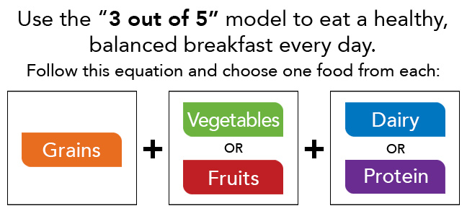
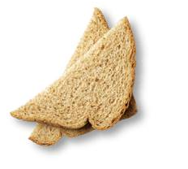
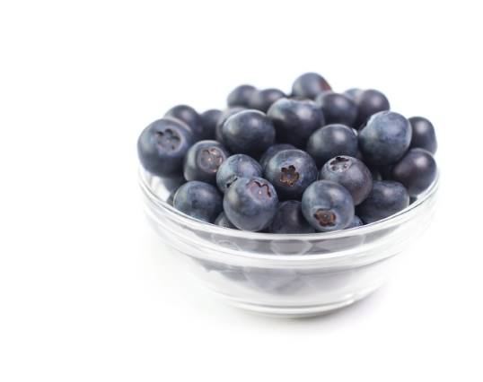
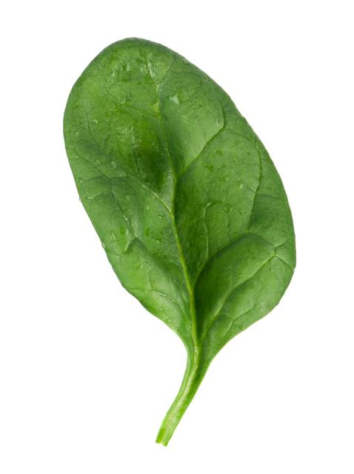
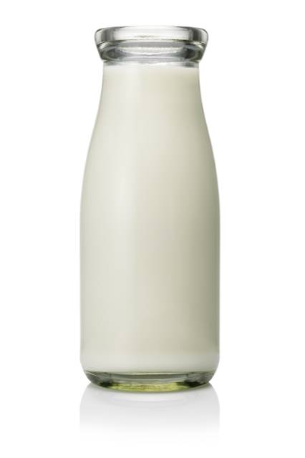
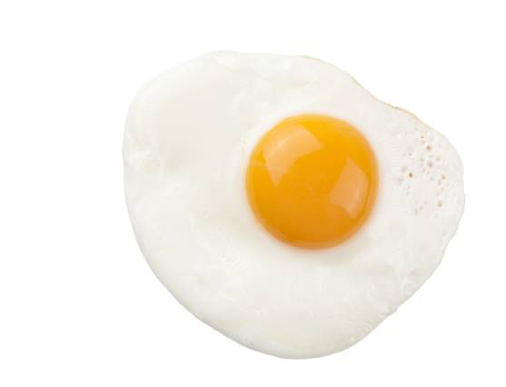
What Makes a Healthy Breakfast?
Page 3
Notes:
Teacher Instruction
The “3 out of 5” model is a tool to help make meal planning easier.
Ask the students to give examples of breakfast using the “3 out of 5” model or to think about their favorite breakfast and identify if it follows this model.
Talking Points
A helpful tool to build a healthy breakfast is the “3 out of 5” model—pick foods from 3 of the 5 food groups.
This will ensure that you’re getting a variety of important nutrients needed for overall health that will also help to keep you full and satisfied until your next meal or snack.
For example, you might choose whole wheat toast, scrambled eggs and a glass of milk.
This breakfast includes foods from the grains, protein and dairy groups, and provides nutrients including calcium, vitamin D, B-vitamins, fiber and protein.
Can you think of some other examples of healthy breakfasts by choosing foods from 3 of the 5 food groups? Write your answers in the chat box.

Slide 16
What keeps you from eating a healthy breakfast?
Notes:
Teacher Instruction
Help students identify their barriers to eating a healthy breakfast
This could be an opportunity to poll the class virtually or have students think independently.
Provide them suggestions like:
Foods from the food groups are not available to me
Waking up too late
Not knowing what to eat
Not hungry for breakfast
Talking Points
Ask: What keeps you from eating a healthy breakfast?

Slide 17

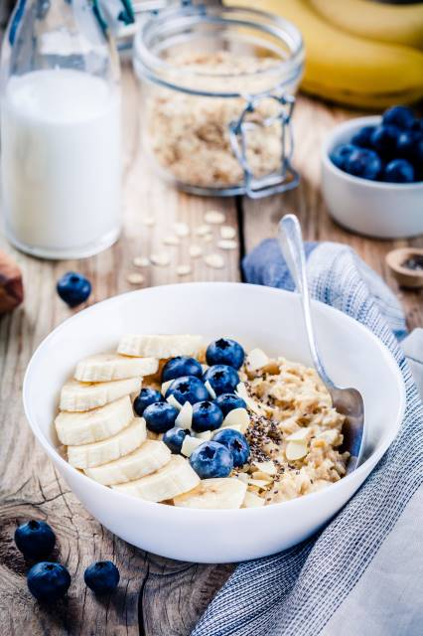
Breakfast Ideas
These sample meals can be prepared in less than 3 minutes and contain 3 of the 5 food-group foods:
  Bagel with light cream cheese or peanut butter and orange juice
  Cereal with low-fat milk and banana
  English muffin with melted cheese and a sliced pear
  Low-fat yogurt topped with almonds and an apple
Page 3
Notes:
Teacher Instruction
There may be other barriers to a healthy breakfast besides time. If time or ideas for healthy breakfasts are the barriers, reading through the examples on the slide can be a helpful tool.
If your audience struggles with food insecurity, you may want to talk about food access locations and how they can support breakfast.
Talking Points
One possible reason for skipping breakfast is being too busy in the morning to cook or sit down for a meal.
The breakfast ideas listed on this slide can be made in 3 minutes or less, and most can also be taken with you and eaten on the go.
Each of these breakfasts also include foods from 3 of the 5 food groups.
[Read through breakfast examples listed on the slide.]
Independently, think about how likely you are to eat one of these breakfasts.
Ask: what are some of your favorite breakfasts?
Ask: what is one small step you could take to improve your breakfast? Write it down privately or share in the chat if you’re comfortable.

Slide 18
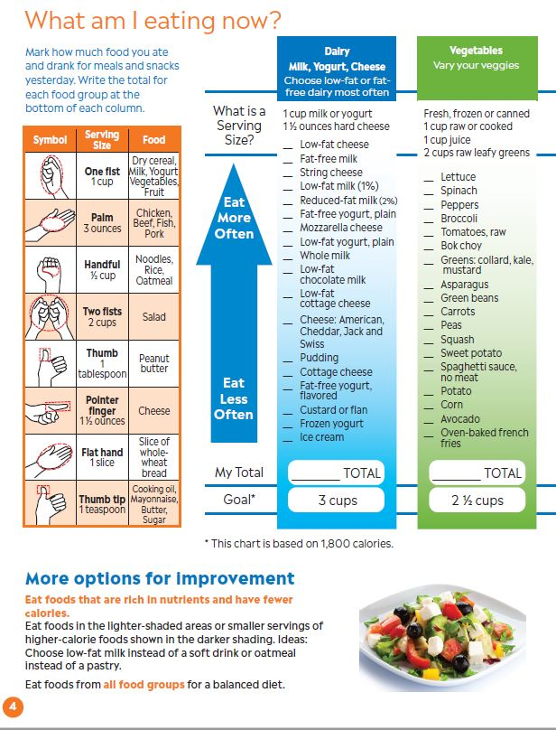
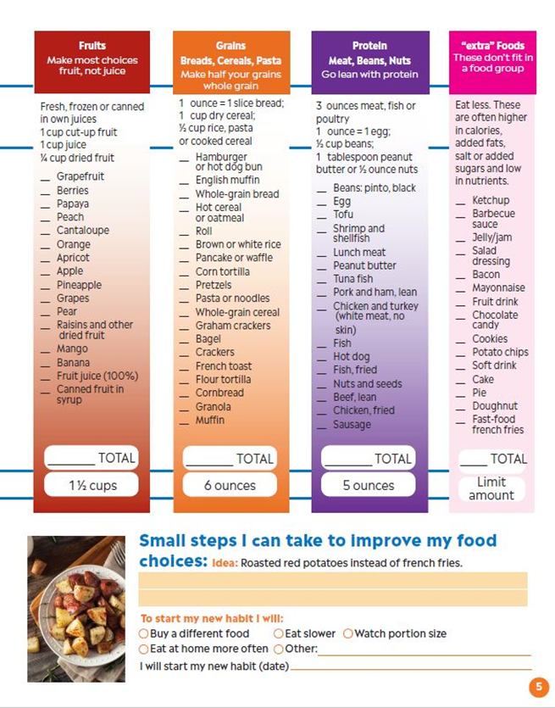
Page 4 + 5
Notes:
Teacher Instruction
Ask students to reference pages 4 & 5 from the handout for the next section of the presentation.
Talking Points
Next, we’ll cover pages 4 & 5 in your handout.
We’ll take a closer look at the recommendations for healthy eating and see how our current eating habits compare.

Slide 19
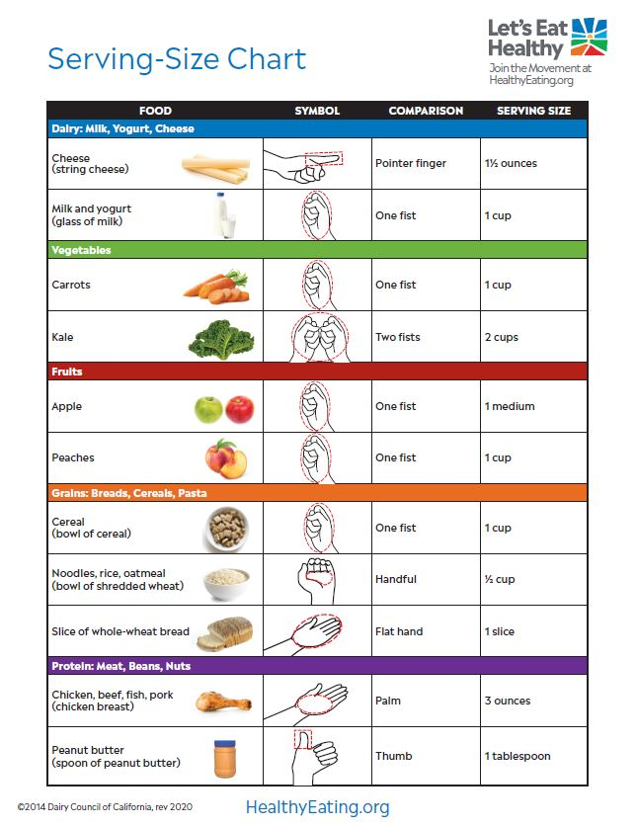
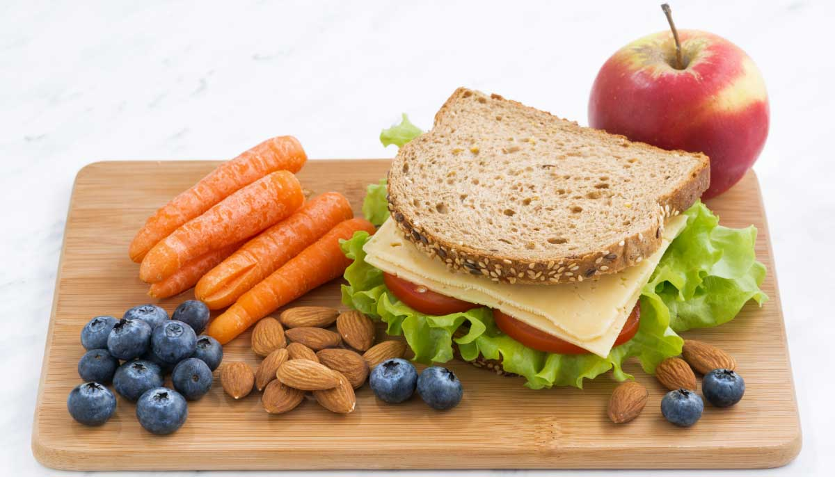
It’s All In Your Hands
Use this chart to estimate your serving size.
Page 4
Notes:
Teacher Instruction
Read the slide aloud to students. They can reference the chart in their booklet.
Talking Points
Explain to students that most foods can be measured using hands as measuring symbols.
Ask students why it would benefit them to use their hand to check serving sizes before they ate the food. Answer: using a visual estimate can help us to keep track of our food portions without having to weigh or measure what we are eating.
Ask students to show using their hands what the serving size of a cup of milk is. Answer is a fist.
Ask students to show using their hands what the serving size of a slice of bread is. Answer is a flat hand.
Continue with as many examples as time allows or if the class needs more practice.
Keeping track of how many servings we eat from the different food groups each day helps us to see if we are getting enough of the foods that are recommended.

Slide 20
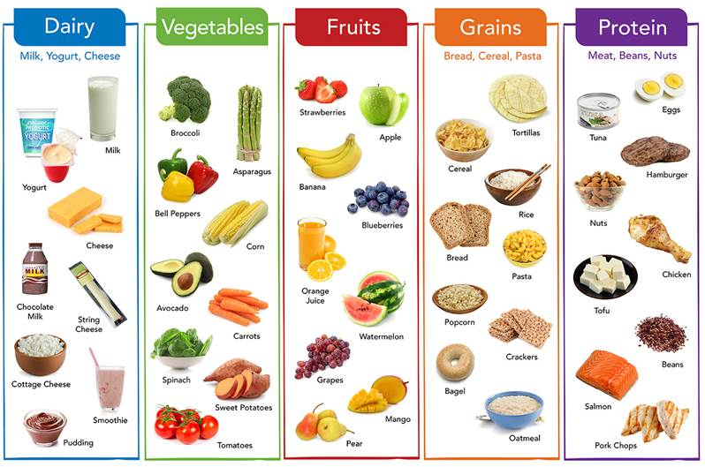
What am I eating now?
Page 4 + 5
Notes:
Teacher Instruction
Walk students through estimating their food and beverage intake from the previous day using the chart on pages 4 & 5 in their handout.
Students can keep the results private.
Give students 5-10 minutes to work on completing these pages in their handout.
Talking Points
All five food groups are important and contribute to a healthy diet quality.
This means there is flexibility in building an eating style that works for your needs–through moderation, variety and balance- and to enjoy foods and eat well.
Unfortunately, the majority of Americans do not eat the recommended amounts of each food group.
Specifically, Americans are typically not eating enough foods from the dairy, fruit and vegetable groups.
You can use the charts on pages 4 & 5 of your handout to see how your own usual diet compares to the healthy eating recommendations. Use the hand symbols to estimate your portion sizes as you think through what you ate yesterday, including all meals and snacks. Compare what you ate to the goals for each food group listed at the bottom of the chart.
[Give students time to complete the exercise on their own.]
[After students complete the exercise:]
Self-reflection: What did you notice about your own eating habits compared to the recommendations? It’s not uncommon to have more or less than recommended in certain food groups.
It can be hard to make changes to how we eat, but we’ll talk through some small steps on the next slide that can be helpful if you’re feeling overwhelmed.

Slide 21

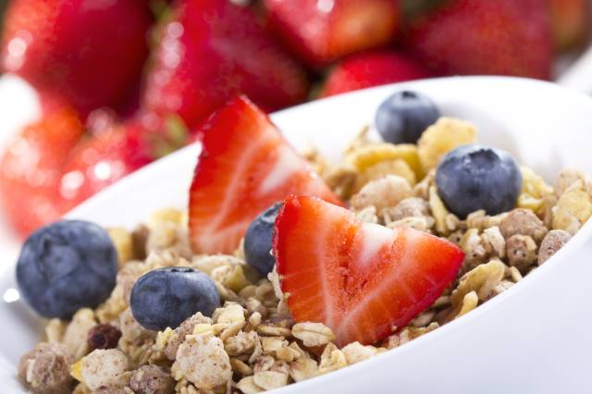

Trade Up!
Eat foods that are nutrient-rich and have fewer calories. Choose:
  Low-fat milk instead of soda
  Oatmeal or whole grain cereal in place of a pastry
  Baked chicken instead of fried chicken
Eat foods from all food groups for a balanced diet.
Page 4
Notes:
Teacher Instruction
Discuss additional ways to improve diet quality within the different food groups.
Talking Points
Eating a variety of foods from the five food groups will ensure that you are building a healthy eating pattern.
In the previous section, we talked about the quality of foods and the importance of eating foods that are rich in nutrients and have fewer calories.
Some examples of food swaps that deliver more nutrients for fewer calories are included on this slide.
These include choosing milk instead of soda, oatmeal or whole grain cereal instead of a pastry and baked chicken instead of fried chicken.

Slide 22
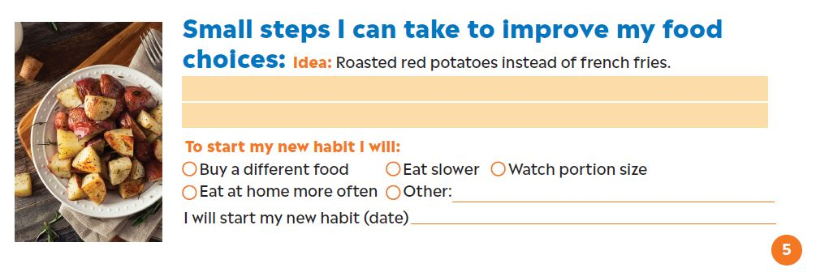
Small Steps Lead to Big Change
Page 5
Notes:
Teacher Instruction
Guide students to recognize that healthy eating changes start with small steps.
Encourage them to think through their own personal barriers to healthy eating, and to set a small but achievable healthy eating goal.
Ask students to share ideas in the chat box.
Talking Points
Instead of trying to change everything all at once, think about one small change you can make to improve your eating habits today.
Daily eating habits are what make up your eating pattern.
It’s more important to your overall health to focus on your eating habits as a whole, rather than to dwell on one particular food or meal.
What barriers do you encounter when you’re trying to eat healthy?
What is one small, achievable goal you can set for yourself?
It could be to try and eat one more serving of dairy or fruit each day if you’re not getting enough of one of those food groups.
Or it could be trying a new vegetable each week to increase variety in your diet.
[Ask students to share ideas in the chat box of a small change they would like to make to their diet.}
Change is never easy, but if you focus on putting small steps into action it will build healthy habits over time.

Slide 23
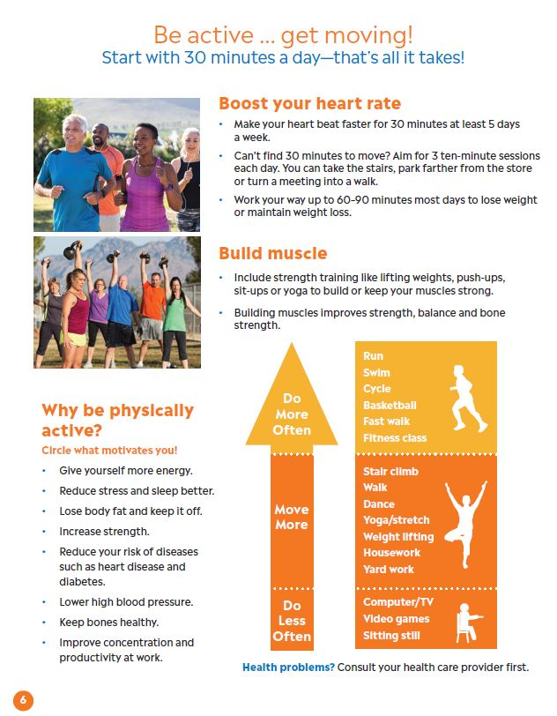
Page 3
Notes:
Teacher Instruction
Ask students to reference page 6 from the handout for the next section of the presentation.
Talking Points
Healthy eating is one important component to overall health.
In this next section we’ll talk about the importance of physical activity for health.

Slide 24
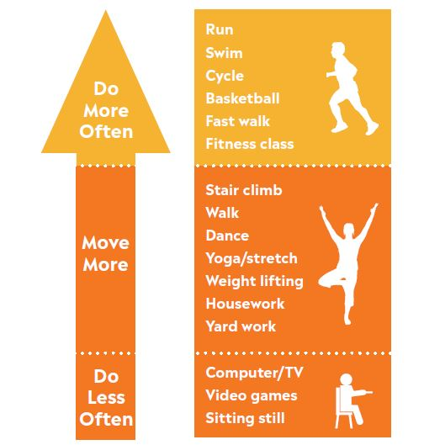
Benefits of Physical Activity
Improved energy
Less stress and better sleep
Weight loss and maintenance
Increased strength
Reduced risk of diseases
Lower blood pressure
Keep bones healthy
Improved concentration and productivity
Page 6
Notes:
Teacher Instruction
Discuss the benefits of physical activity and encourage students to think through their own motivations for being physically active.
Talking Points
Physical activity leads to many benefits, including improved health, mood and energy.
Think about this list of benefits and circle on your handout the ones that motivate you to be physically active.

Slide 25


Be active for 30 minutes a day!
No time to exercise? Try these options:
  Three 10-minute sessions daily
  Take the stairs
  Walking meeting
  Ride your bike instead of driving
  Stretch break
For weight loss, work your way up 60-90 minutes of exercise each day.
Page 6
Notes:
Teacher Instruction
Share the goal of 30 minutes of activity/day with students and discuss creative ways to get moving when you’re short on time.
Guide students through a short physical activity break.
Talking Points
30 minutes a day is all you need to be physically active.
You can even break it up into smaller segments throughout the day if it’s easier to find 3 blocks of 10 minutes each, rather than one block of 30 minutes.
Think about ways that you can add more movement into your day within your normal schedule. Take the stairs instead of the elevator, or have a walking meeting while talking to a coworker—all these activities add up and count as physical activity.
For weight loss, your goal should be 60-90 minutes of exercise each day.
We’re going to take a short physical activity break now together.
[Teacher can guide students through a series of stretches and movements, show a brief video like this one, a 5-minute office yoga break: https://www.youtube.com/watch?v=6fnLKyRJsrs or short brain break exercises: https://www.youtube.com/playlist?list=PLjFF28kApSw6OsZuGRfvnUabXobbYYbpK]

Slide 26
Boost Your Heart Rate
Easy
Can talk normally
(e.g., slow walking)
Heart pumping faster, a little hard to talk (e.g., fast walking)
Heart pumping very fast and difficult to talk (e.g., running)
Moderate
Challenging
Page 6
Notes:
Teacher Instruction
Discuss different ways to boost your heart rate from easy activities to more challenging forms of exercise.
Encourage students to share ideas.
Talking Points
Physical activity causes your heart to beat faster, which strengthens your heart and burns calories.
Vary your activities to get your heart to reach each of these levels throughout the week.
[Read slide aloud to students.]
What are some examples of activities that you already do in these different levels? Write your answers in the chat box.

Slide 27

Build Muscle
Include strength training like lifting weights, push-ups, sit-ups or yoga to build or keep your muscles strong.
Building muscles improves strength, balance and bone health.
Page 6
Notes:
Teacher Instruction
Discuss the importance of strength training with students.
Talking Points
As we age we naturally lose muscle mass, which makes it important to include strength training as part of your regular exercise routine.
Building muscle helps to improve strength, balance and bone density, and can also help with weight maintenance.
Lifting weights, using your body weight for exercises like sit-ups and push-ups, and even yoga can count as strength training.

Slide 28
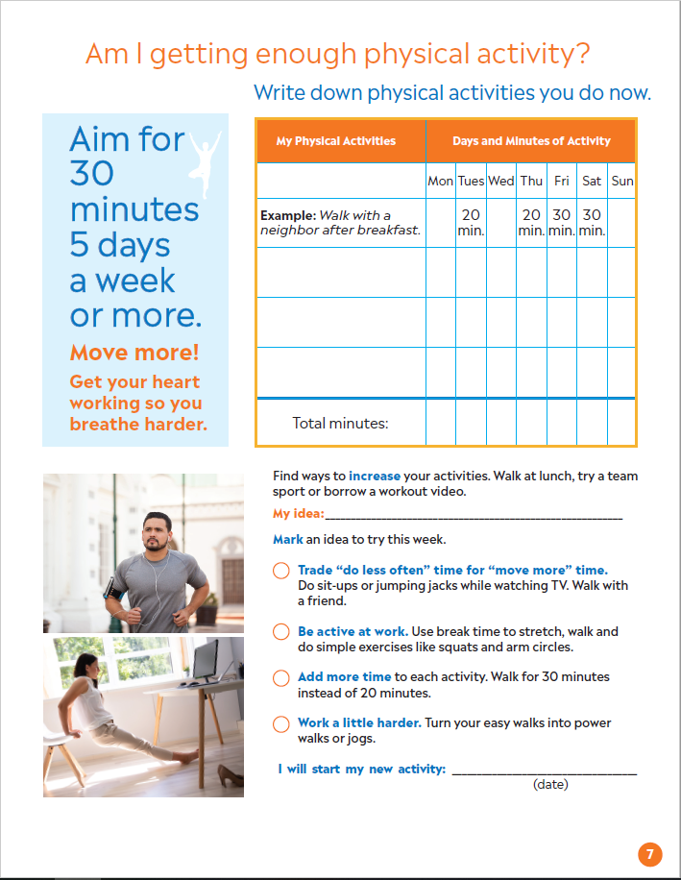
Page 7
Notes:
Teacher Instruction
Ask students to reference page 7 of their handout for the next section of the presentation.
Talking Points
Please turn to page 7 of your handout where we’ll think through how much physical activity we’re currently getting and set small, achievable goals to increase our daily activity.

Slide 29
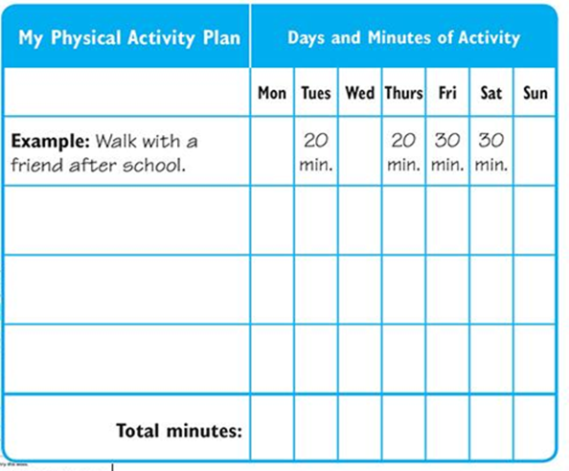

Physical Activity: It All Adds Up
Page 7
Notes:
Teacher Instruction
Guide students to think through the various ways they are active every day and how it can contribute to the recommendation to move for 30 minutes at least 5 days per week.
Encourage them to share creative ideas for increasing physical activity.
Talking Points
Health experts suggest aiming for at least 30 minutes of physical activity at least 5 days per week.
Think about the activity that you are already doing, and where you can swap moving less for moving more.
You can use the chart in your handout to plan out your physical activity for the week, and find creative ways to get at least 30 minutes of activity in, most days of the week.
Remember, you can break it up into smaller chunks of time if that makes it easier for you to achieve.
I’ll give you a few minutes now to complete the physical activity chart at the top of page 7. [Pause while students complete chart.]
If you’re getting less than 30 minutes of activity, 5 days a week, you may be ready to challenge yourself to increase your physical activity.
Use the thought starters on the bottom of page 7 to help you brainstorm a new activity goal to try this week.
Notice that small changes count—it can be as simple as adding 10 more minutes to an activity you are already doing, or challenging yourself to work a little bit harder than you usually do.
What are some easy ways you can increase your physical activity this week? Enter your ideas into the chat box.

Slide 30
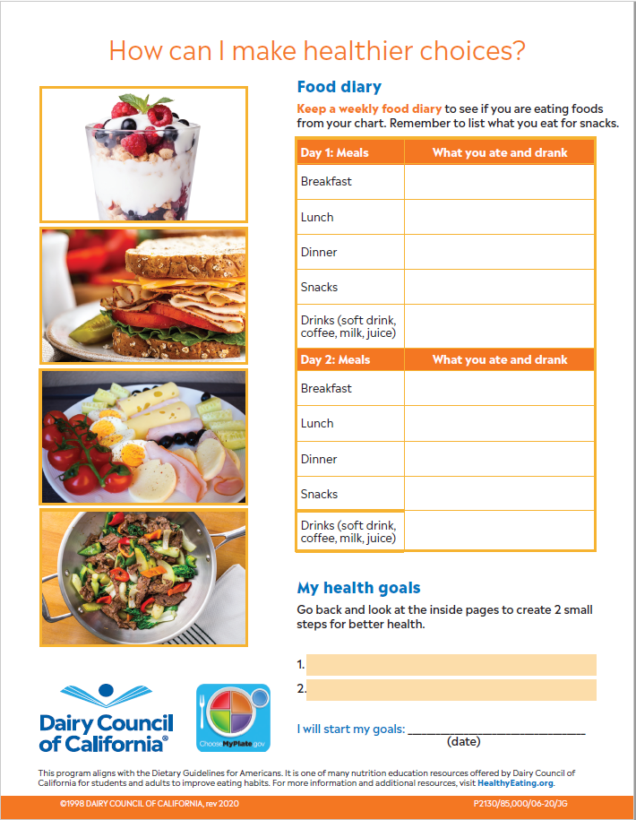
Page 8
Notes:
Teacher Instruction
Ask students to reference page 8 in their handout for the last section of the presentation.
Talking Points
To finish up our lesson today we’re going to talk about making SMART goals to make healthier choices with diet and physical activity.

Slide 31
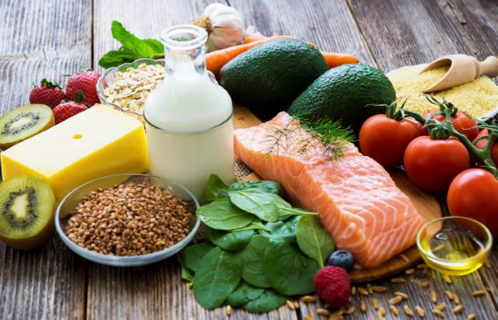
SMART Goal Setting
Specific
Measurable
Achievable
Relevant
Time-based
Notes:
Teacher Instruction
Guide the students through SMART goal setting for diet and/or physical activity to improve overall health.
Ask students to share ideas for their own SMART goals.
Talking Points
Health is a lifelong journey—you want to focus on progress, not perfection.
If you feel that you are ready to make small changes it helps to make SMART goals.
These are goals that are specific, measurable, achievable, relevant and time-based.
Following this framework helps to lead to greater success of meeting your goals.
Let’s go through an example together.
Say you noticed that you would like to try and increase your intake of milk, cheese, or yogurt to meet the recommendation of 3 cups of dairy each day.
Your SMART goal might be:
Add one serving of dairy each day over the next week buy buying a large carton of yogurt and eating a cup each day for your afternoon snack. Use a visual of your fist to measure out one cup.
Keeping a food diary of what you’re eating to see how it compares to the recommended amounts of each food group is another example of a goal. To make it a SMART goal, you’ll want to set a certain number of days to keep the food diary so that it is time-based, and make sure to pick a timeframe that is achievable for you as keeping a food diary can be time consuming.
You can use the same format to set a goal for any other areas of your diet that you would like to make small changes in, as well as for physical activity goals.
Can you think of other examples based on the information we’ve gone through in this handout together?
Enter your ideas into the chat box.
If having access to food is a hurdle to healthy eating, getting connected to food programs is an important goal. Programs like Supplemental Nutrition Assistance Program (SNAP), WIC (Women, Infants and Children), school meal programs (for children grades K-12), food bank programs and regional food pantries can help.

Slide 32
Small Steps to a Healthier You
The self is not something ready-made,
but something in continuous formation through choice of action.
— John Dewey
Notes:
Teacher Instruction
Read the quote aloud.
Talking Points
Think about what this quote means to you.
Change doesn’t occur overnight, and that there may be bumps in the road, but setting small—and SMART—goals helps to make them achievable.

Slide 33
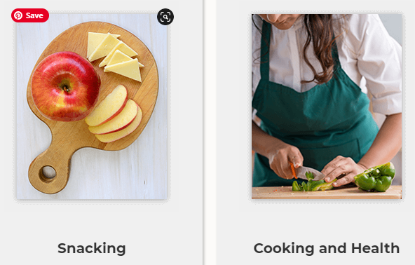

Additional Tools and Resources
HealthyEating.org
Notes:
Teacher Instruction
Read the slide aloud to students.
Additional teacher resources are listed below.
Content and nutrition info:
HealthyEating.org/Primer
HealthyEating.org/Teens
Videos with questions built in:
https://edpuzzle.com/media/5f4c6b8b8e0b5c3f553df7f0
https://edpuzzle.com/media/5f6689bf4b602440be56813d
Videos:
Ask a Nutritionist Playlist
What is Diet Quality?
What is Healthy Eating?
How to Plan Healthy Meals
Brainbreaks/Physical Activities Videos – These images reflect kids, but the videos themselves are pretty generic with simple PA
Talking Points
If you want to dive deeper into healthy eating, check out the resources at HealthyEating.org (on this slide) for more information.

Slide 34
Questions?
Notes:
Teacher Instruction
Ask students if they have any questions.

